Slide 1
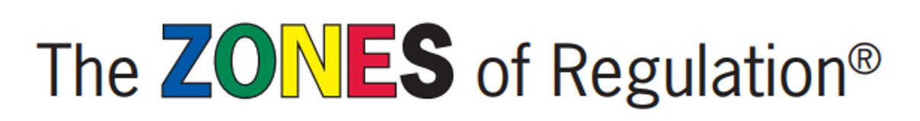

Staff Inset

Slide 2
By the end of this session, you should have an understanding of:
The Zones
Important Concepts
Uses
Main Takeaways

Slide 3
What Are the Zones?
The Zones of Regulation is a framework used to teach students self-regulation.
This system improves the students' ability to recognise and communicate how they are feeling in a safe, non-judgemental way.
It also allows students to tap into strategies or tools to help them move between zones.
Notes:
Add references – further info is available in handbook if you're interested in sensory processing, executive functioning, and emotional regulation

Slide 4
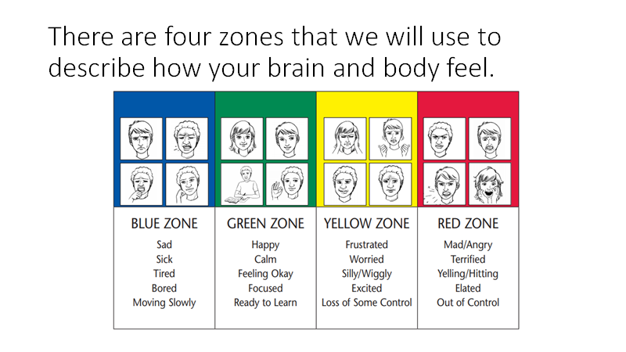
Notes:
These are not the be all and end all – just some examples
Think of them as stoplights or traffic signs – green light is 'good to go'. Yellow or caution is slow down or take warning, same as the Yellow Zone. Red light or stop sign means stop; when a person is in the Red Zone they need to stop and regain control. Blue can be compared to a rest area where you pull over when you're tired and need to recharge.

Slide 5
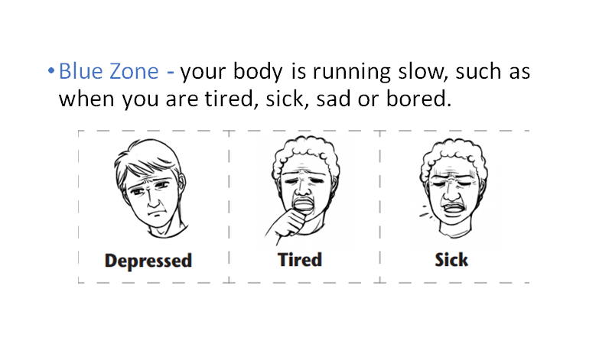
Notes:
The Blue Zone is used to describe low states of alertness, such as when one feels sad, tired, sick or bored. This is when one's body and/or brain in moving slowly or sluggishly.

Slide 6
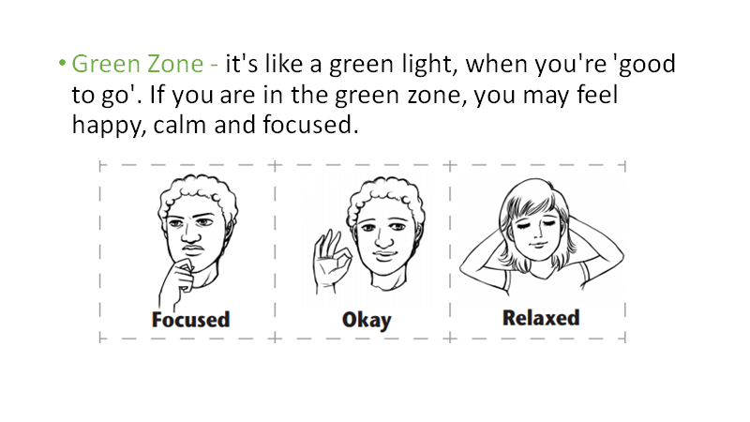
Notes:
The Green Zone is used to describe a regulated state of alertness. A person may be described as calm, happy, focused or content when in the Green Zone. This is the Zone students generally need to be in for schoolwork and for being social. Being in the Green Zone shows control.

Slide 7
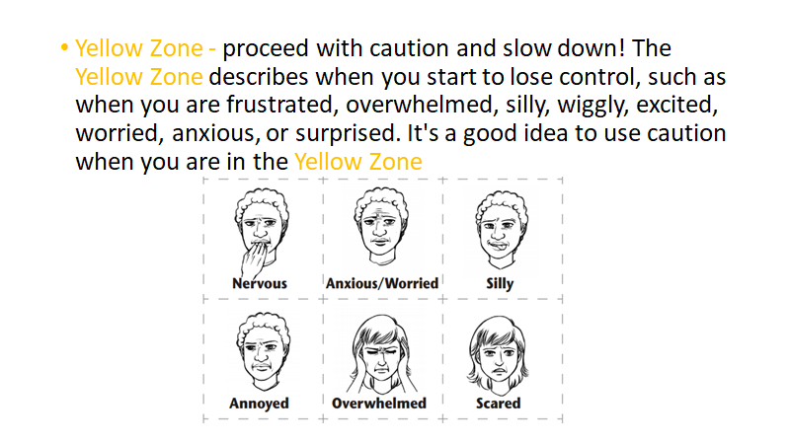
Notes:
The Yellow Zone is also used to describe a heightened state of alertness; however, a person still has some control when in the Yellow Zone. A person may be experiencing stress, frustration, anxiety, excitement, silliness, nervousness, confusion, and many more slightly elevated emotions and states when in the Yellow Zone (such as wiggly, squirmy, or sensory seeking). The Yellow Zone is starting to lose some control.

Slide 8
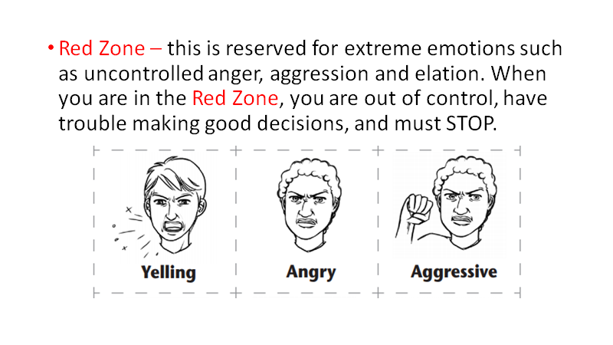
Notes:
The Red Zone is used to describe extremely heightened states of alertness or very intense feelings. A person may be experiencing anger, rage, explosive behaviour, panic, terror, or elation when in the Red Zone. Being in the Red Zone can best be explained by not being in control of one's body.

Slide 9
IMPORTANT
Everyone experiences ALL of the zones at one time or another.
The Red and Yellow Zones are not 'bad' or 'naughty' zones – you feel what you feel.
You are teaching students to figure out what behaviours are expected in given circumstances and determine if they need to manage their behaviours while in different zones to meet the demands of the situation.
It is intended to be neutral and not project judgement when helping students recognise their levels of alertness and feelings.

Slide 10
Who is it for?
Initially, the curriculum was developed for students with neurobiological and mental health disorders
However, it became apparent that the curriculum can reach a much broader population – including adults
Adults who teach The Zones report better insight into their own states and become more aware of the tools they can use to self-regulate.
Can start from as young as 4 years old, and has varied activities for younger and older students.
Notes:
ASD
ADHD
Tourette syndrome
ODD
Conduct disorder
Selective mutism
Anxiety disorders

Slide 11
Other Important Concepts

Slide 12
Expected & Unexpected Behaviour
Situation: Walking out onto the playground after eating lunch.
Expected Behaviour Unexpected Behaviour
Notes:
The idea that different situations have different expected and unexpected behaviours – listening to someone speaking would be different to performing a dance routine, etc.

Slide 13
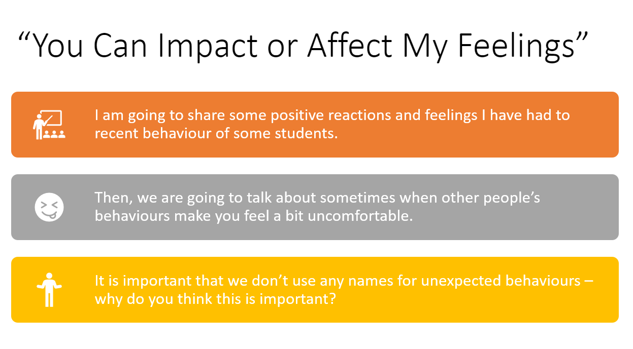
Notes:
You can choose your own behaviour, but others' feelings can be impacted by that behaviour

Slide 14
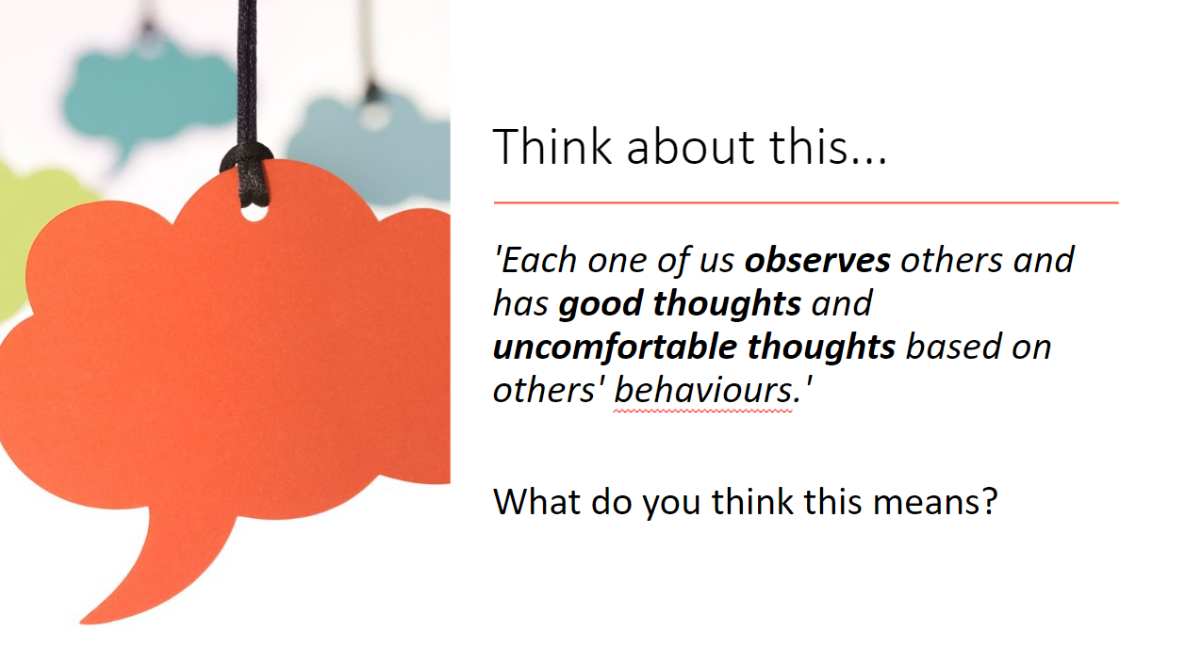
Good Thoughts vs. Uncomfortable Thoughts
Notes:
These behaviours (expected/unexpected) lead to good thoughts or uncomfortable thoughts

Slide 15
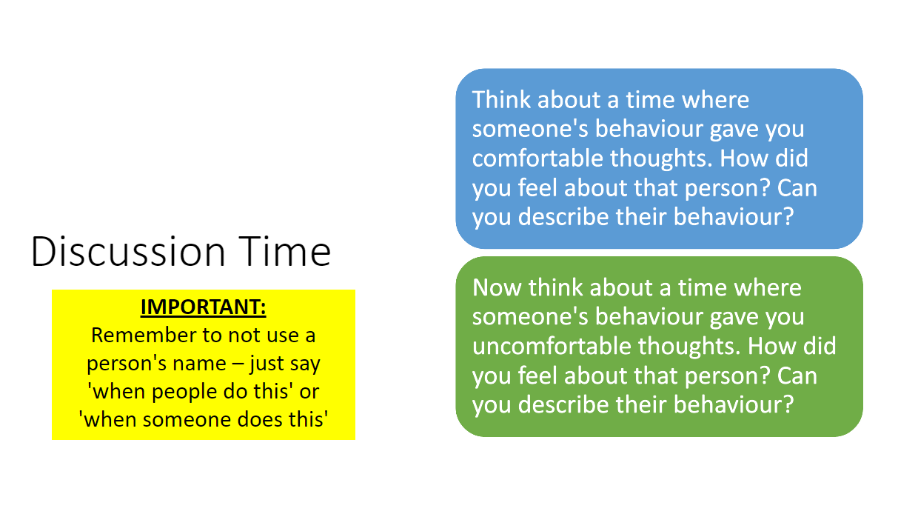
Notes:
Don't name for unexpected behaviours, especially with a child who is trying hard to change a particular behaviour or has trouble with something e.g. calling out, standing up, etc.

Slide 16
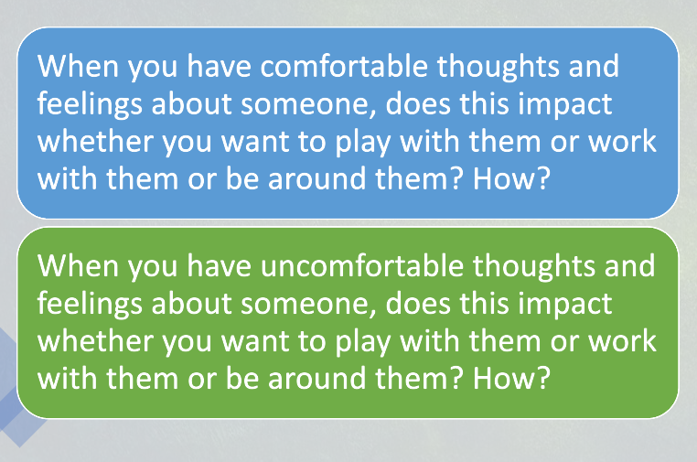

Slide 17
First Lessons
Zones Wall Chart – creating a class display through discussion
Zones Bingo – playing Bingo to help identify the Zones

Slide 18
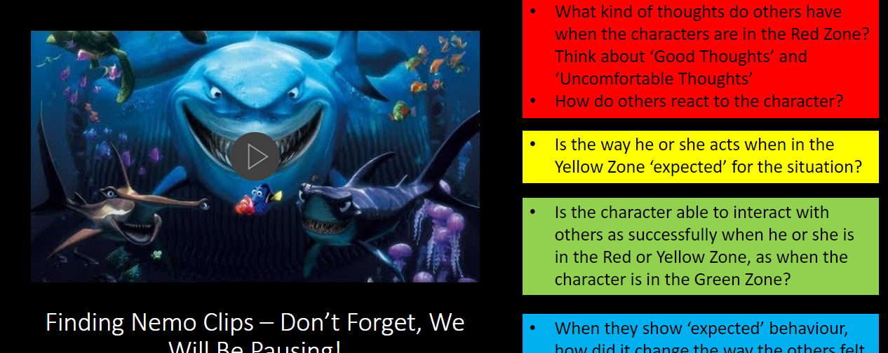
The Zones in Video
https://www.youtube.com/watch?v=XWuPGKLJXe8
Notes:
Bringing it all together – Zones, behaviours, and thoughts – first with video characters, then with themselves

Slide 19
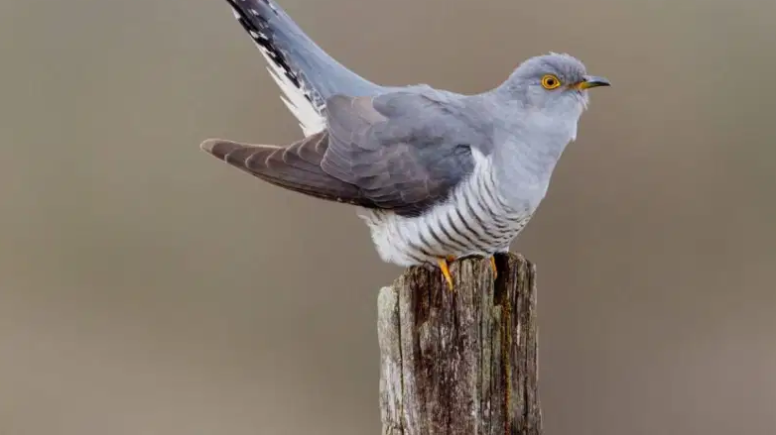
The Zones in Practise – Y6 captains

Slide 20
The Toolbox
From here, individual children are taught different tools that can calm them down and return them to the Green Zone.
They then put these tools in their Toolbox, which are tracked for their effectiveness.
When they successfully use a tool to help themselves, they celebrate this with an award.

Slide 21
Refer to ALL the Zones as much as possible – just acknowledging or labelling is helpful.
Label yourself! Talk to other adults about it!
The more we are all on board, the more consistent it will be for everyone – children, middays, teachers, teaching assistants, SLT, office staff, maintenance – everyone!

Slide 22
Main Takeaways
Yellow and Red Zones are NOT 'bad' or 'naughty' - it is a state of being.
We are teaching the children:
to recognise when they are in these Zones;
how their behaviours can impact the thoughts and feelings of others;
what tools they can use to regulate their behaviour; and
celebrate when they try and succeed!

