Slide 1
Parent Council
Summer 2
2019

Slide 2
The purpose of the Parent Council is to:
Give parents an insight into how the school is run
Allow the Senior Leadership Team to understand better the views of parents on matters concerning the school
Contribute to addressing the school’s priorities
Continue to build on the relationship between the school and the wider community
Contribute to the monitoring and improvement of teaching and learning

Slide 3
As a Council Member you will
Attend half-termly meetings
Represent the interests of all parents within the class you represent
Contribute to discussions and ideas concerning the schools priorities
Interview teachers and pupils with the help of the Senior Leadership Team

Slide 4
Today’s Agenda
Introduction
Attendance at Mission Grove
Persistent absences at Mission Grove
Discussion about ways we can improve attendance and persistent absences
Contact details and photos

Slide 5
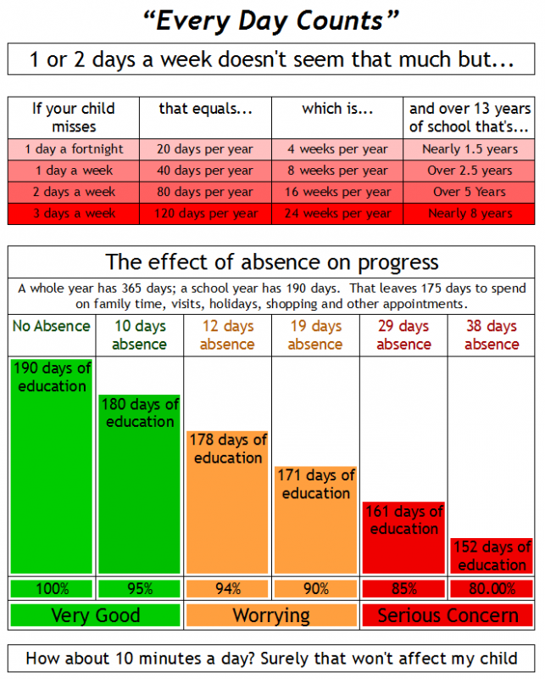

Slide 6
Promoting Good Attendance at Mission Grove
Whole school assemblies rewarding the classes with best attendance
End of term assemblies recognising individuals with 100% attendance
SLT meeting with parents of pupils that have attendance below 95%
Messages in the newsletter highlighting the importance of good attendance and what good attendance is
Class attendances published weekly on the school app
No “48 hours off school” recommendation

Slide 7
Unauthorised Absence
Parents could be charged up to £120 per parent per child if not paid within a certain number of days.
Parents are warned they could be charged with a unauthorised warning letter detailing the charges.
Mission Grove Primary has fined 22 families in total with one family being fined twice

Slide 8
Attendance at Mission Grove
2017/18
 | Attendance 2017/18 | Persistent Absences 2017/18
Mission Grove | 93.5% | 22%
Waltham Forest | 95.7% | 9.6%
National | 95.8% | 8.7%

Slide 9
Other Local Schools
 | Attendance 2017/18 | Persistent Absences 2017/18
South Grove | 96.0% | 7.7%
Edinburgh | 96.0% | 6.3%
Hillyfield Academy | 96.1% | 6.0%
National | 95.8% | 8.7%

Slide 10
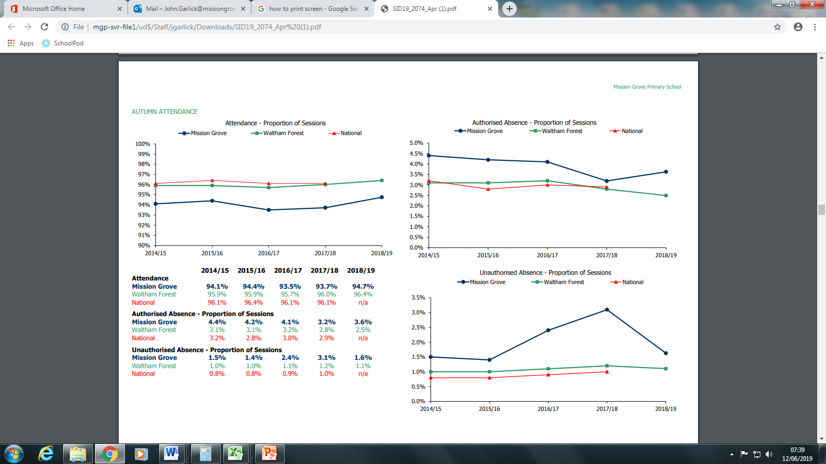
How We Compare

Slide 11
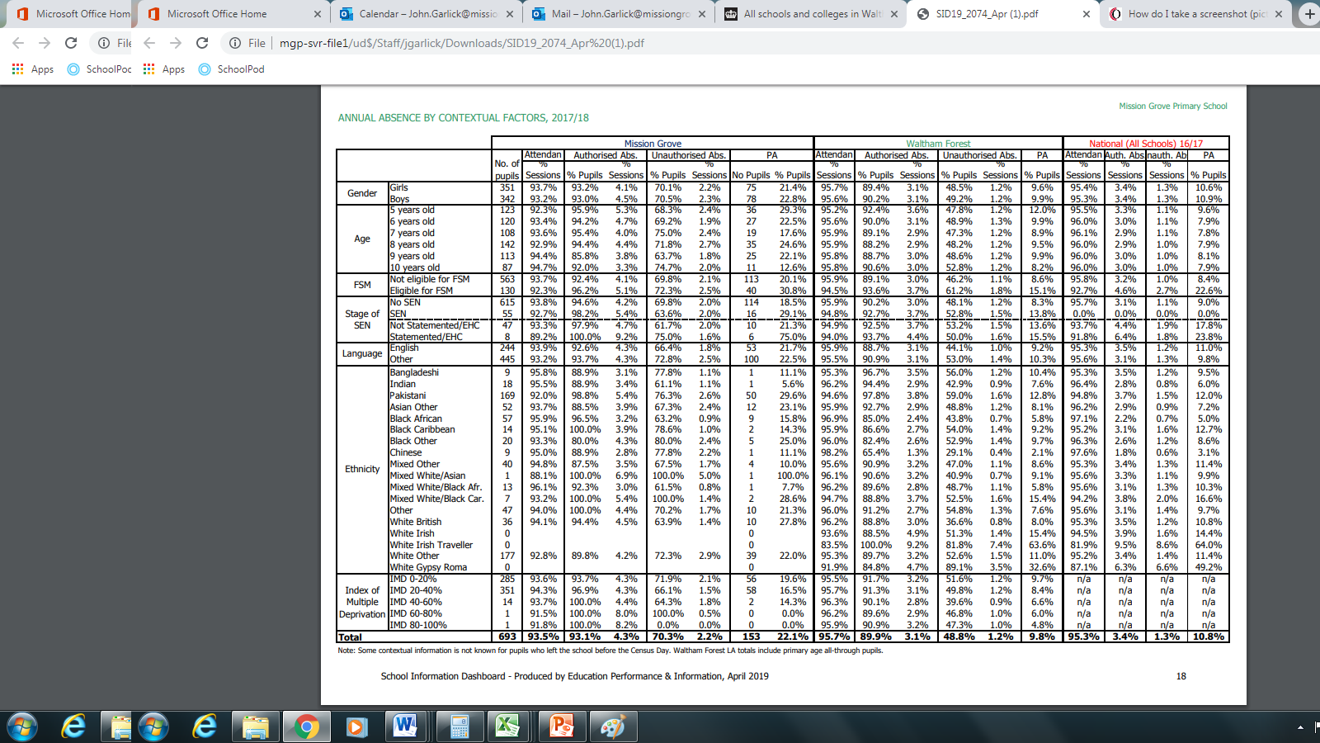
Contextual Factors

Slide 12
3 largest groups by ethnicity
Ethnicity | Attendance %
White Other | 92.8%
Pakistani | 92.0%
Black African | 95.9%
School | 93.5%

Slide 13
Attendance by Age Group
 | Mission Grove | Waltham Forest | National
5 Year Olds | 92.3% | 95.2% | 95.5%
6 Year Olds | 93.4% | 95.6% | 96.0%
7 Year Olds | 93.6% | 95.9% | 96.1%
8 Year Olds | 92.9% | 95.9% | 96.0%
9 Year Olds | 94.4% | 95.8% | 96.0%
10 Year Olds | 94.7% | 95.8% | 96.0%

