Slide 1
Phonics - Statutory Assessment Information
Year 1 – Phonics Screening – Week beginning 6th June
Year 2 – Re-take of Phonics Screening (for some children) - Week beginning 6th June

Slide 2
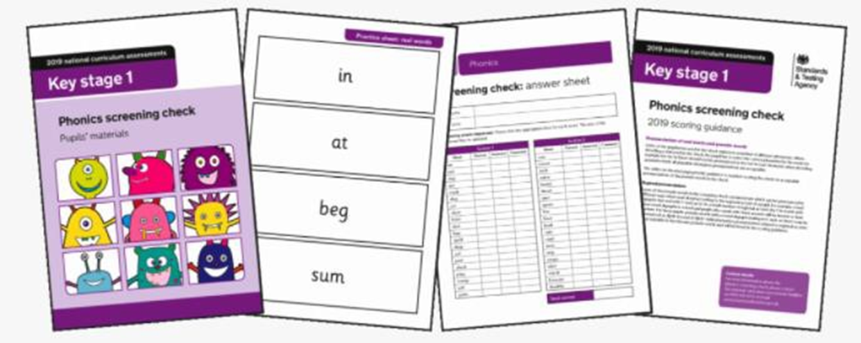
Year 1 Phonics Screening Check
What is it?
The check is made up of 40 words, and usually lasts 5-10 minutes.
The pass mark has generally remained at 32 out of 40, but it is not fixed.
If your child does not pass the Y1 phonics screening check they will be re-tested at the same time next year when they are in Y2.

Slide 3
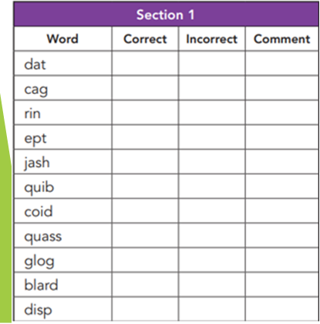
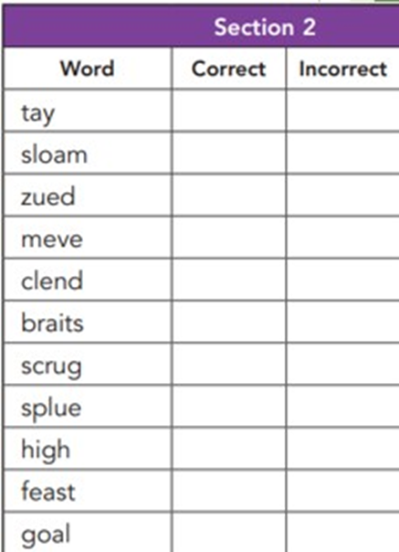
The words in section 1 will have a variety of simple word structures (for example CVC, VCC, CCVC and CVCC) using:
• single letters (a, b, c, d, e, f, g, h, I, j, k, l, m, n, o,
p, q(u), r, s, t, u, v, w, x, y, z)
• some consonant digraphs (ch, ck, ff, ll, ng, sh, ss, th, zz)
• frequent and consistent vowel digraphs (ar, ee, oi,oo, or)
Section 2
The words in section 2 will have a variety of more complex word structures (for example CCVCC, CCCVC, CCCVCC and two syllable words) with some:
• additional consonant digraphs (ph, wh)
• less frequent and consistent vowel digraphs, including split digraphs (a-e, ai, au, aw, ay, ea, e-e, er, ew, i-e, ie, ir, oa, o-e, ou, ow, oy, ue, u-e, ur)
• trigraphs (air, igh).

Slide 4
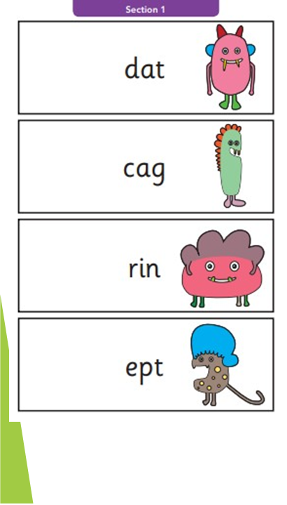
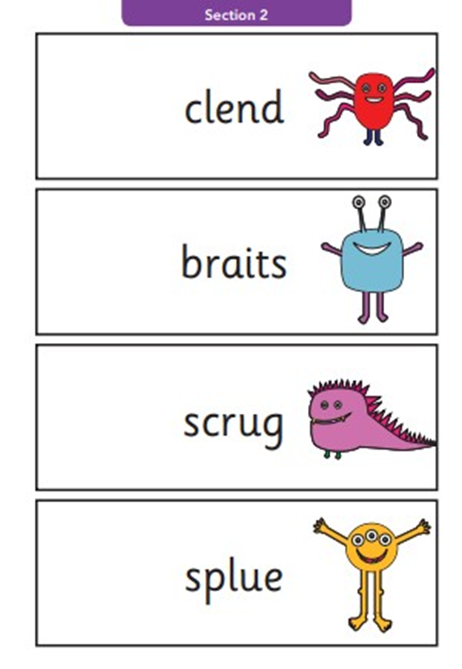
The test is made up of a combination of real words, and nonsense, or ‘alien’ words, that help to show if pupils can work out how to decode words they haven’t seen before.
We call them “alien” words to the children so that they focus on getting the correct sound and don’t try to turn each one into a real word.
What about the results?
We have to report the results to the local authority towards the end of the summer term.
We’ll also let you know the results. These are usually sent out with your child’s end of year report.

Slide 5
How do we prepare them at school?
Your child is being taught phonics at school in groups according to their level. This is regularly assessed and these groups are fluid. Where necessary, additional groups take place to support individual children who may be struggling with their learning.
How can you help?
You can help your child by:
• Reading to and with them – it’s not all about phonics! Reading for pleasure is the single biggest indicator of a child’s future success – more than their family circumstances, their parents’ educational background or their income.
• Playing sound and reading games
• Teaching them new words, and showing them how they’re written

