Slide 1
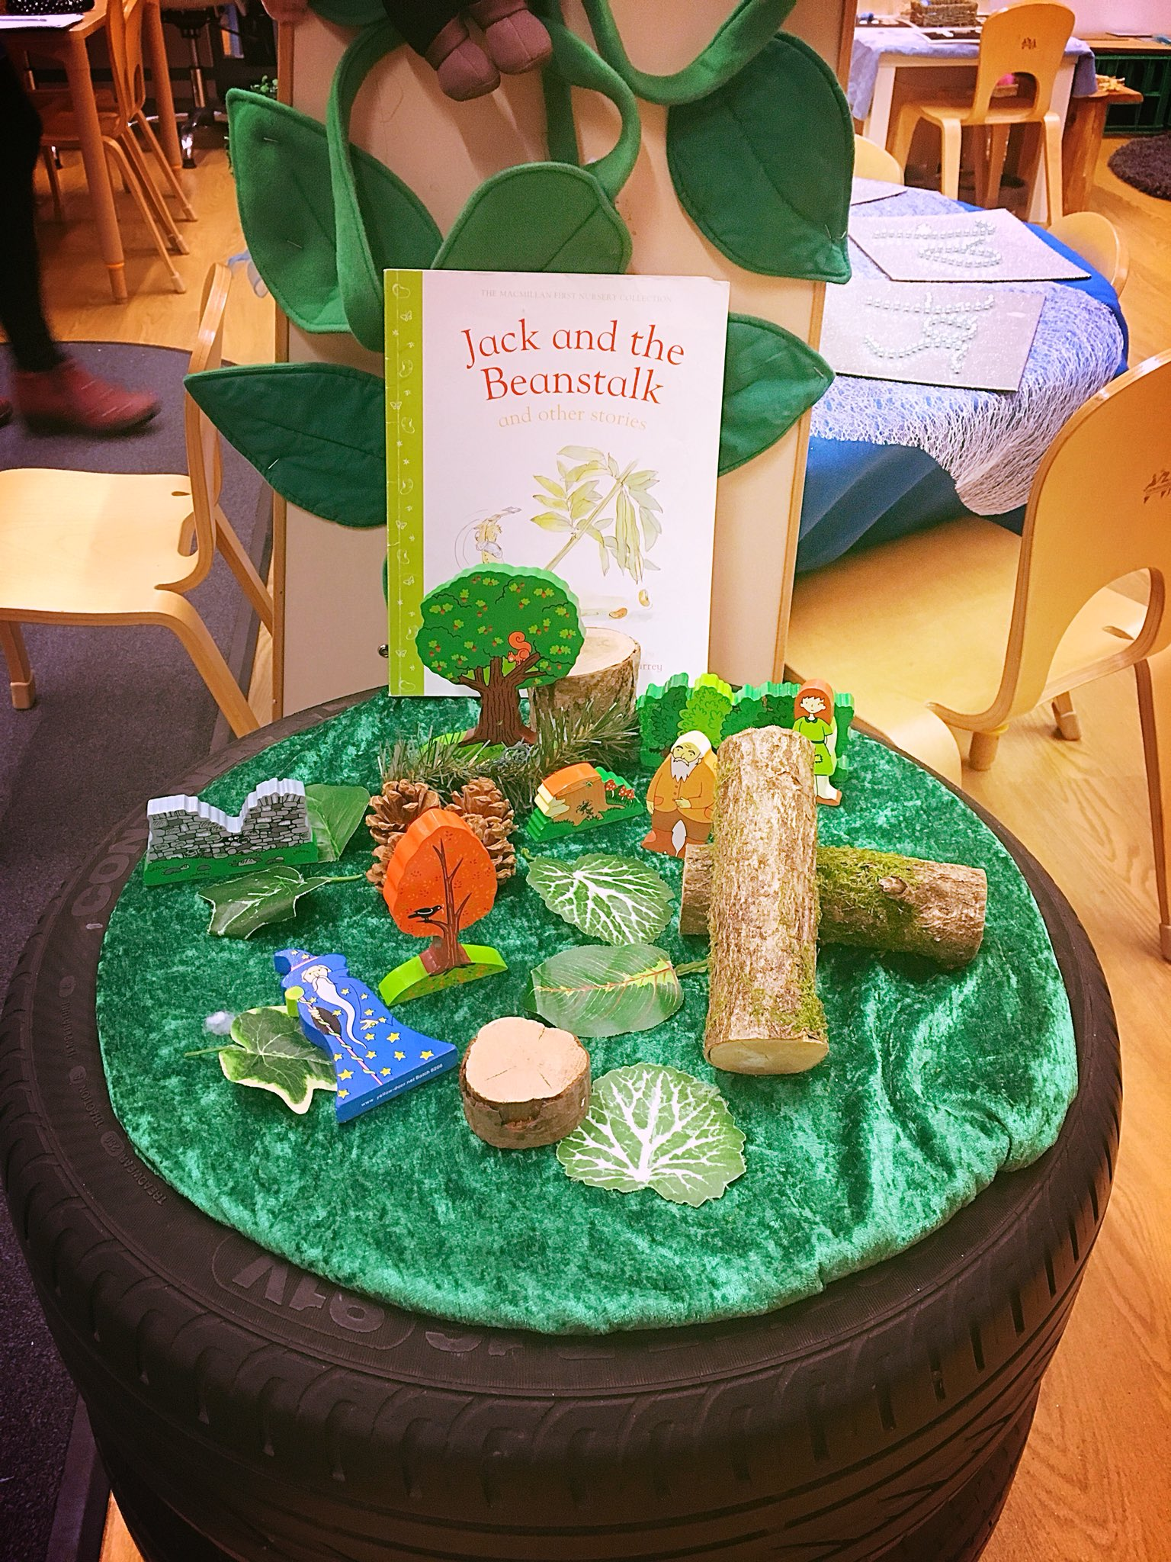
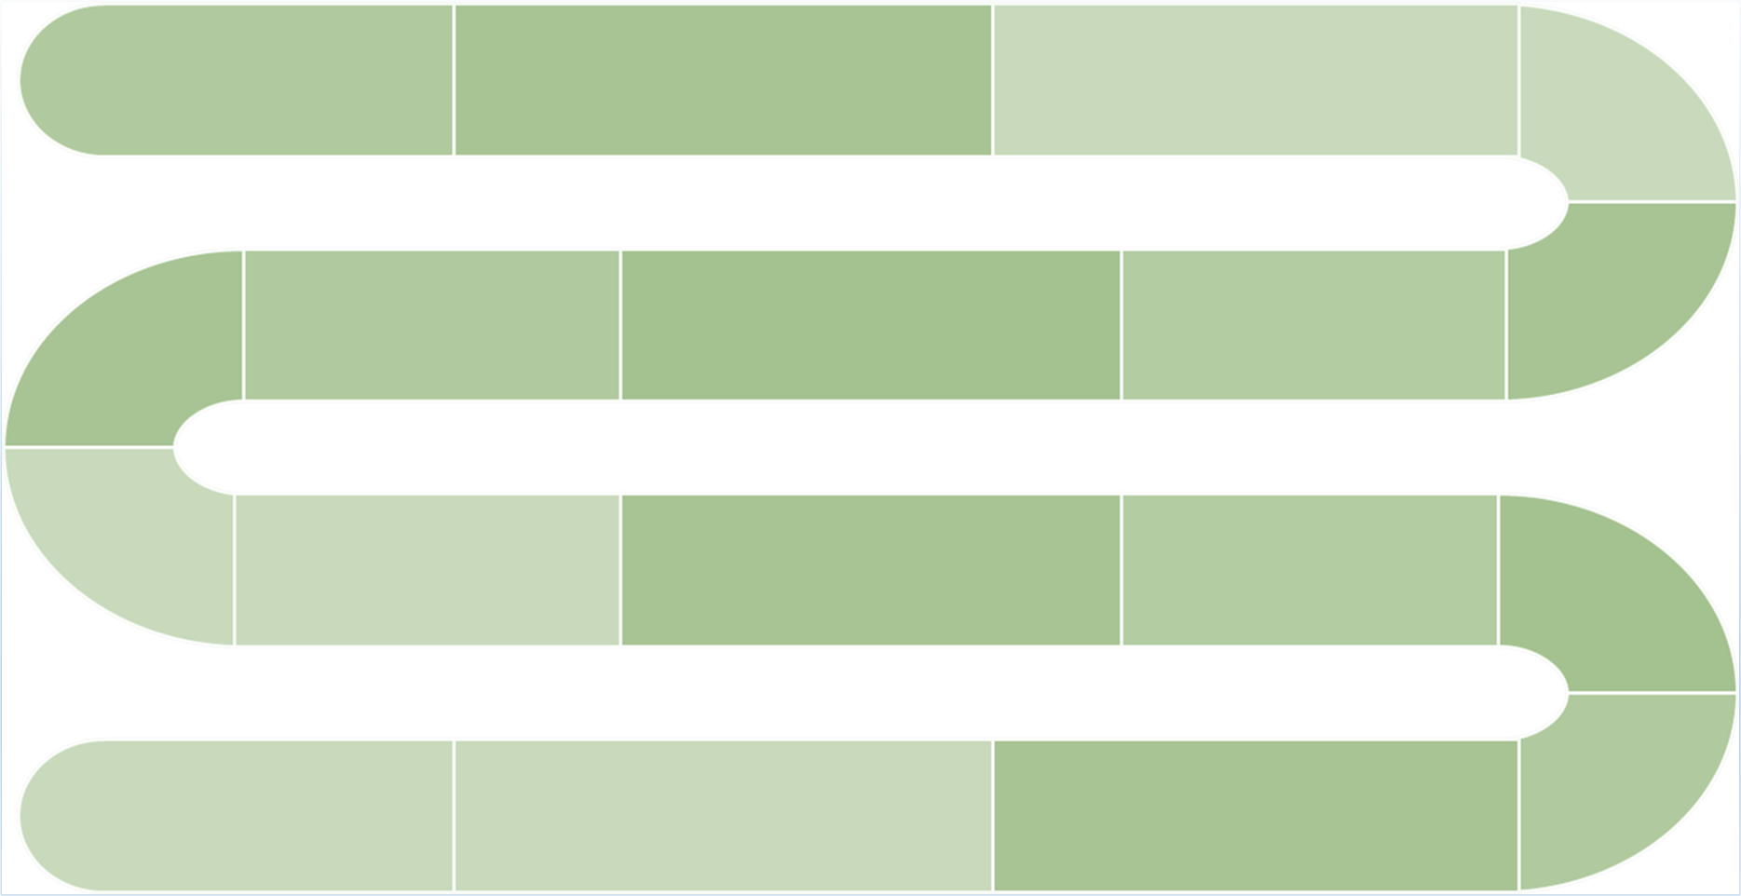
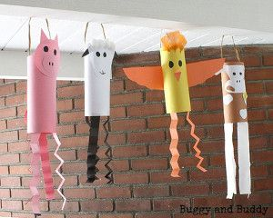
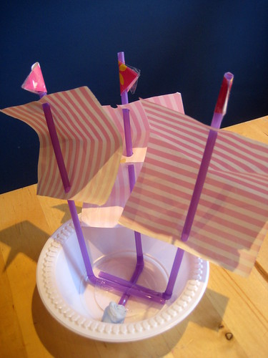
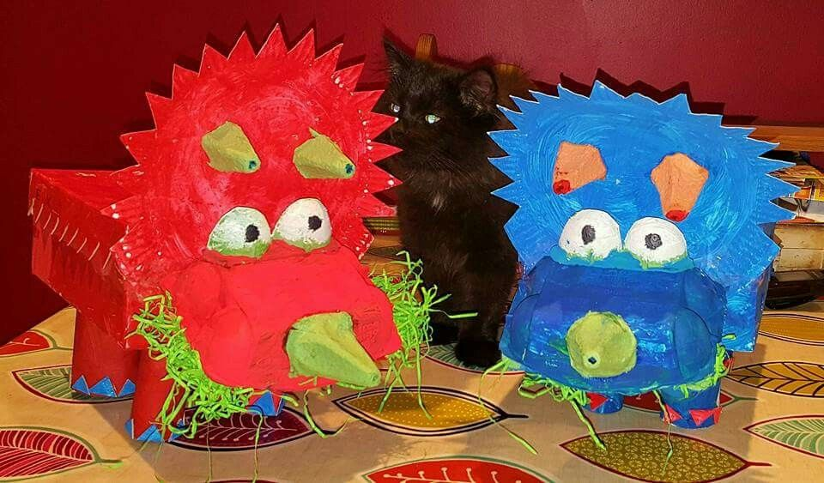
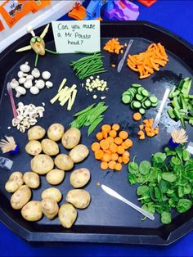
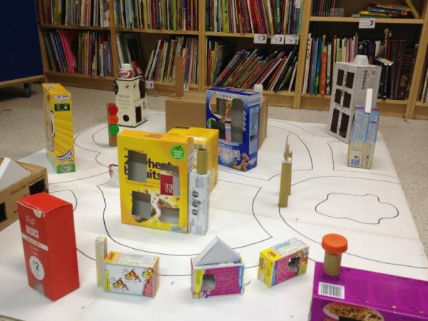
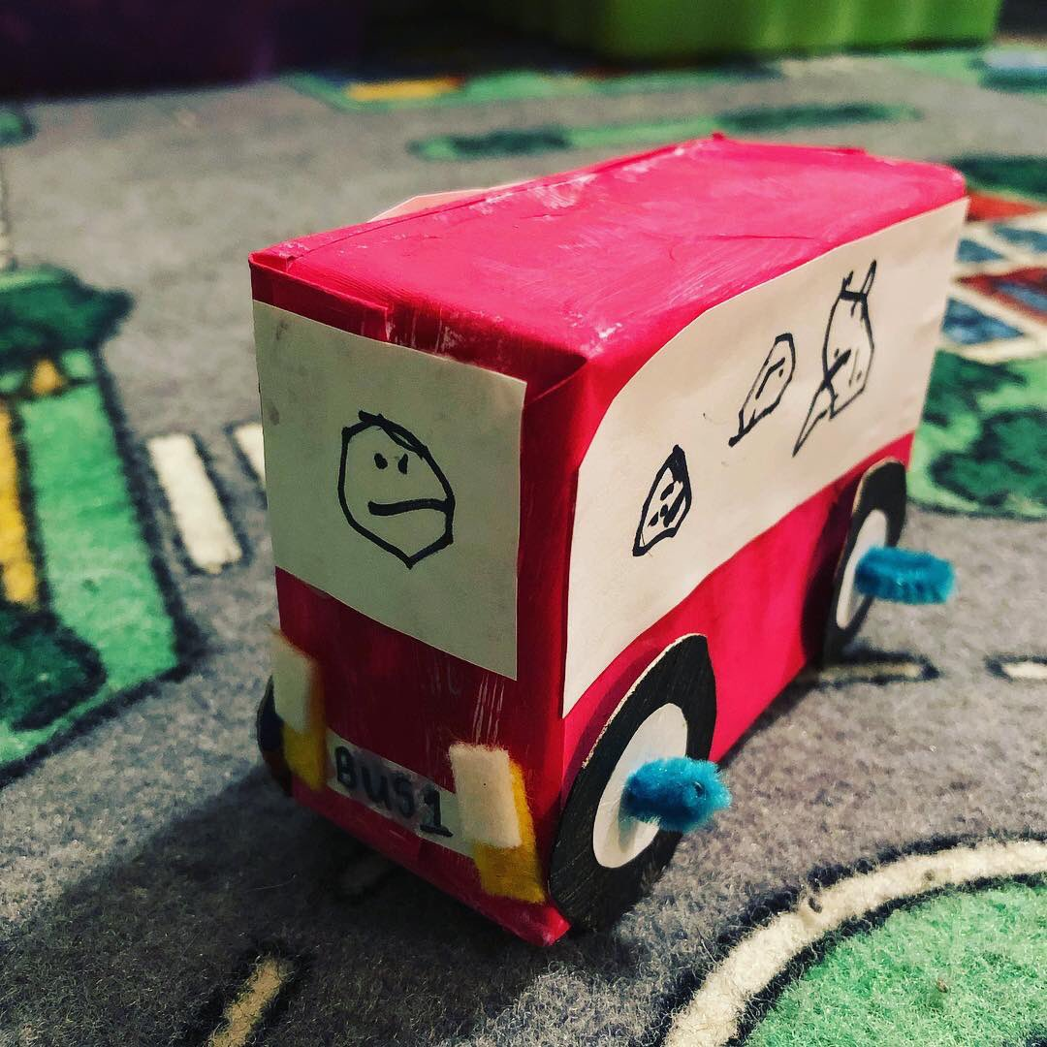
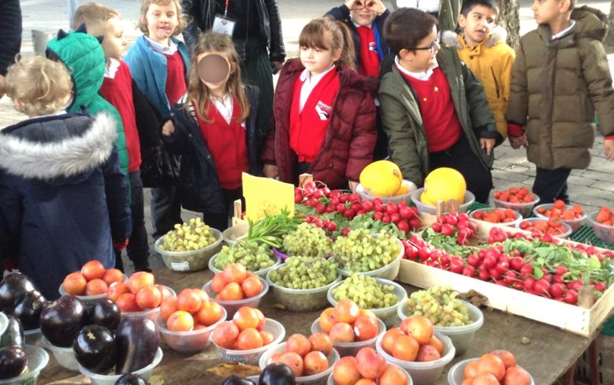
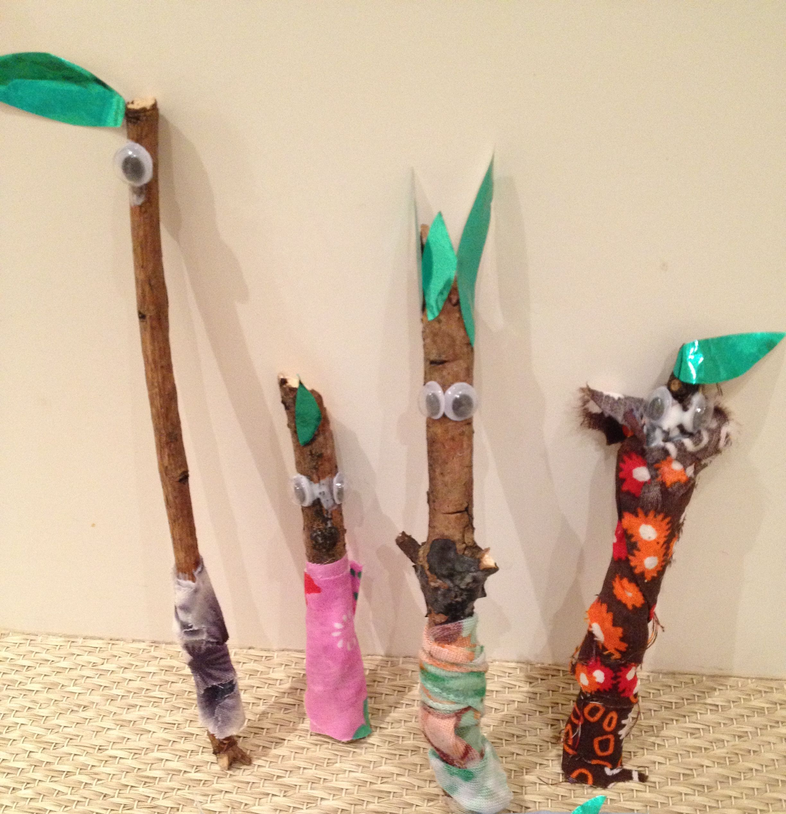
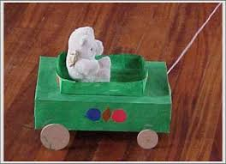
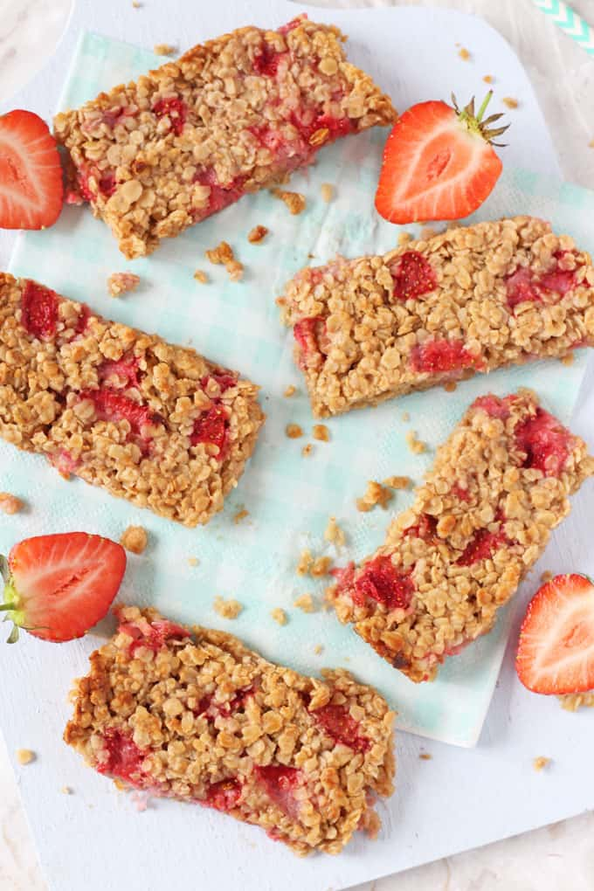
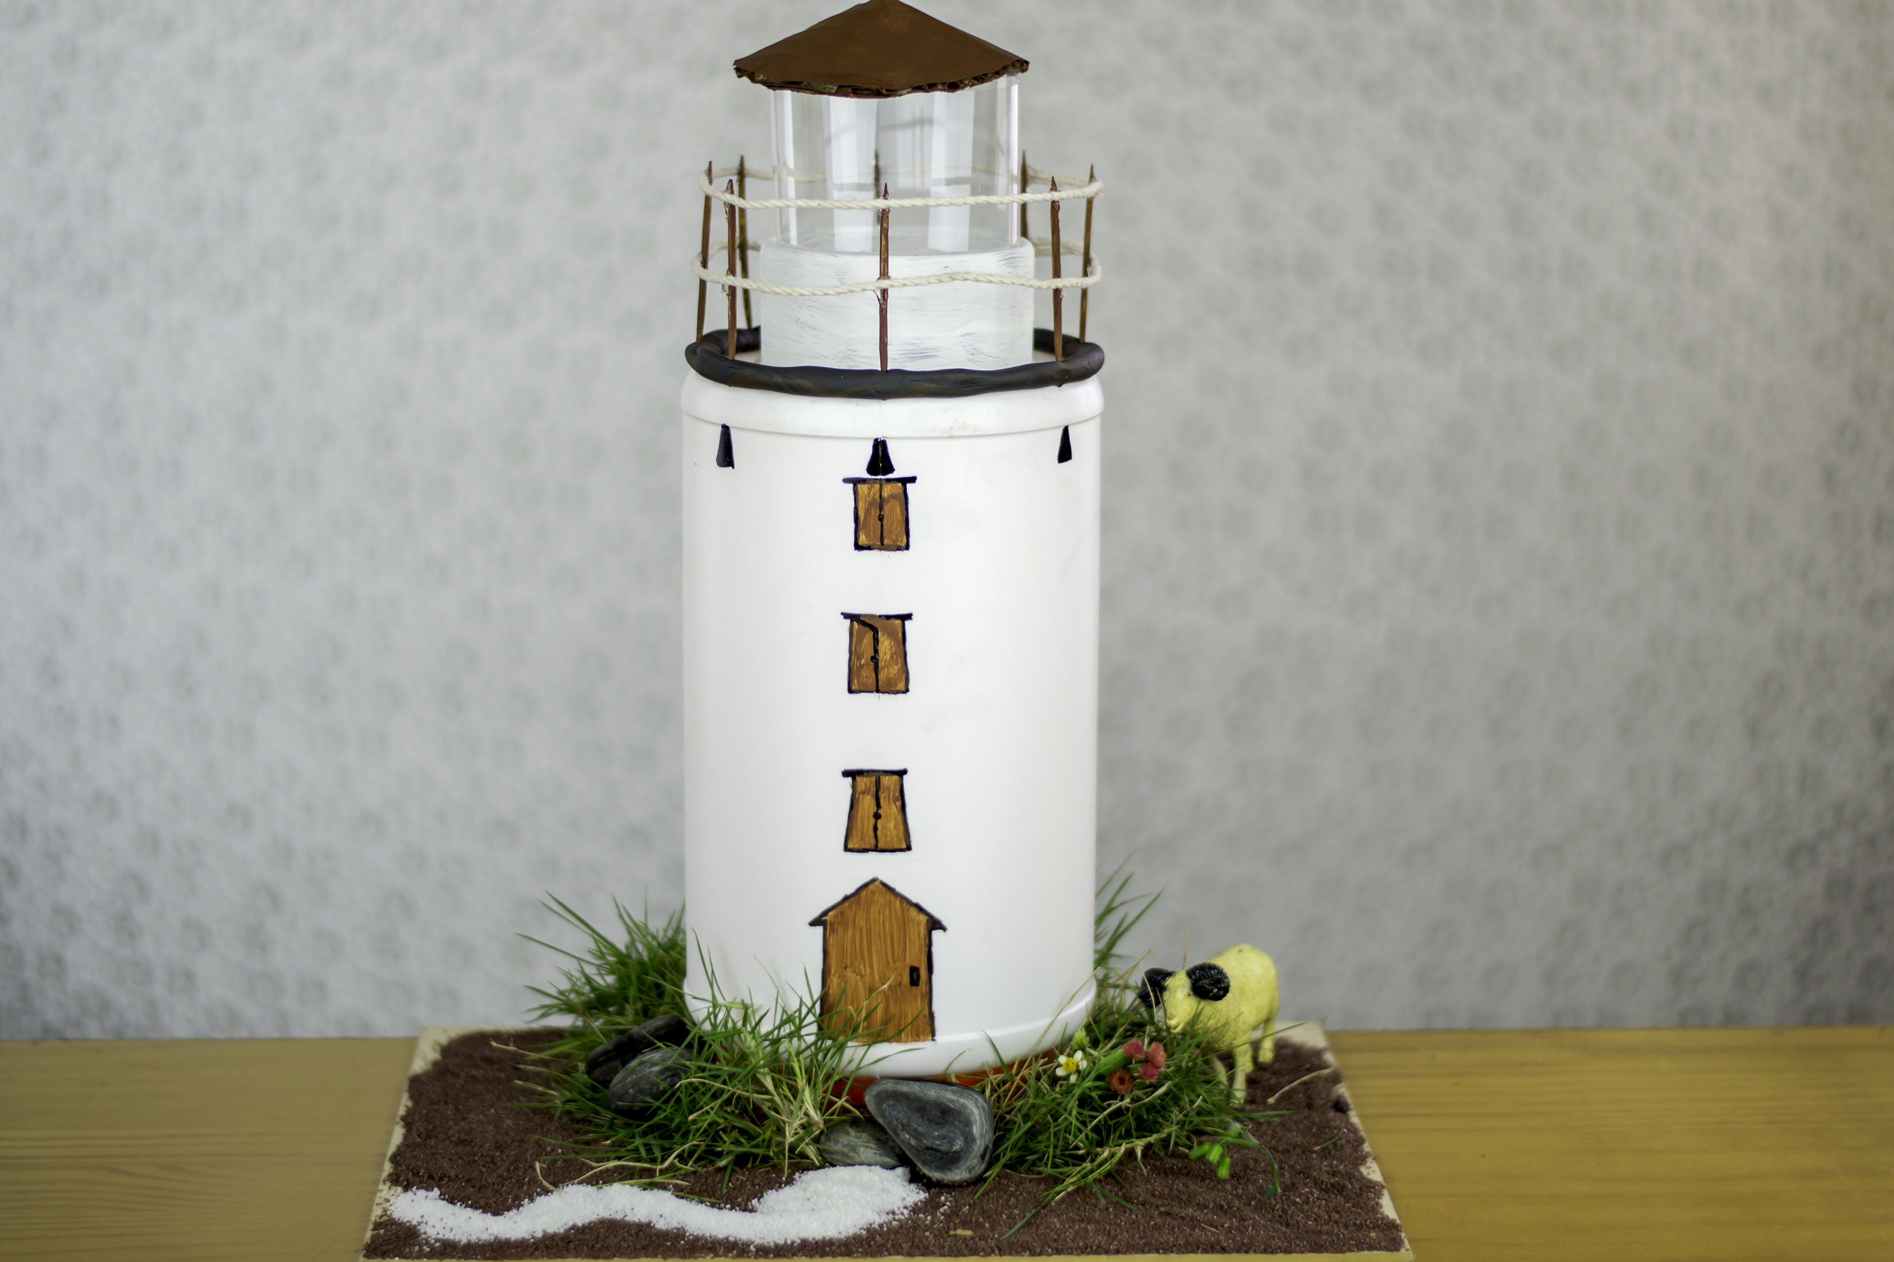

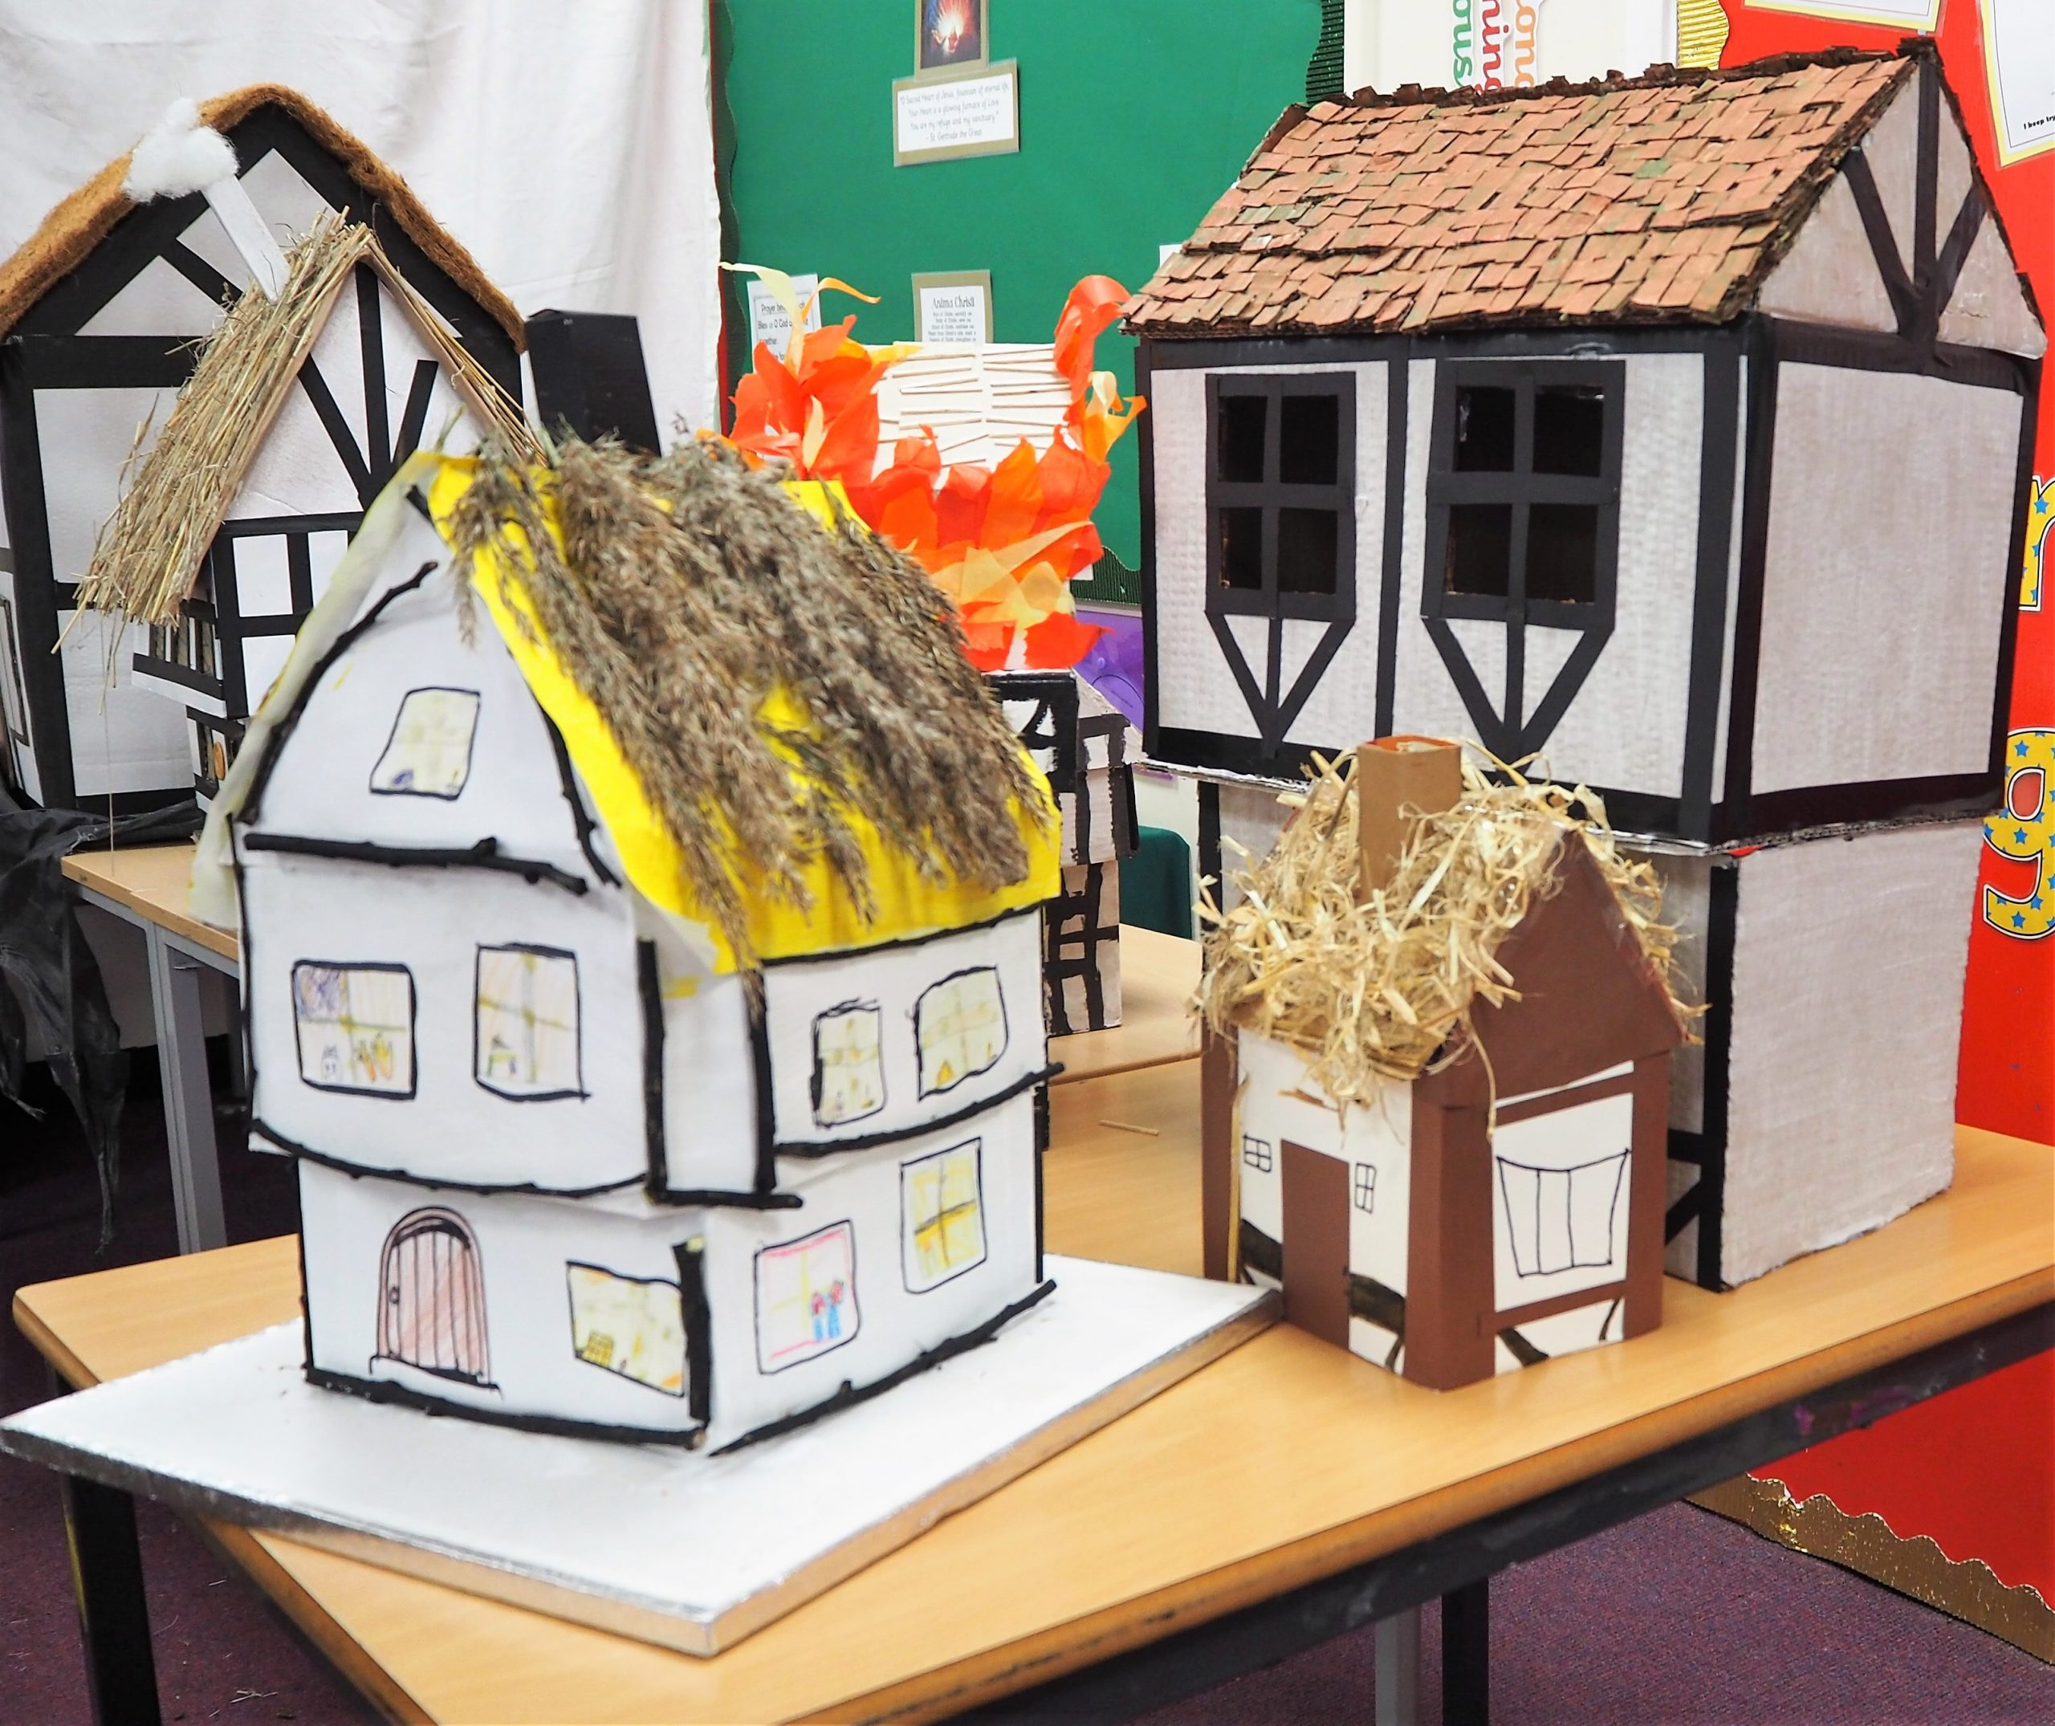
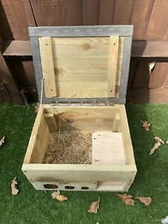

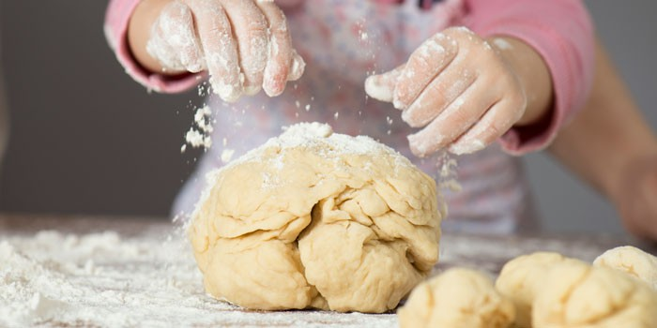

Dinosaurs, Farm animals
Creating a Chinese dragon, dinosaur sensory world/ 3D junk modelling; Explore different materials freely, in order to develop their ideas about how to use them and what to make.
Ourselves, Traditional tales
Use different tools to thread, sew, paint, cut, fasten.
Use a correct pencil grip and gaining control with mark making implements.
Using and holding scissors correctly
Pirates
Develop my own ideas and then decide which materials to use to express myself when creating a pirate ship.
Transport and Journeys
Make 3D models of different vehicles, based on own ideas.
EYFS
Summer
Manage own basic hygiene and understand the importance of healthy food choices.
Food, Glorious Food
Understand where different foods come from.
Growing
Use and handle tools, objects, construction and malleable materials safely and with increasing control, e.g. using the Woodwork Bench.
Journeys
select from and use a range of tools and equipment to perform practical tasks
Year​ One
Beside the seaside
Select from and use a range of materials and components, including construction materials, textiles, ingredients according to their characteristics.
Toys
Design purposeful, functional, appealing products for themselves and other users based on design criteria; select from and use a range of tools and equipment to perform practical tasks.
Our Perfect Planet
Use the basic principles of a healthy and varied diet to prepare dishes.
Great Fire of London
Build structures, exploring how they can be made stronger, stiffer and more stable
Year
Two
Use the basic principles of a healthy and varied diet to prepare dishes.
Kenya
Textiles-choose suitable materials and measure, cut and join textiles to make a product, with some support.
Wonderful Walthamstow; Nocturnal Animals
Select from and use a wide range of materials and components, including construction materials, textiles and ingredients, according to their characteristics.
Mission Grove Primary School Curriculum Road Map - DT

Slide 2
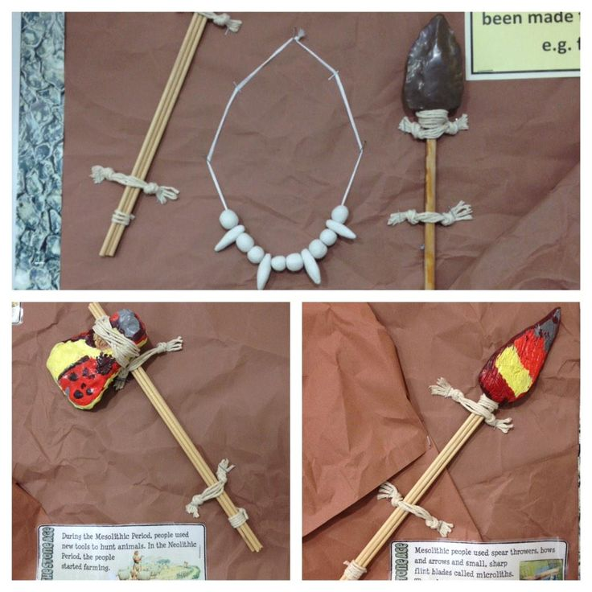


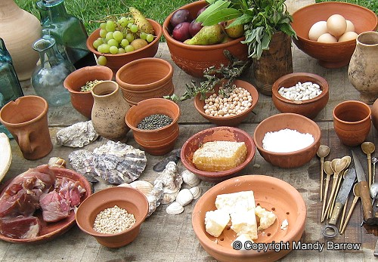
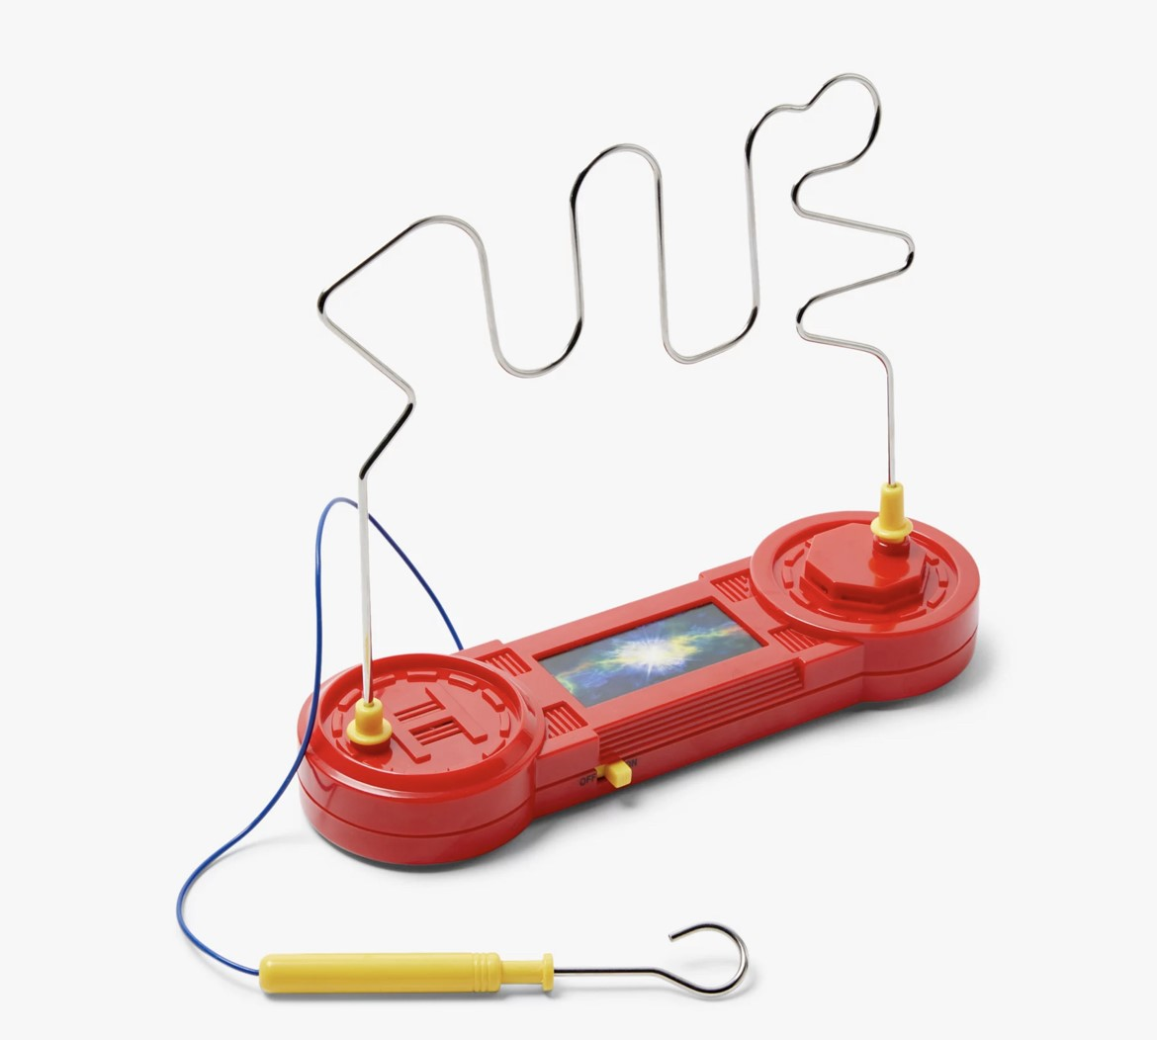
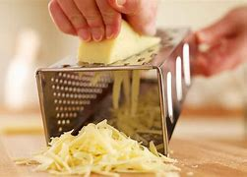
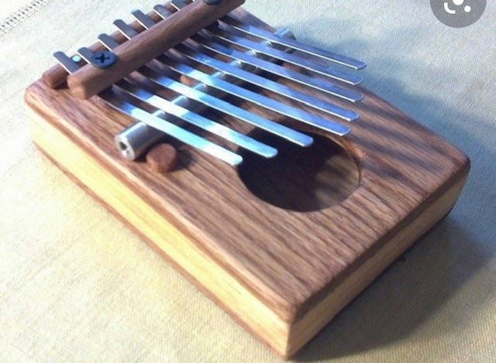
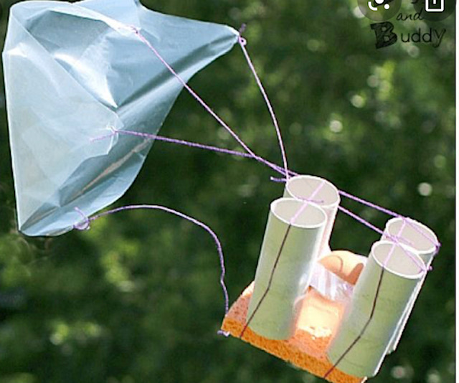
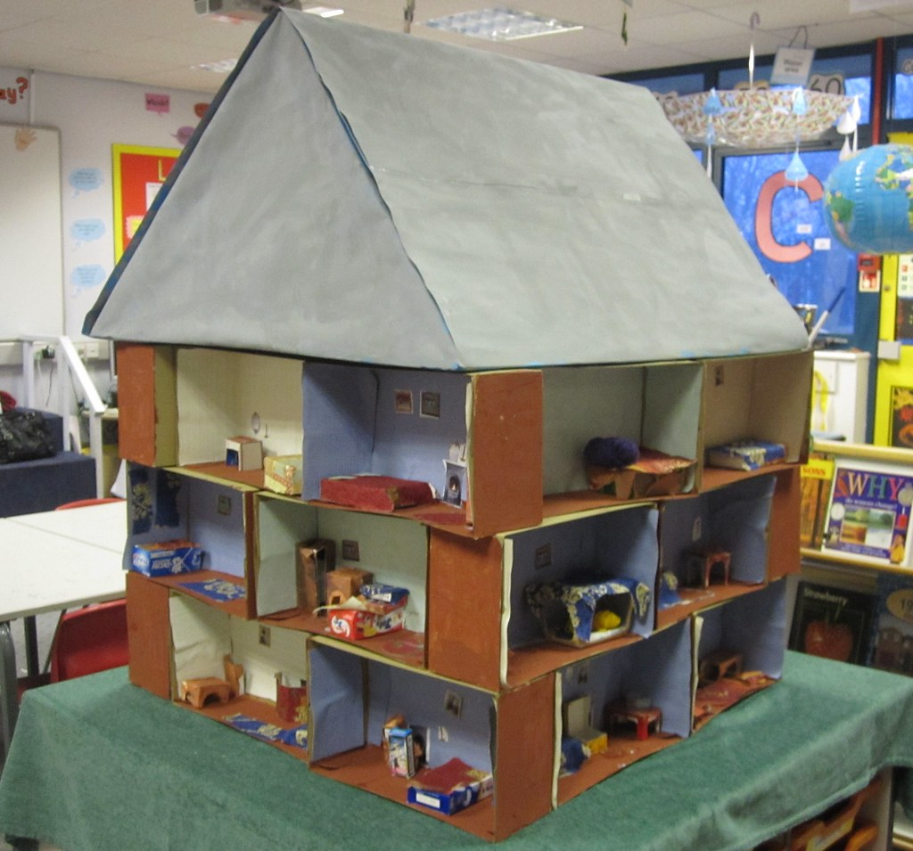
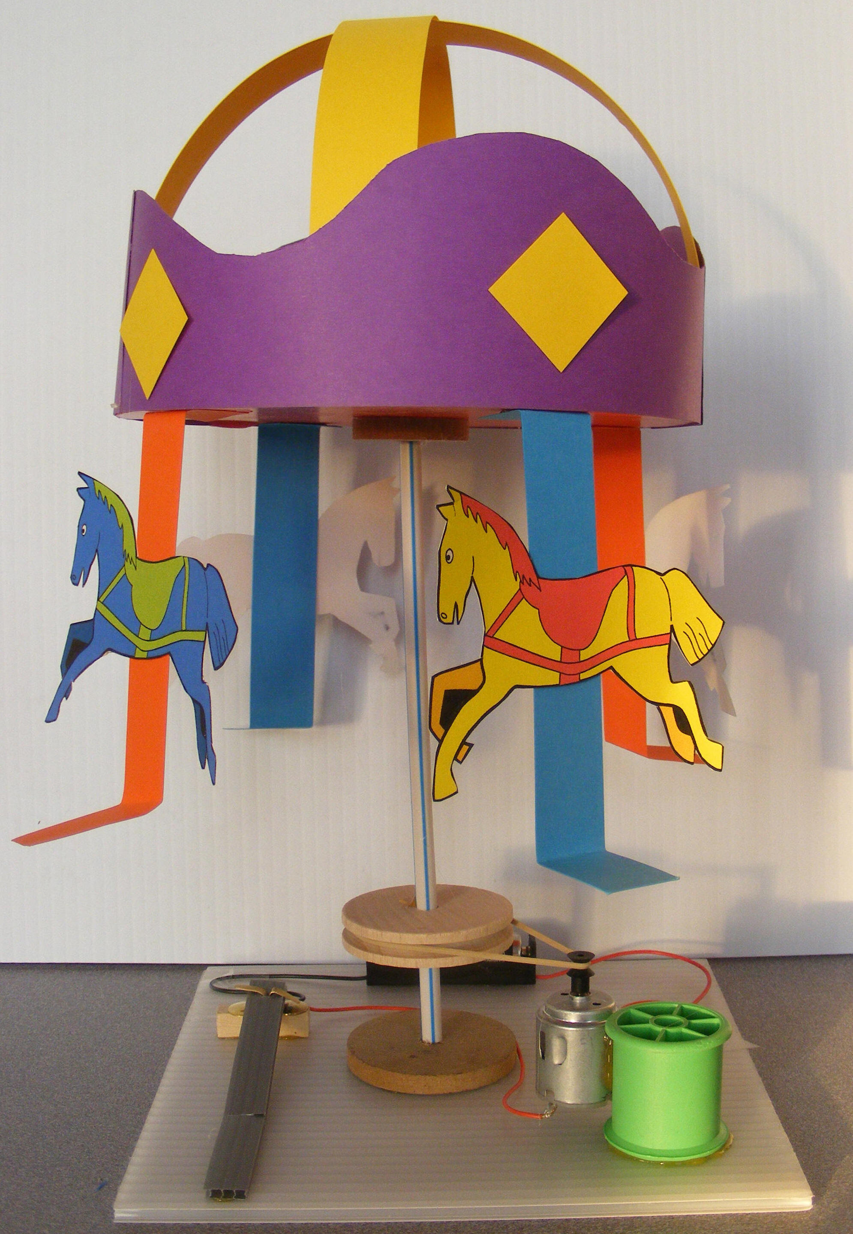
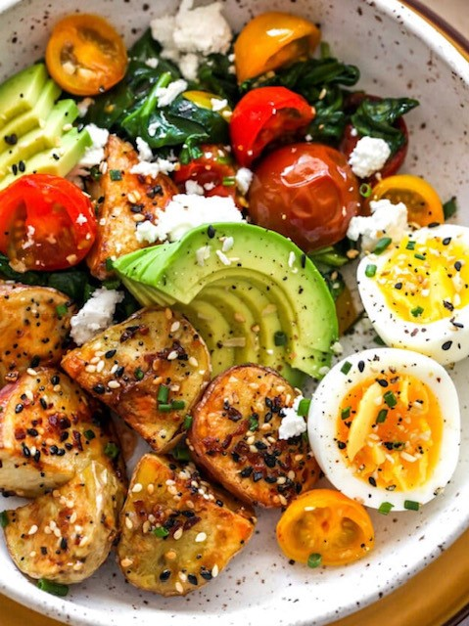
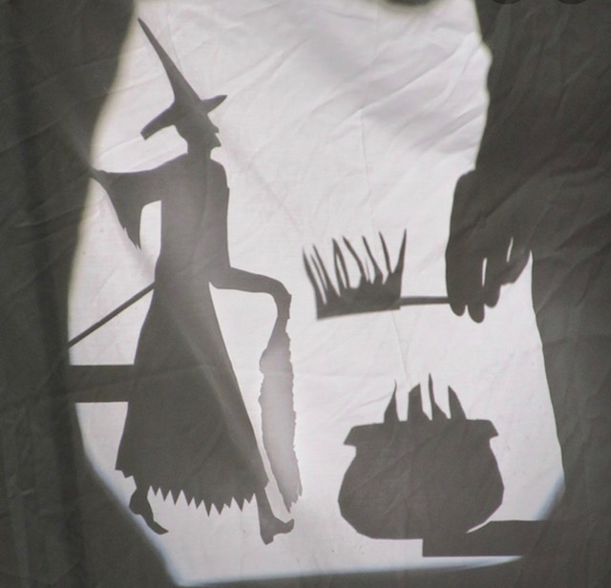
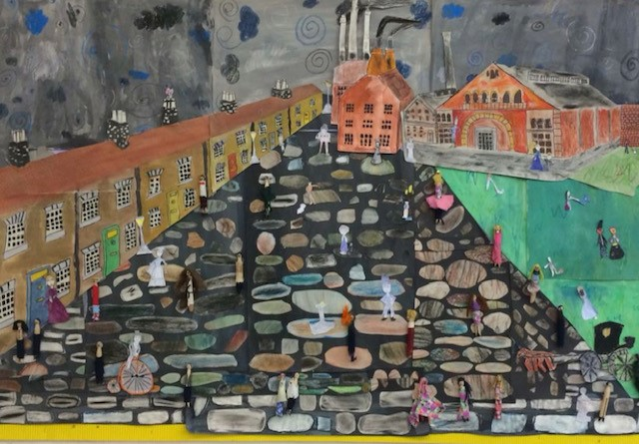
This Is Me
Learn to use appropriate materials
Work accurately to make cuts and holes .
Begin to make strong structures
The Stone Age
Use research and develop design criteria to inform the design of innovative, functional, appealing products that are fit for purpose, aimed at particular individuals or groups
The Romans
Understand seasonality, and know where and how a variety of ingredients are grown, reared, caught and processed.
Year Three
Food & Nutrition
Learns to explain importance of food and drink for active, healthy bodies.
Prepares and cooks some dishes safely and hygienically thinking about how to present the product in an attractive/appealing way.
Uses some of the following techniques: peeling, chopping, slicing, grating, mixing, spreading, kneading and baking
Machines
Learn to use a number of components in a circuit.
Mechanical systems
Learns to select the most appropriate tools / techniques.
Explains alterations to product after checking it.
Year
Four
Structure
Learns to measure accurately enough to ensure precision.
Begins to reinforce and strengthen a 3D frame.
The Victorians
Select from and use a wider range of tools and equipment to perform practical tasks [for example, cutting, shaping, joining and finishing], accurately
Year
Five
Food and Nutrition
Learns to name some types of food that are grown, reared or caught in the UK or wider world.
Presents dishes in a presentable and appealing manner.
Textiles
Learns to use a range of joining techniques.
Understands that a single 3D textiles project can be made from a combination of fabric shapes.
Mechanical systems
Learn to use cams, pulleys and gears to create movement.
Electrical systems
Learns to incorporate a switch into a product.
Year Six
Mission Grove Primary School Curriculum Road Map - DT

