Slide 1
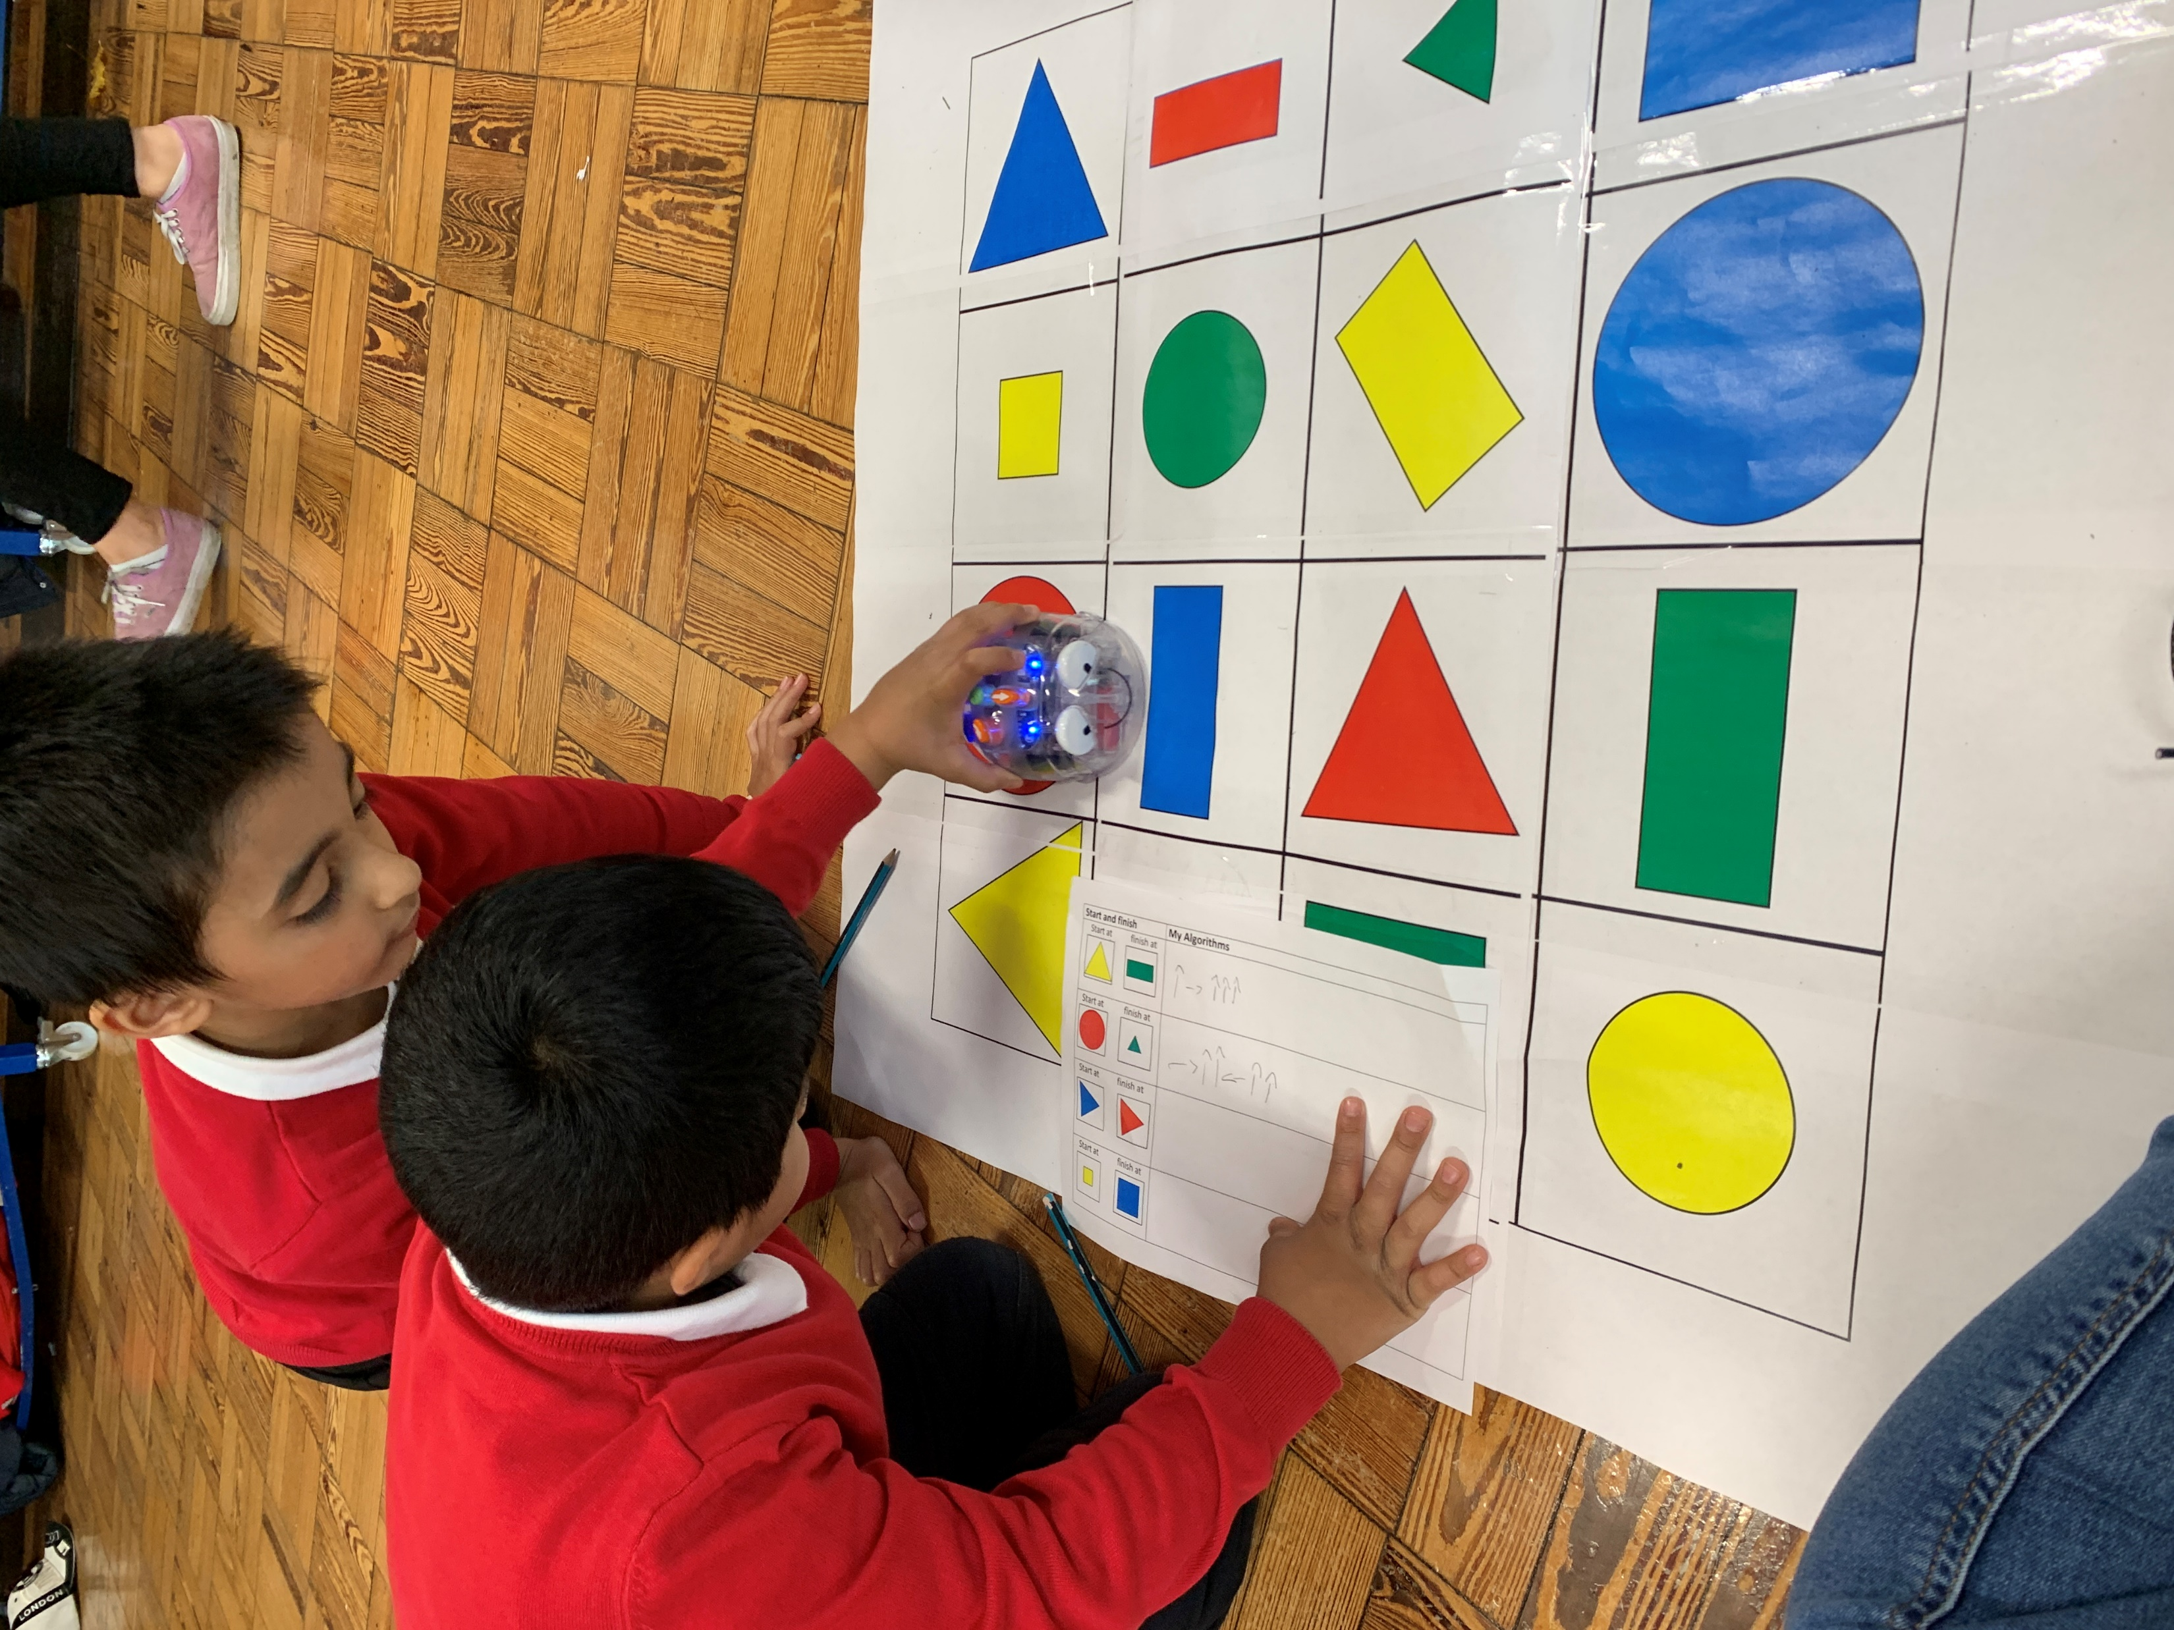
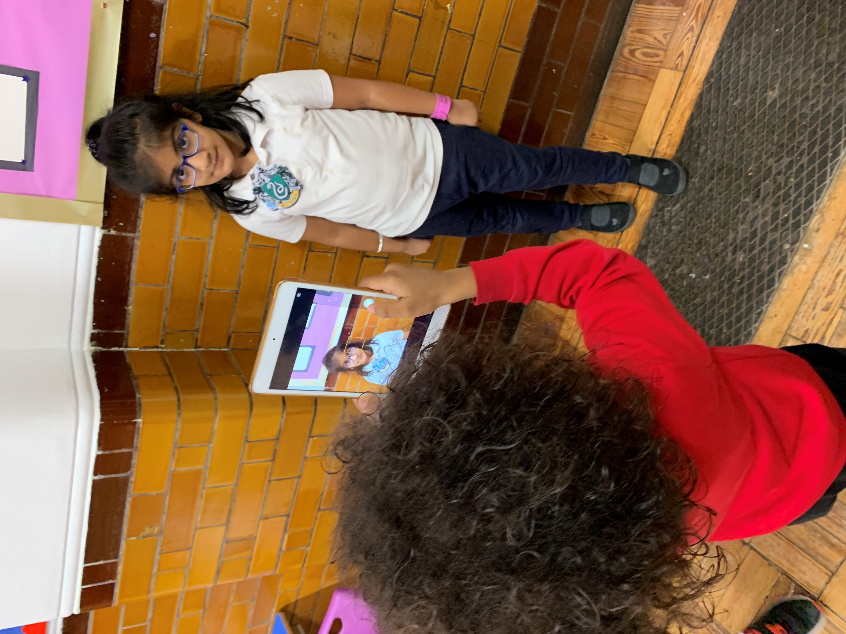
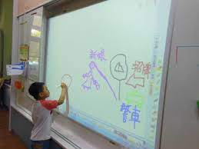

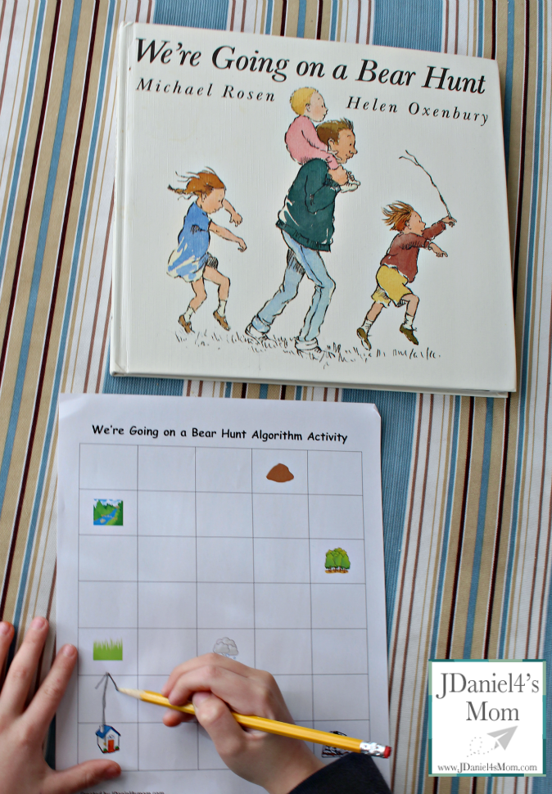
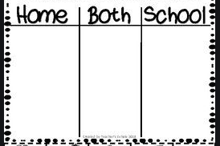
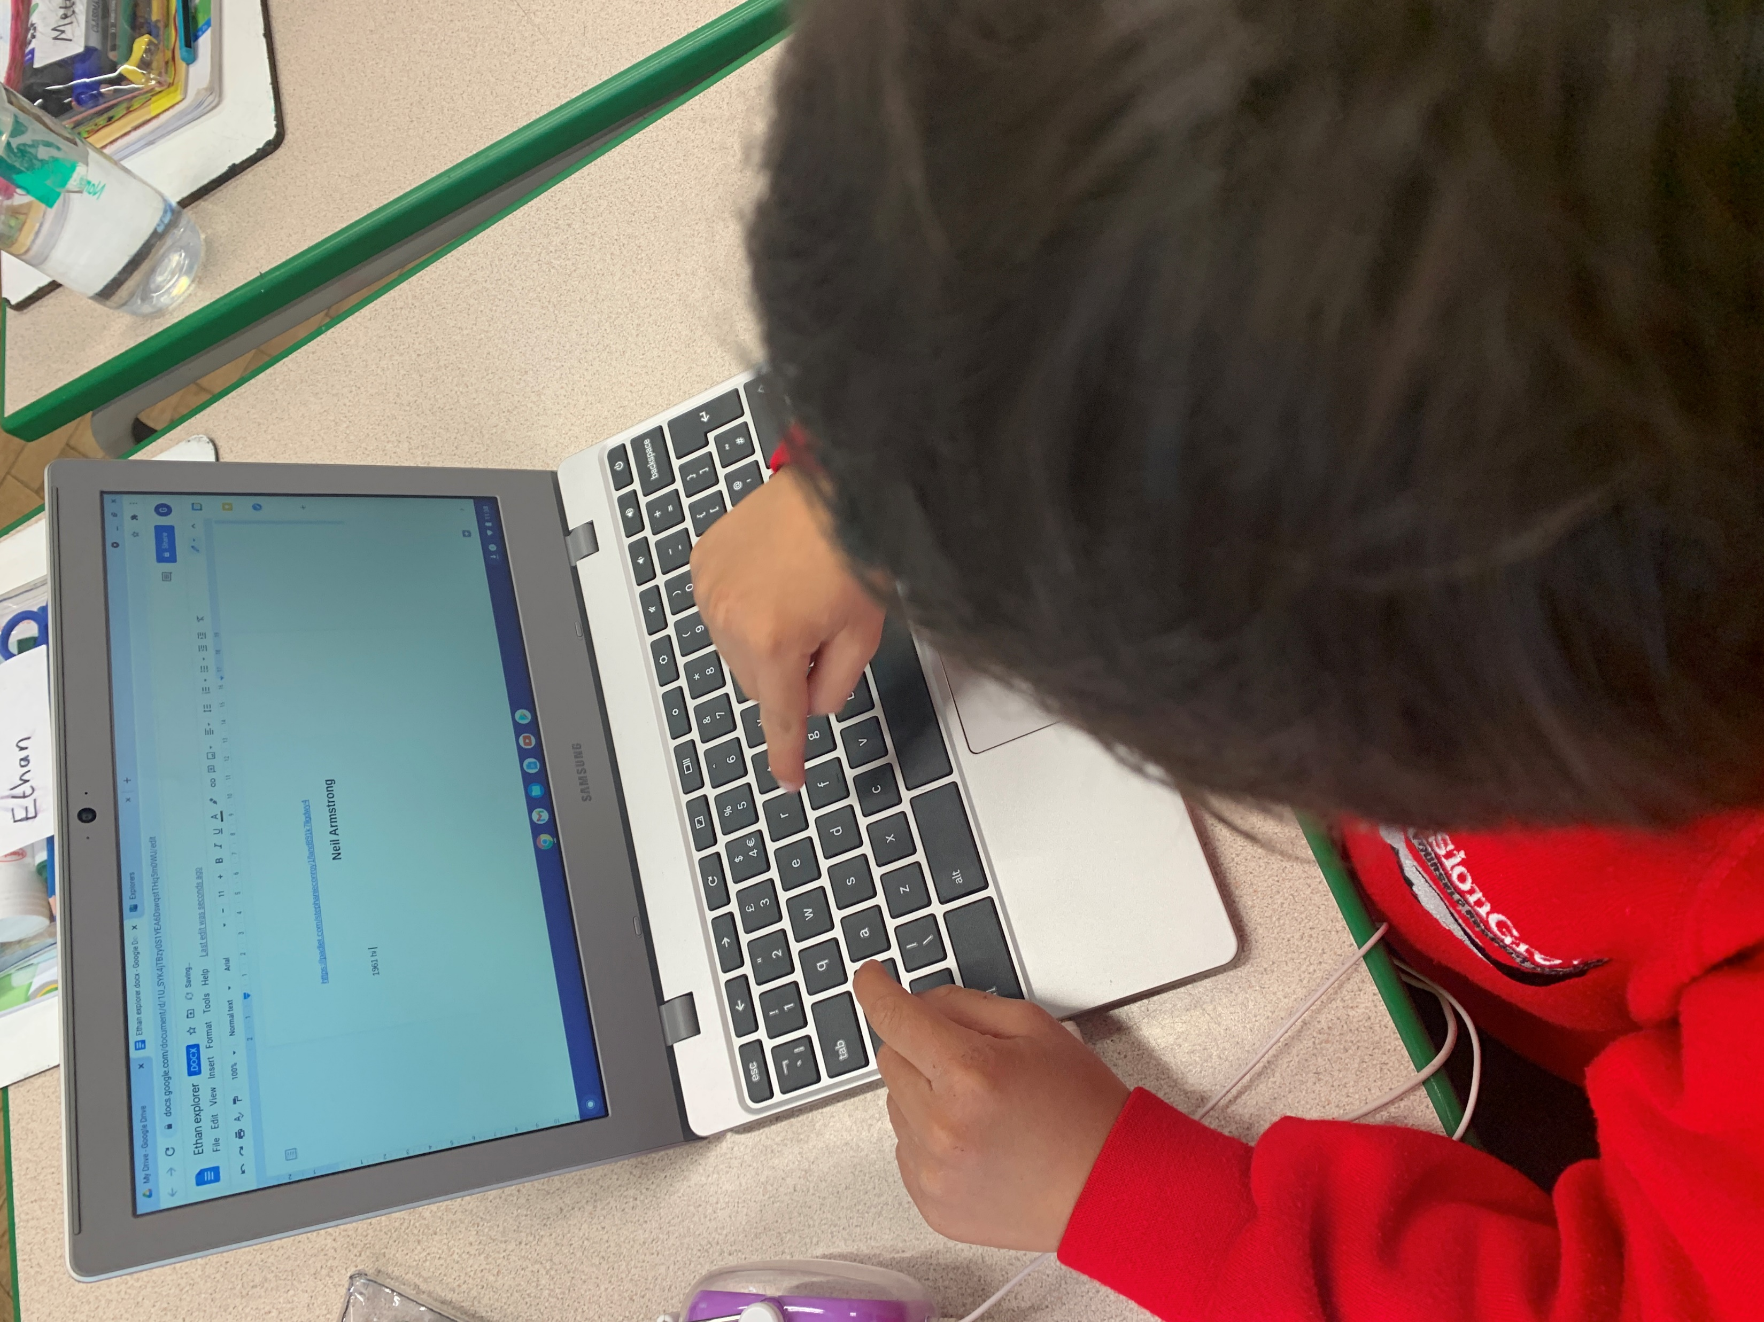
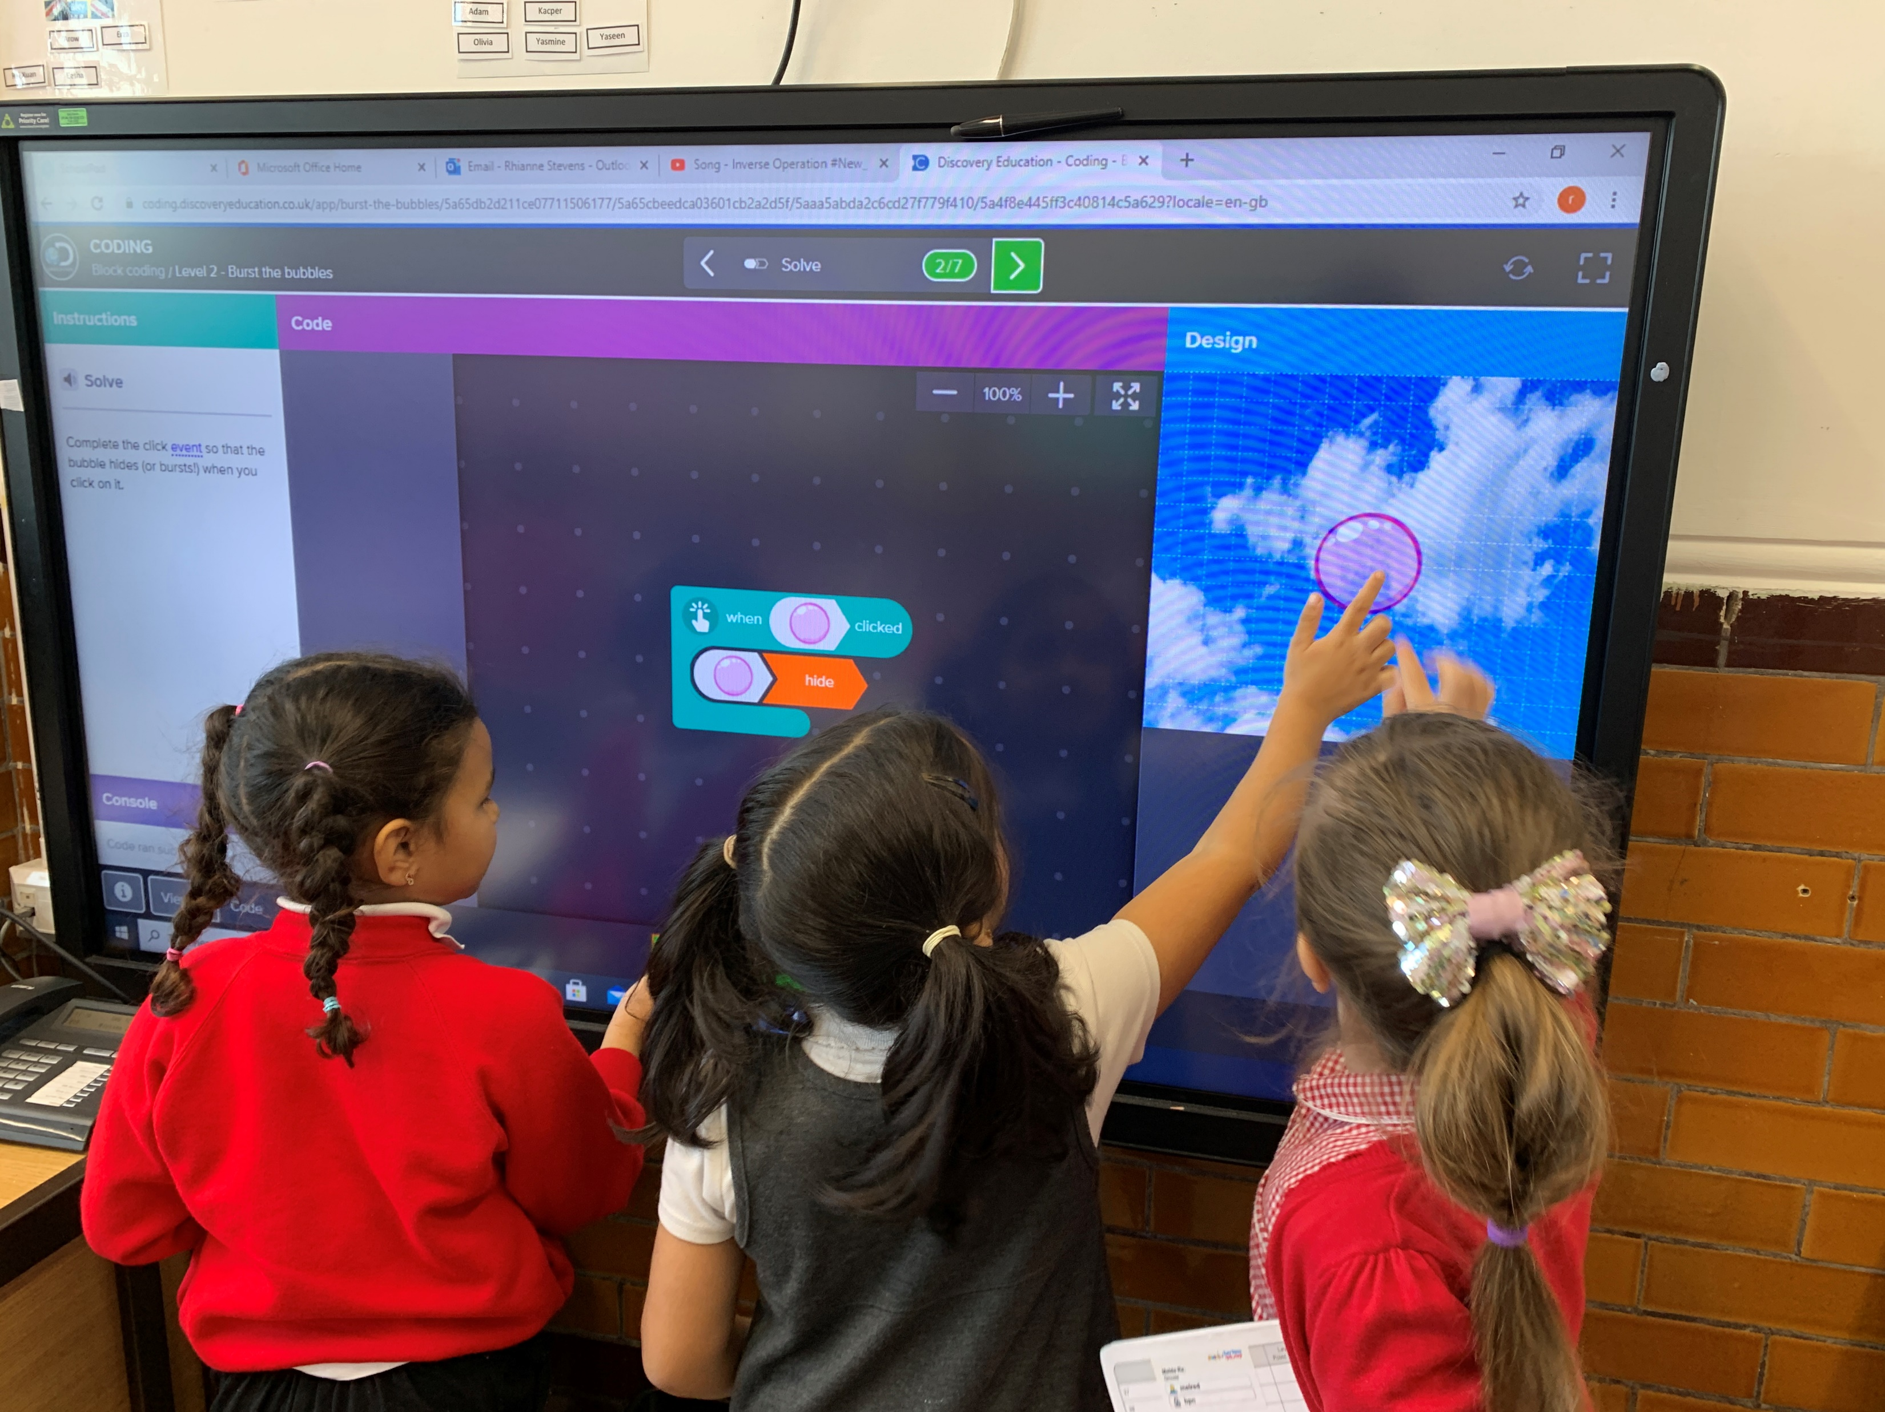
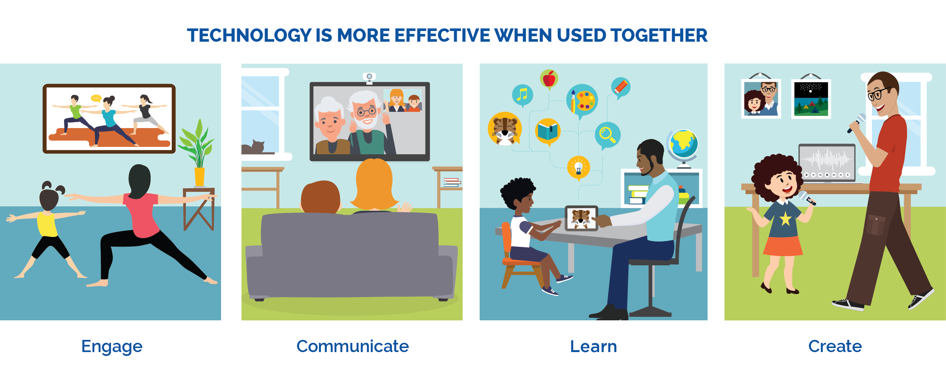
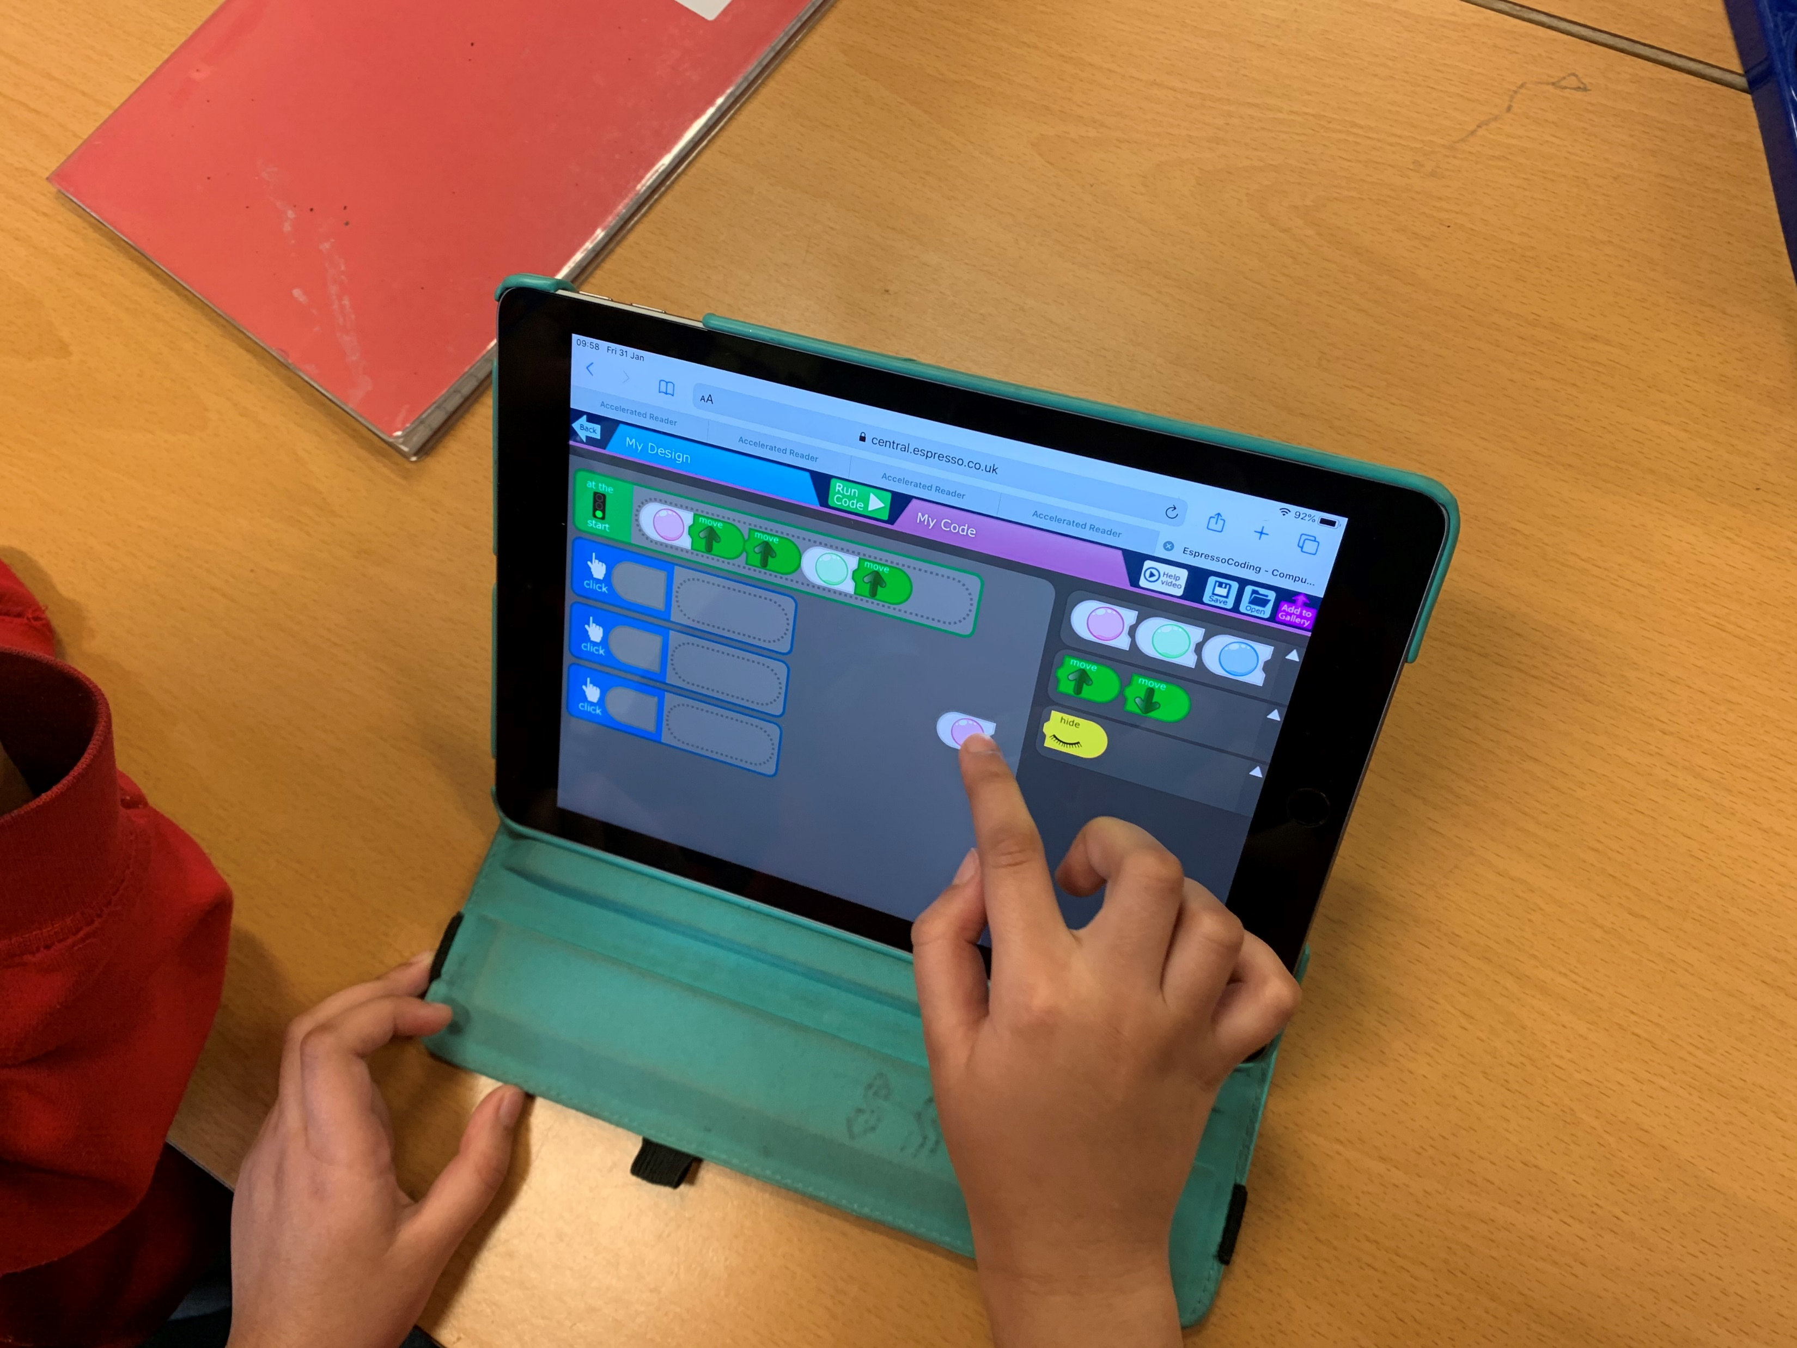
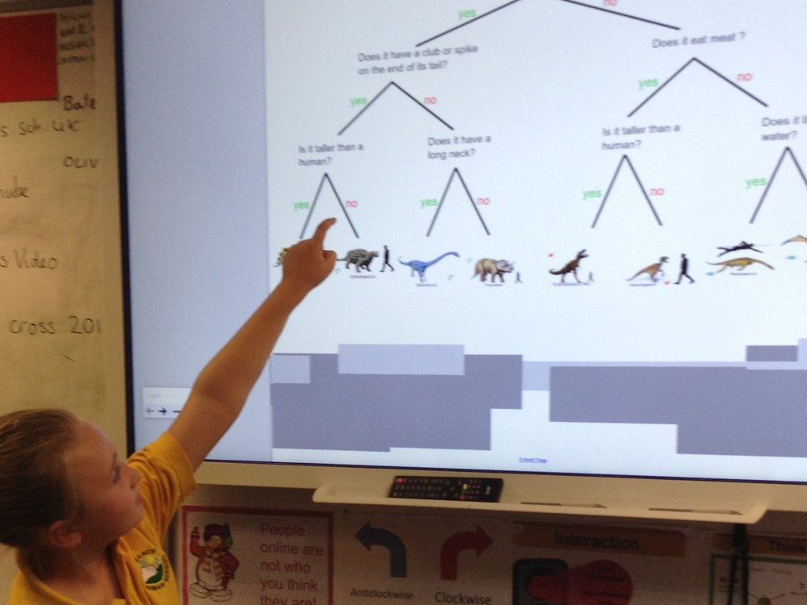
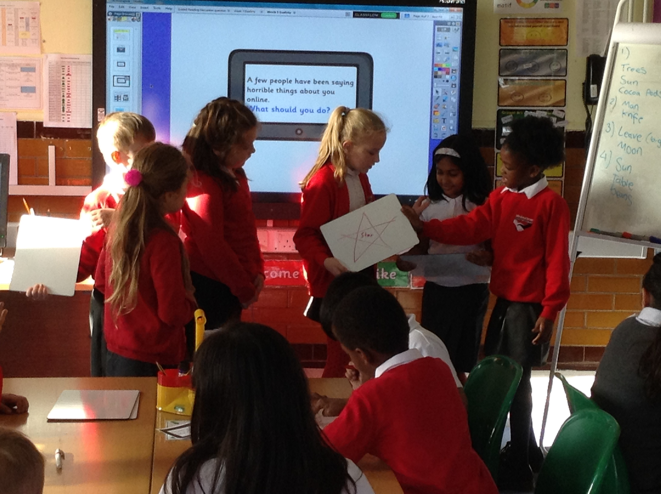
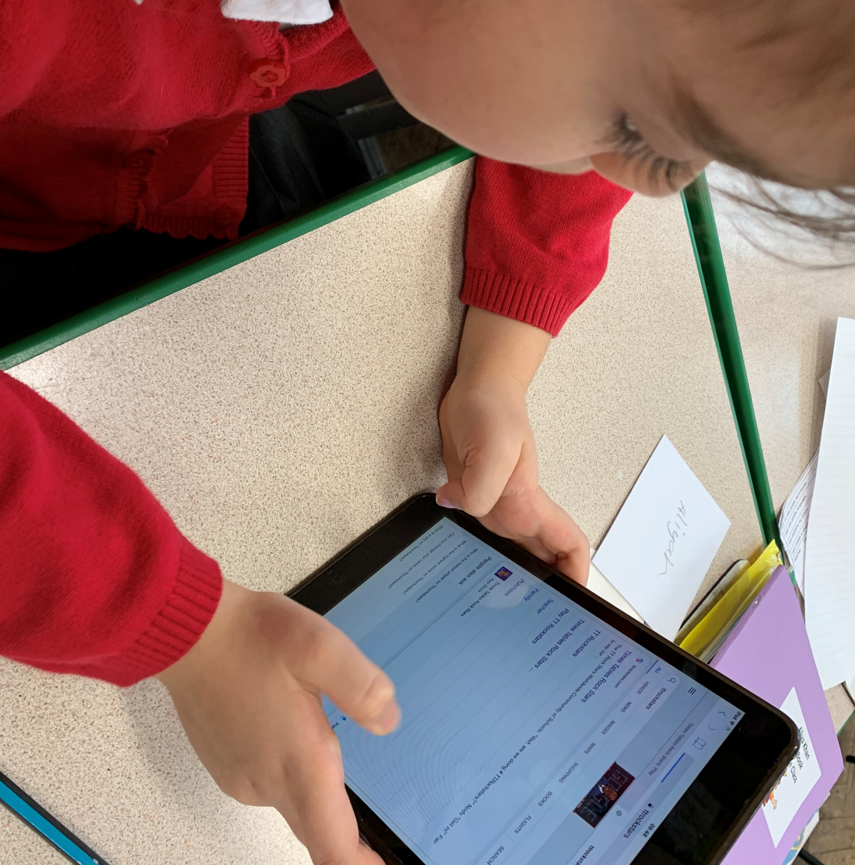
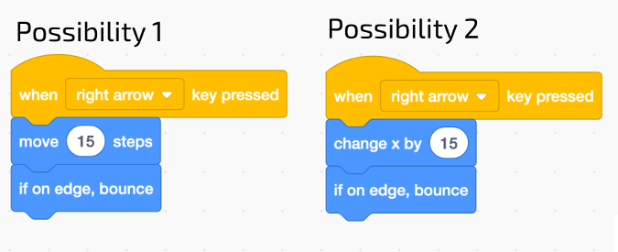

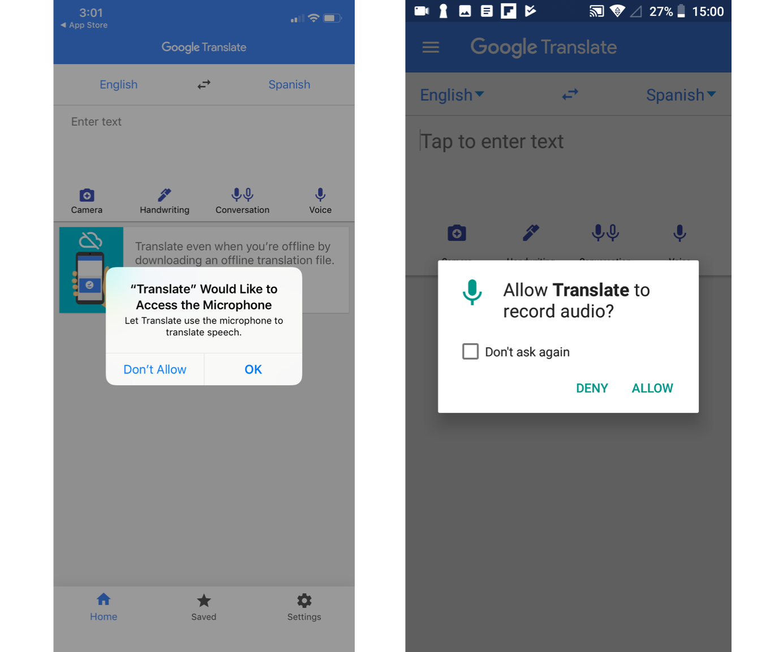
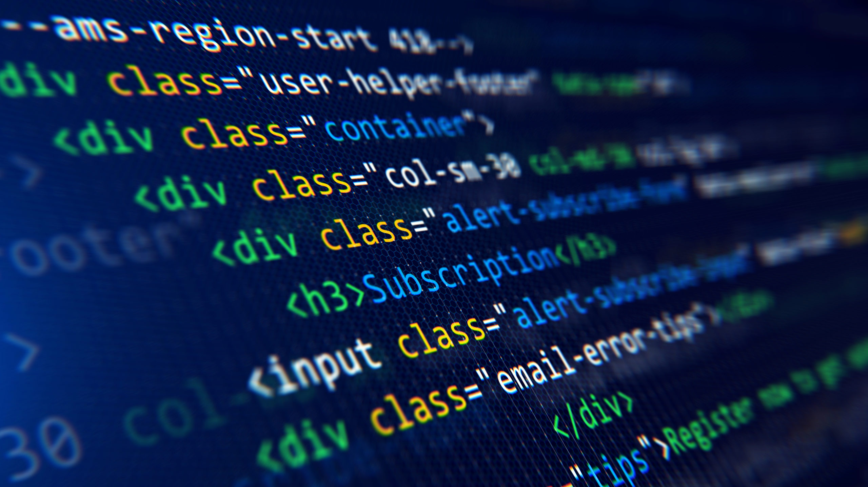
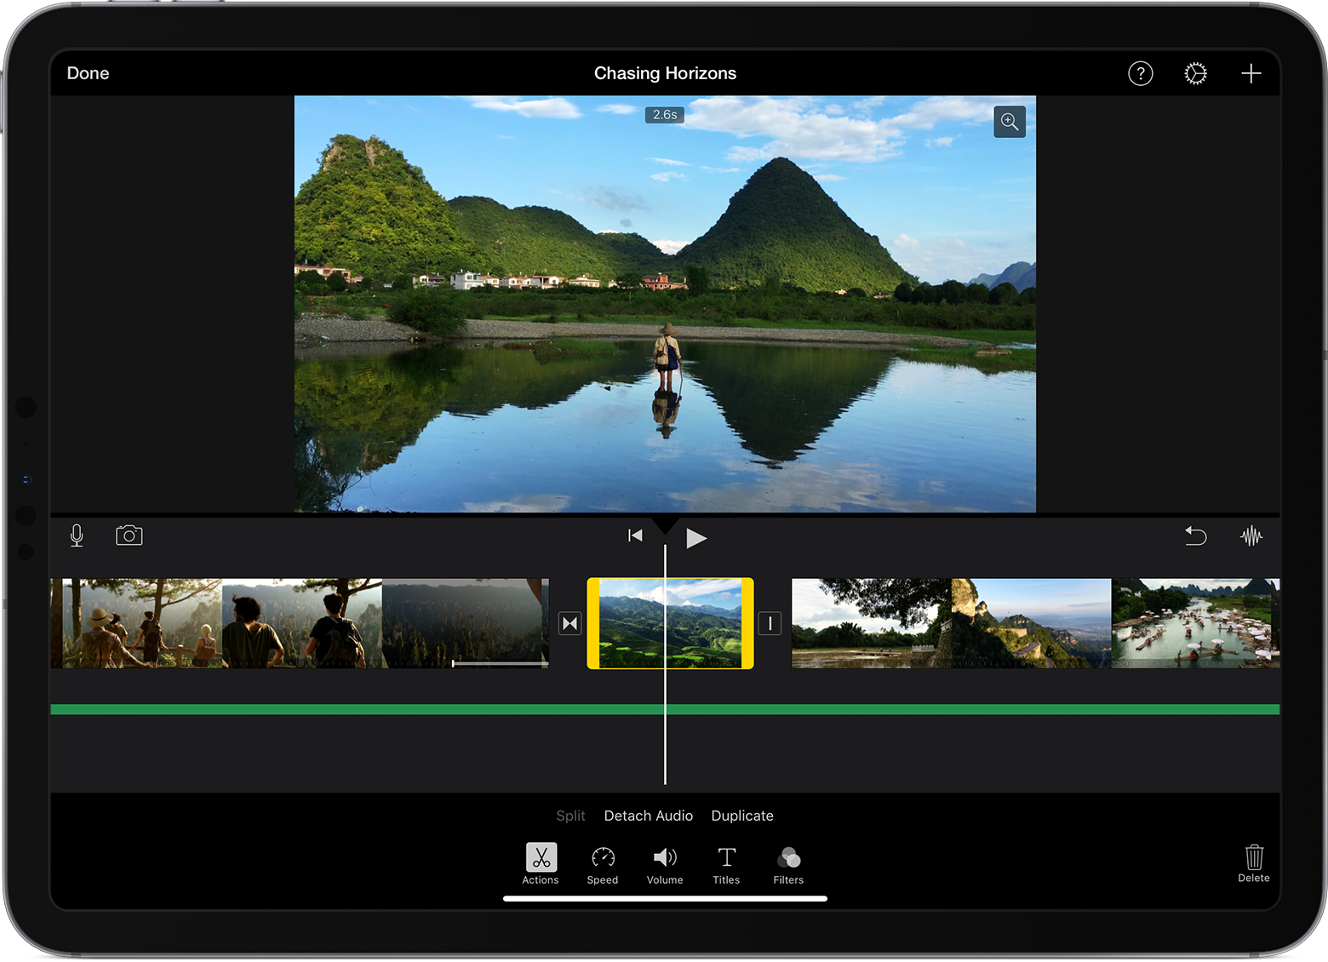
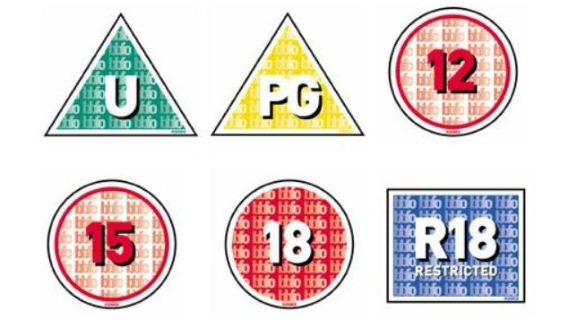
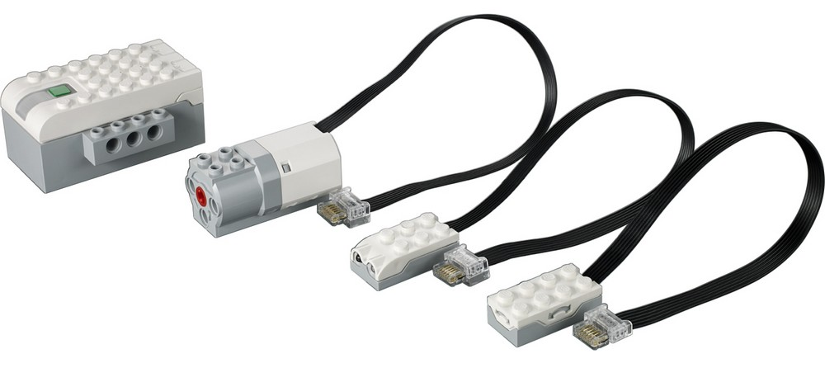
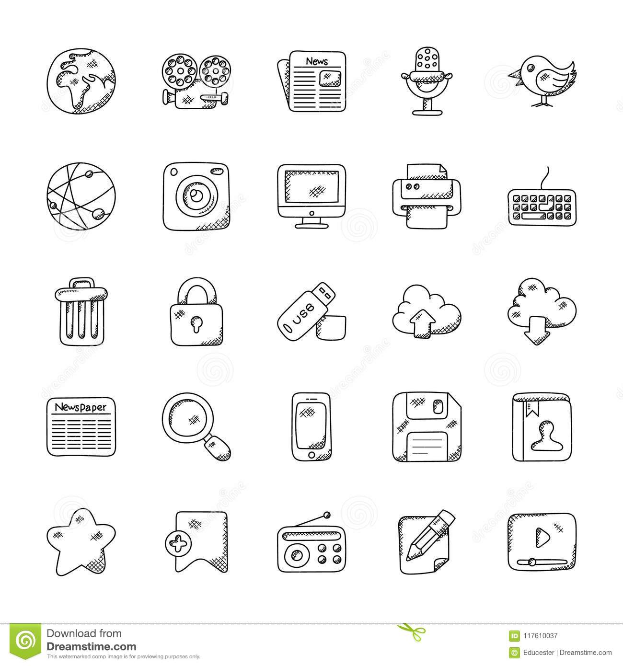
Technology in our Lives: Recognise purposes for using technology in school and at home.
Multimedia: Use a camera or sound recorder to collect photos or sound
Programming: Use simple software to make things happen – press buttons on a floor robot and talk about movements
Data Collection: Collect information as photos or sound files.
Technology around us: Recognising technology in school and using it responsibility
Digital Painting: Choosing tools in a program to create art, and making comparisons with working non-digitally
Moving a Robot: Writing short algorithms and programs for floor robots and predicting outcomes
Grouping Data: exploring objects labels, then using them to sort and group objects by properties
Digital Writing: Using a computer to create and format texts, before comparing to writing non-digitally
Programming Animations: Designing and programming the movement of a character on screen to tell stories
Reception
Year
One
Information technology around us: Identifying IT and how its responsible use improves our world.
Digital Photography : capturing and changing digital photographs for different purposes.
Robot Algorithms: creating and debugging programs, and using logical reasoning to make predictions
Pictograms: collecting data in tally charts and using attributes to organise and present data on a computer
Digital Music: Using a computer as a tool to explore rhythms and melodies, before creating a musical composition.
Programming quizzes: Designing algorithms and programs that use events to trigger sequences of codes.
Connecting Computers: identifying that digital devices have inputs, processes and outputs.
Stop Frame animation: capturing and editing digital still images to produce a stop-frame animation.
Sequencing sounds: Creating sequences in a block-based programming language to make music.
Branching databases: Building and using branching databases to group objects.
Desktop publishing : Creating documents by modifying texts, images and page layouts.
Events and actions in programs: Writing algorithms and programs that use a range of events to trigger sequences of actions.
Year
Three
Year
Two
The internet: Recognizing the internet as a network of networks, including the WWW.
Audio production: Capturing and editing audio to produce a podcast.
Repetition in shapes: Using text-based programming language to explore count-controlled loops when drawing shapes.
Data logging : Recognizing how and why data is collected over time.
Photo editing : Manipulating digital images and reflecting on impact of changes.
Repetition in games :Using block-based programming language to explore count-controlled and infinite loops.
Year
Four
Year
Five
Communication and collaboration: Exploring how data is transferred by working collaboratively online.
Webpage creation: Designing and creating webpages, considering copyright.
Variables in games: Exploring variables when designing and coding a game.
Introduction to spreadsheets : Answering questions by using spreadsheets to organise and calculate data.
3D modelling : Planning, developing and evaluating 3D computer models of physical objects.
Sensing movement : Designing and coding a project that captures inputs from a physical device.
Systems and searching : Recognising IT systems in the world and how some can enable searching on the internet.
Video production: Planning, capturing and editing video to produce a short film.
Selecting in physical computing : Exploring conditions and selecting using a programmable microcontroller.
Flat-file databases: Using a database to order data and create charts to answer questions.
Introduction to vector graphics : Creating images in a drawing program by using layers and group of objects.
Selection in quizzes : Exploring selecting in programming to design and code an interactive quiz.
Year
Six
Mission Grove Primary School Curriculum Road Map - Computing

