Slide 1

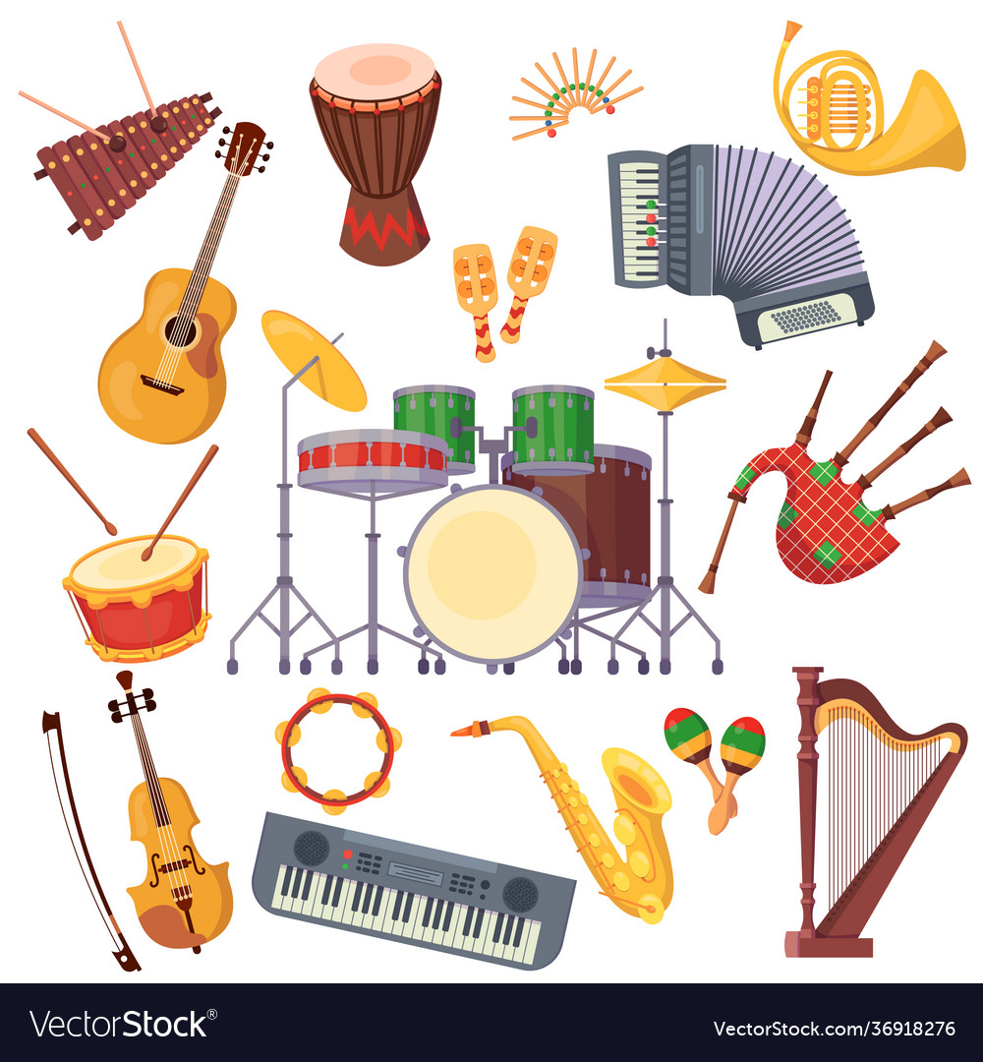


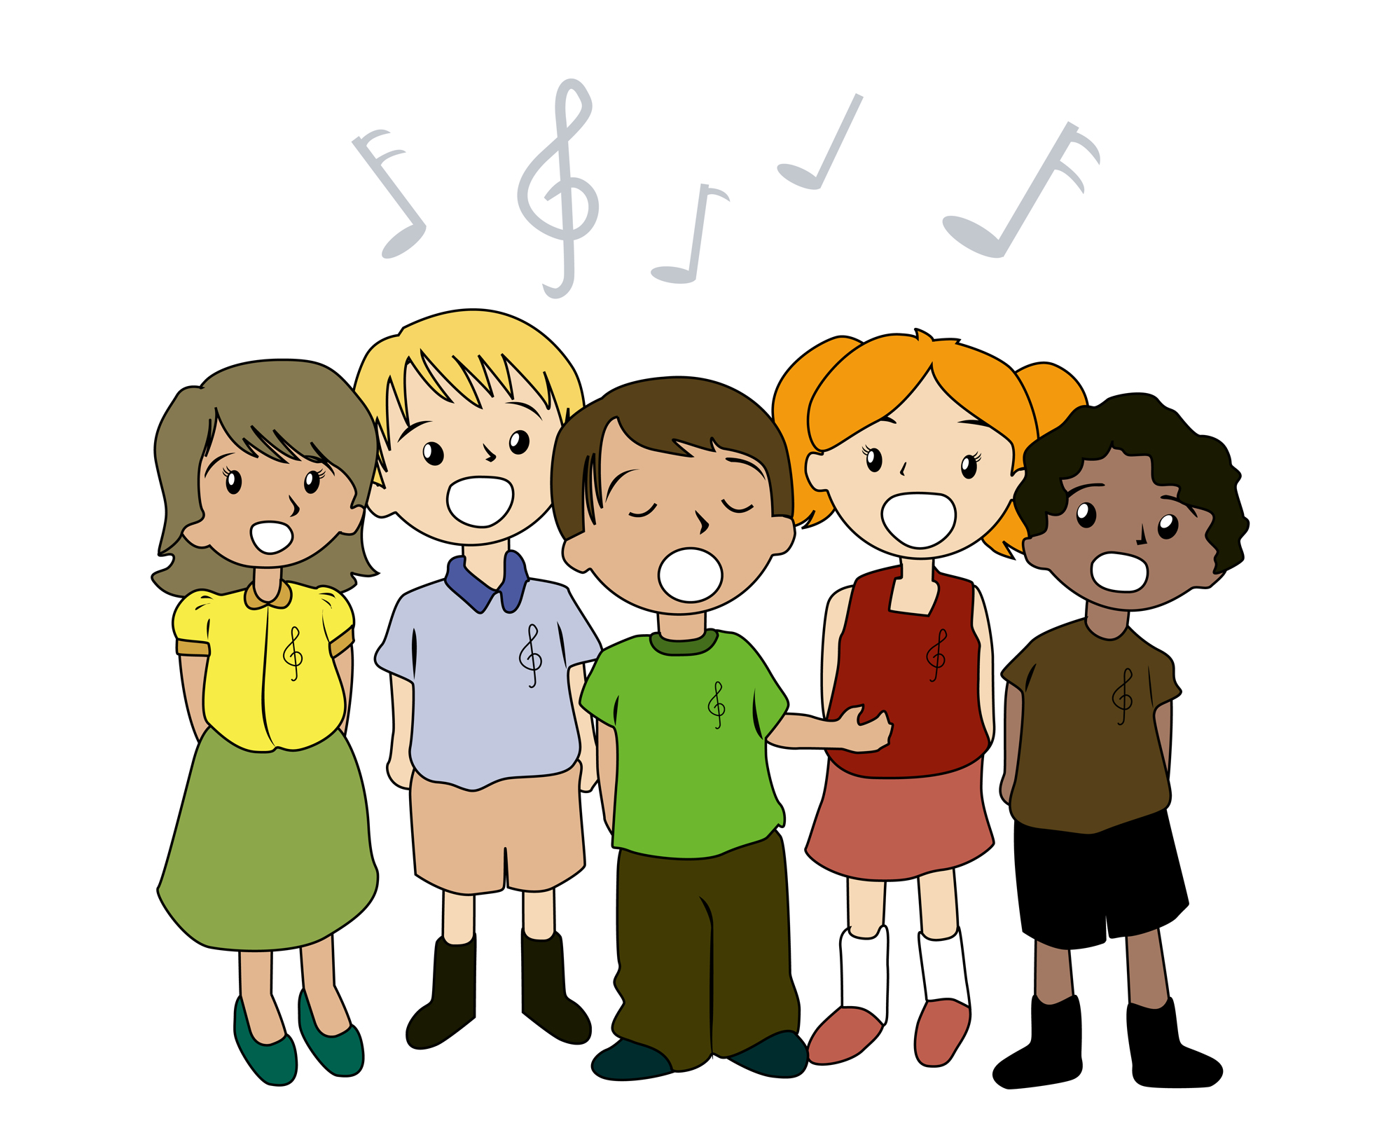
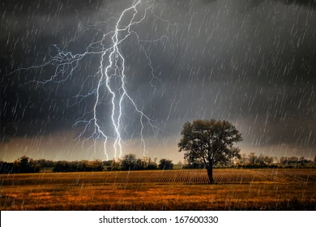
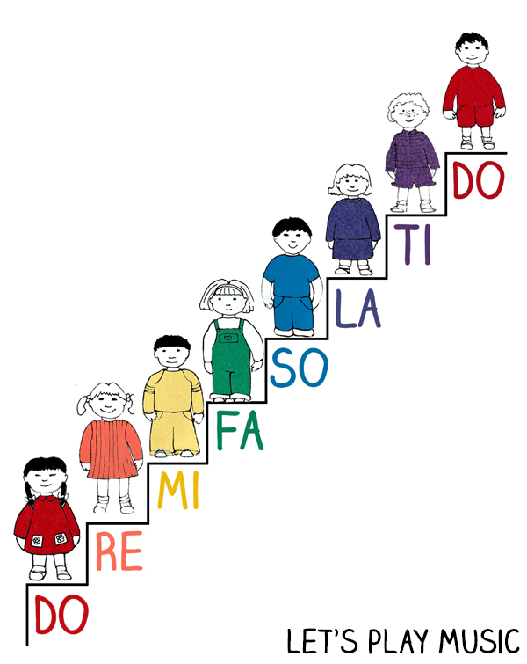


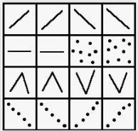

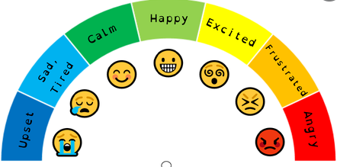
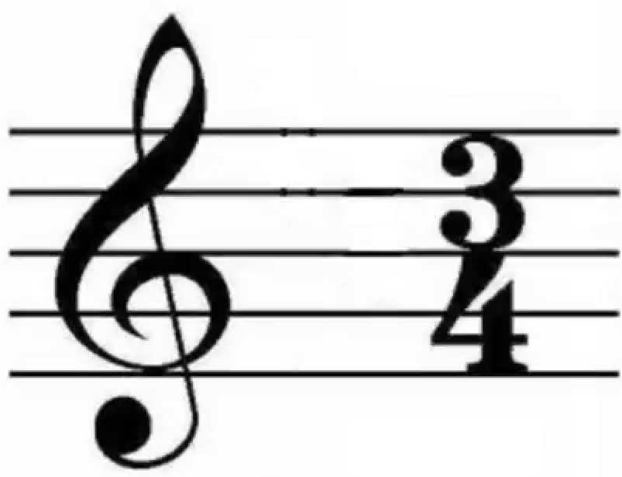
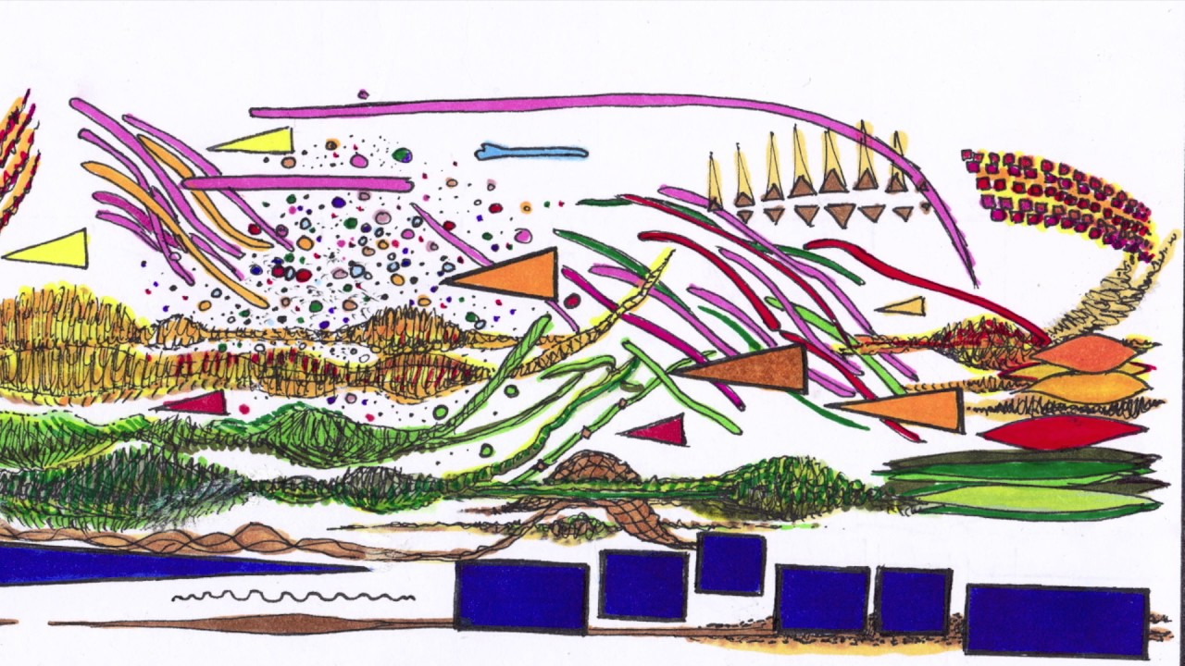
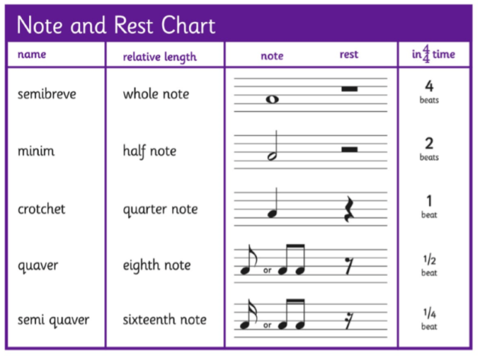
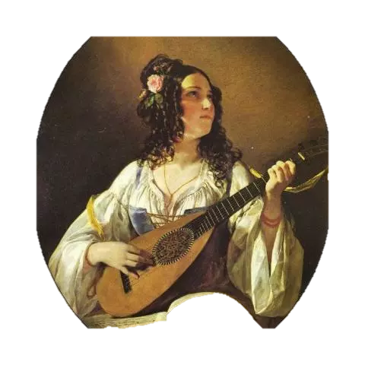
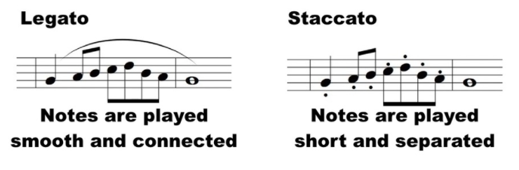

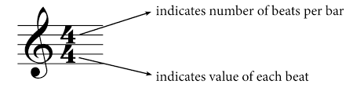

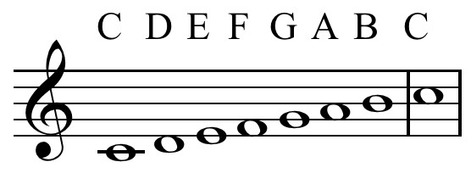
Singing
Sing the pitch of a tone sung by another person (‘pitch match’)
Sing a range of nursery rhymes and songs.
Composing
Can create musical sound effects and short sequences of sounds in response to stimuli, e.g. a rainstorm or a train journey.
Composing
Improvise a song they know.
Singing
Is able to sing simple songs, chants and rhymes from memory, singing collectively and at the same pitch
Year
One
Musicianship
Can walk, move or clap a steady beat with others, changing the speed of the beat as the tempo of the music changes.
EYFS
Musicianship
Explore and engage in music making and dance, performing solo or in groups.
Listening
Respond to what they have heard, expressing their thoughts and feelings.
Singing
Is able to sing a widening range of unison songs of varying styles and structures with a pitch range of do–so tunefully and with expression.
Composing
Uses graphic symbols, dot notation and stick notation, as appropriate, to keep a record of composed pieces.
Listening
Is able to identify different instruments used in a piece of music.
Year
Three
Year
Two
Listening
Responds to different moods in music.
Composing
Can use silence for effect and knows the symbol for a rest (duration).
Singing
Knows the meaning of dynamics (loud/quiet) and tempo (fast/slow) and be able to demonstrate these when singing.
Musicianship
Can play copycat rhythms lead by the teacher.
Musicianship
Understands the differences between minims, crotchets, paired quavers and rests.
Singing
Can sing rounds and partner songs in different time signatures.
Musicianship
Uses graphic notation to imitate the shape of the melody.
Listening
Is beginning to use the terms: pitch, duration, dynamics, tempo, timbre, texture and structure to describe music.
Singing
Sings in three-part rounds, partner songs, and songs with a verse and a chorus.
Year
Four
Composing
Improvises on a limited range of pitches on the instrument they are now learning, making use of musical features including smooth (legato) and detached (staccato).
Year
Five
Listening
Is able to describe different purposes of music in history/ other cultures.
Listening
Chooses from a wide range of musical vocabulary to accurately describe and appraise music including: Pitch/dynamics/tempo/timbre/ texture/lyrics and melody/ sense of occasion/ expression/ solo/ rounds/ harmonies/ accompaniments/ drones/ cyclic patterns/ combination of musical elements/ cultural context.
Composing
Is able to create music with two different moods showing an understanding of how lyrics, melody, rhythms and accompaniments work together effectively (pitch/texture/ structure).
Listening
Appreciates and understands a wide range of high quality live and recorded music drawn from different traditions and from great composers and musicians
Musicianship
Is able to read and perform pitch notation within an octave (e.g. C–C/ do–do).
Singing
Continues to sing three- and four-part rounds or partner songs, and is confident singing when positioned randomly within the group – i.e. no longer in discrete parts – in order to develop greater listening skills, balance between parts and vocal independence
Year
Six
Musicianship
Understands the differences between 2/4, 3/4 and 4/4 time signatures.
Composing
Is able to compose up to a 16 beat melody using the pentatonic scale (e.g. the C major scale C D E G A).
Mission Grove Primary School Curriculum Road Map - Music

