Slide 1
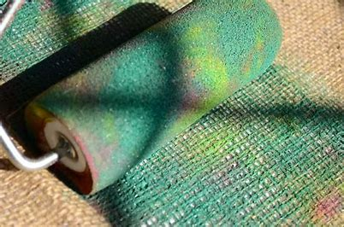
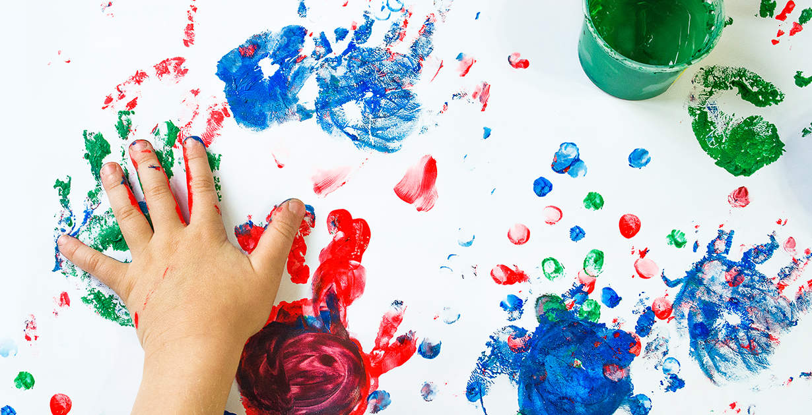
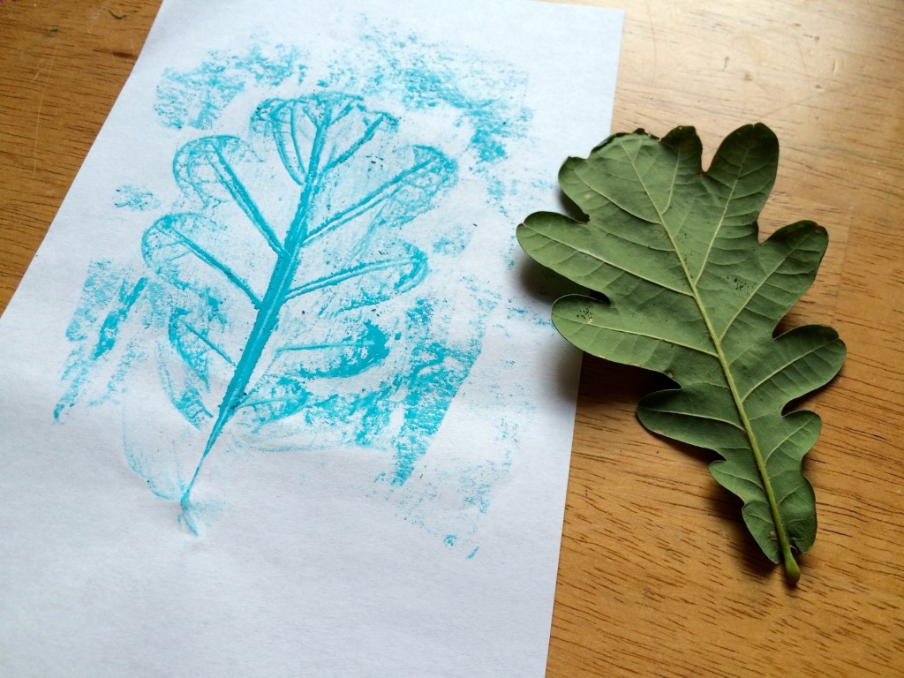
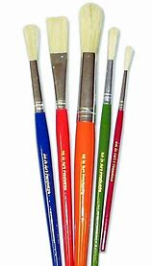
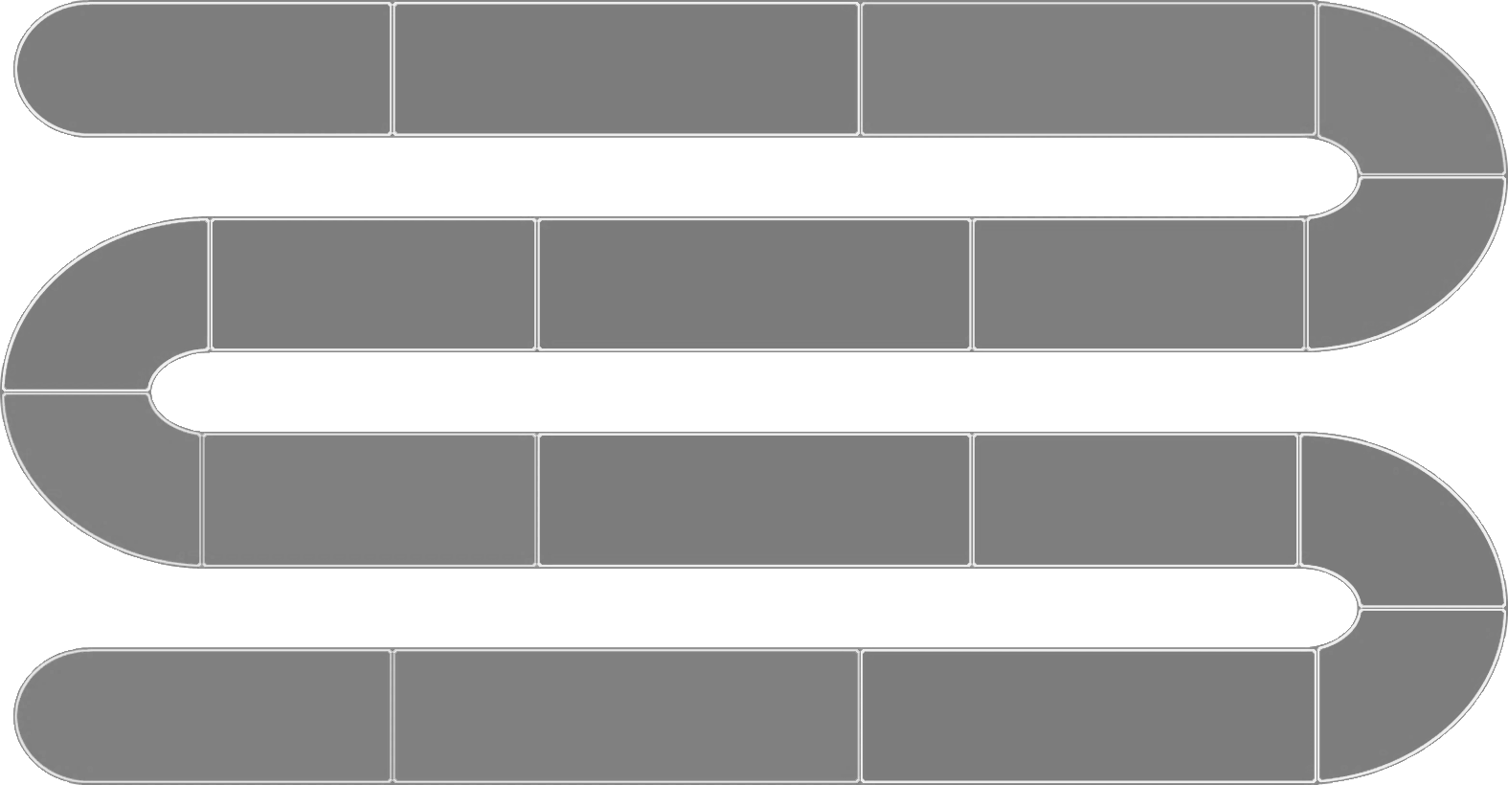
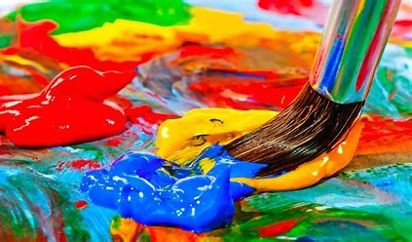
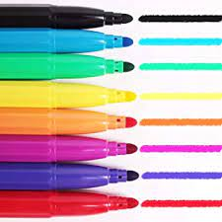
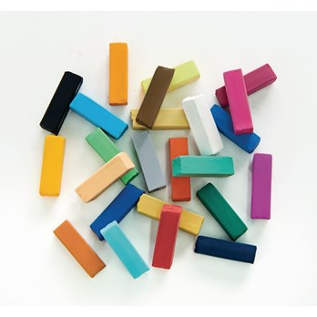
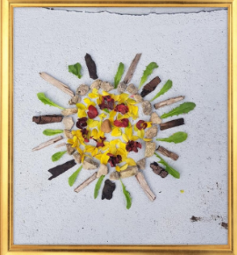
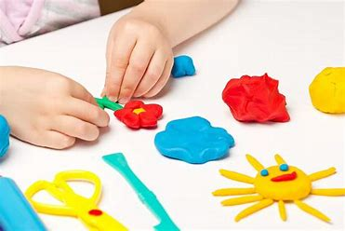
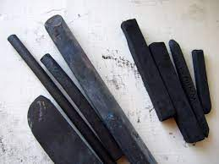
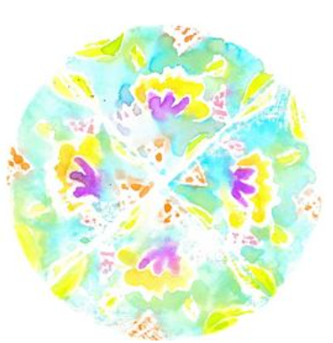
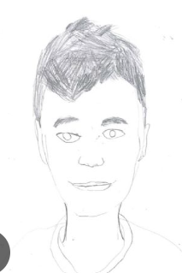
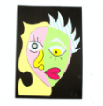
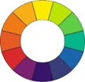
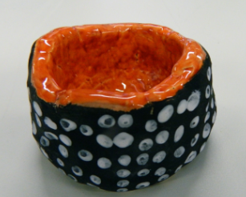
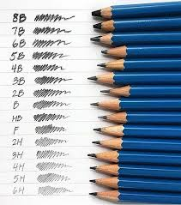
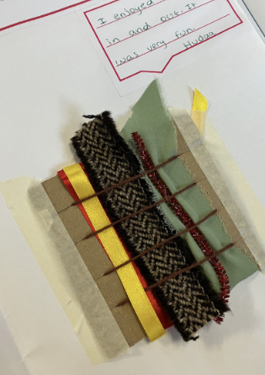
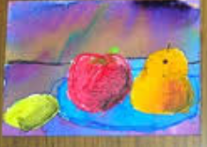
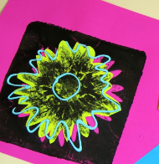
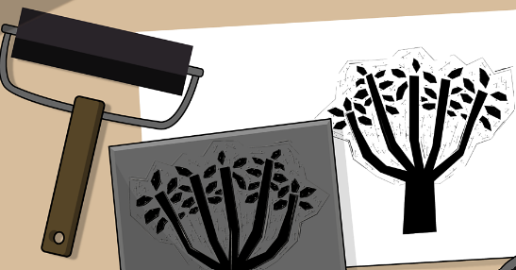
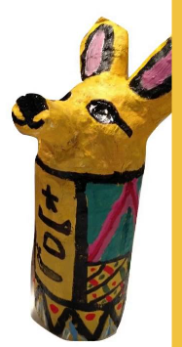
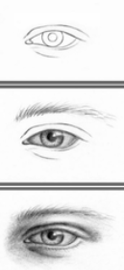
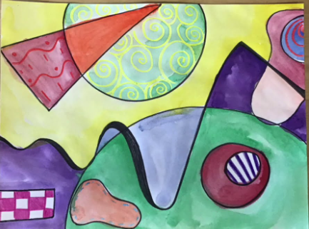
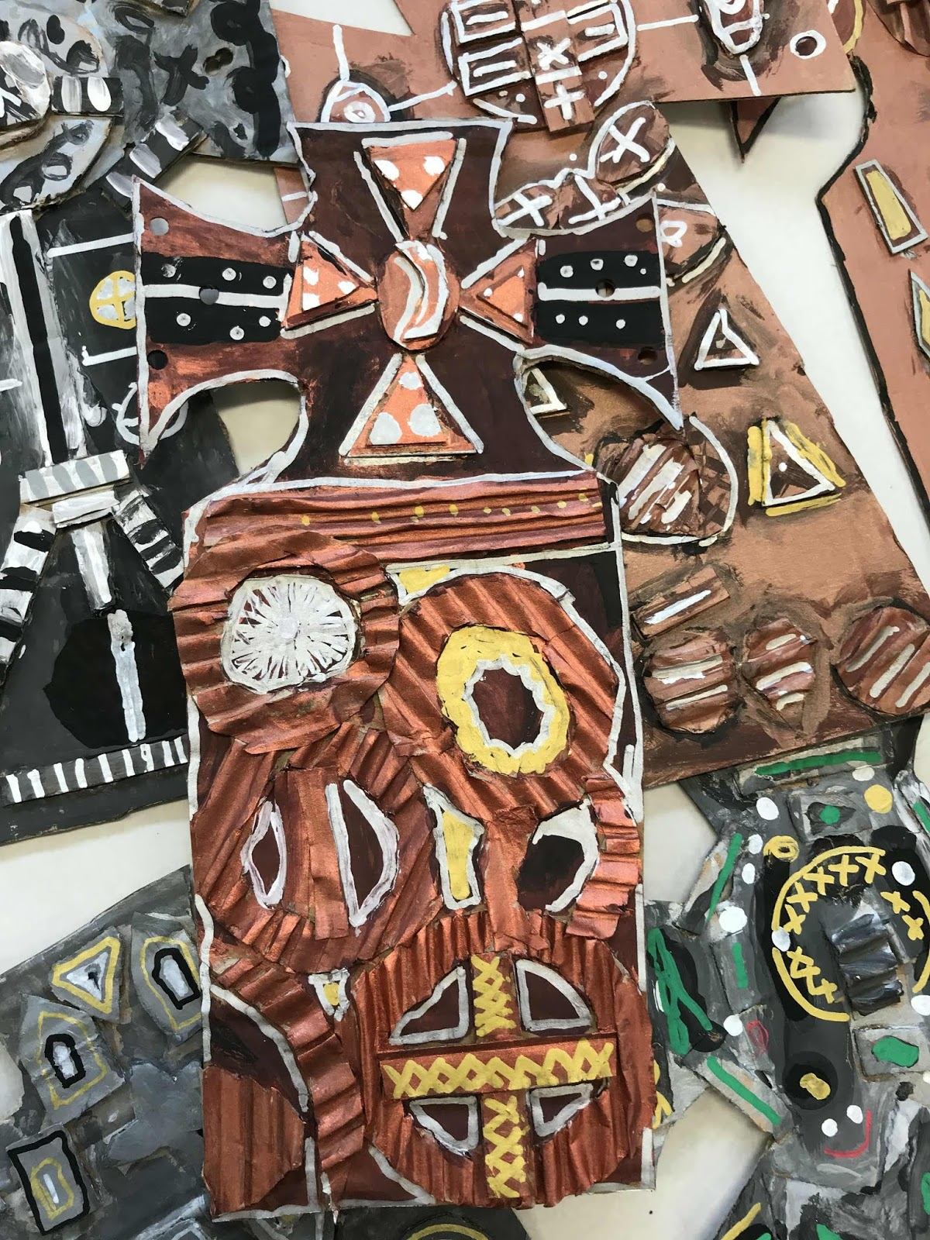
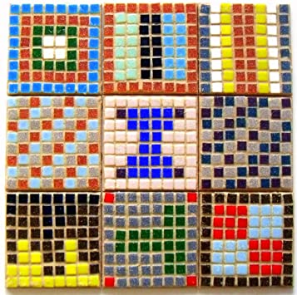
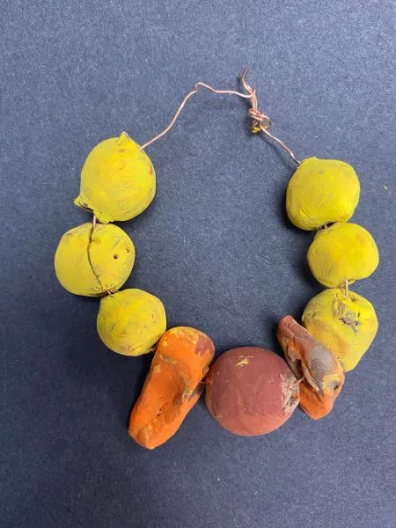
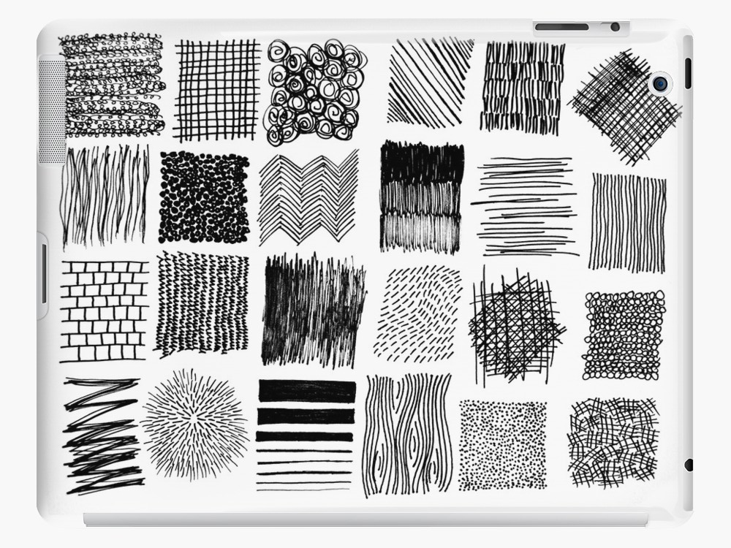
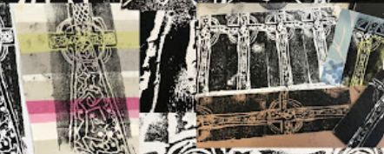
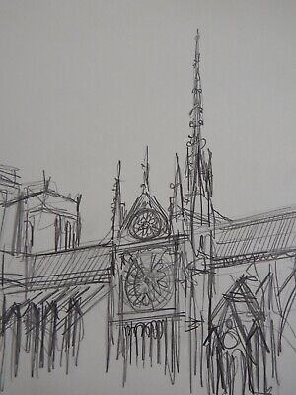
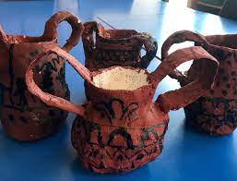
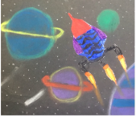
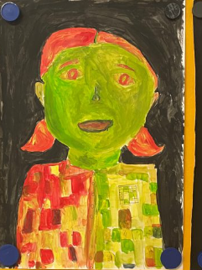
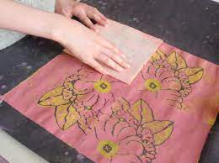
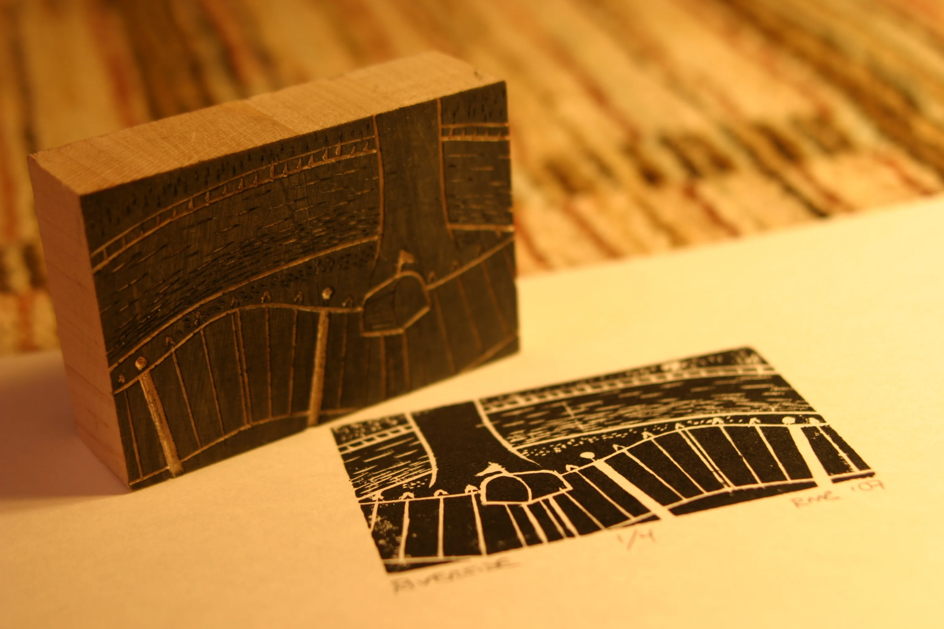
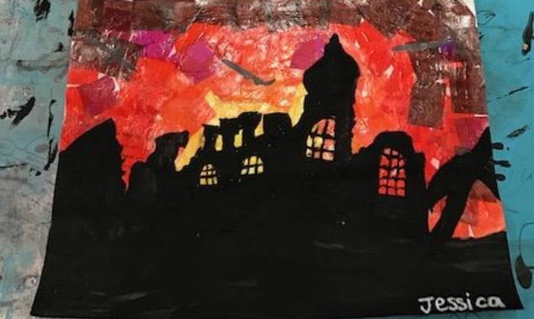
Painting
Explore working with paint on different surfaces and in different ways.
Textiles and Collage
Take rubbings from a variety of objects, e.g. leaves, bricks and coins.
Drawing
Demonstrates control over the types of marks made with different media (pencils, pastels, felt tip, charcoal and chalk) on a range of surfaces.
Natural Sculptures
Experiment Using natural materials to make spirals or circles.
Painting
Experiments with paint using a range of tools, e.g. different brush sizes, hands, feet, rollers and pads on different surfaces.
Drawing
Use and begin to control a range of media (Paint, glue, ink etc) .
EYFS
Sculpture and 3D
Explore feeling, shaping and manipulating materials.
Year One
Printing
To investigate printing using felt tip pens.
Printing
Print from a variety of objects- shapes, fruit, sponges, hands etc.
Textile and Collage
Weave materials (e.g. carrier bags or manipulating fabric and yarns by poking, natural materials on a weaving board) looking at colour and texture
Drawing
Creates accurate drawings of people and inanimate objects– particularly faces and life drawings.
Sculpture and 3D
Adds patterns and detail to their clay work to create texture and shapes using tools.
Textile and Collage
Create a cubism portrait using collage.
Drawing
Uses different grades of pencil – drawing light and dark lines, patterns and shapes.
Year Two
Year Three
Painting
Understand how to experiment with water colour paints and to create a still life painting.
Printing
Makes simple prints using a variety of objects such as a sunflower.
Painting
Understands the colour wheel and colour spectrums and is able to mix all the secondary colours using primary colours confidently.
Printing
Continue to explore relief and mono printing.
Drawing
Is attempting drawings featuring perspective and specific portrait features.
Sculpture and 3D
To use mod roc with accuracy
Drawing
Shows awareness of representing texture through the choice of marks and lines made.
Sculpture and 3D
Sculpting their clay using tools to create stone age jewellery.
Year Four
Printing
Demonstrate an awareness of printing onto fabric and consider the differences to printing on paper.
Year Five
Textile and Collage
Make a simple mosaic.
Textile and Collage
Develop experience in embellishing, using a range of joining techniques.
Painting
Work in the style of a selected abstract artist (not copying).
Painting
Use colours to represent thermal painting.
Textile and Collage
Use a variety of materials to create various set designs, props and costumes.
Sculpture and 3D
Is able to use recycled, natural and manmade materials to create sculptures, confidently and successfully joining different parts if needed.
Printing
Creating woodblock prints.
Drawing
To use techniques to depict perspective and shadows
Year Six
Textile and Collage
Experimenting background colours using collage (mix and match colours to create atmosphere and light effects).
Printing
Investigating the work of William Morris and experimenting with repeating patterns.
Sculpture and 3D
Develop carving techniques on different materials e.g. polystyrene or concrete.
Painting
Mixing textures and combining visual and tactile qualities.
Mission Grove Primary School Curriculum Road Map - Art

