Slide 1
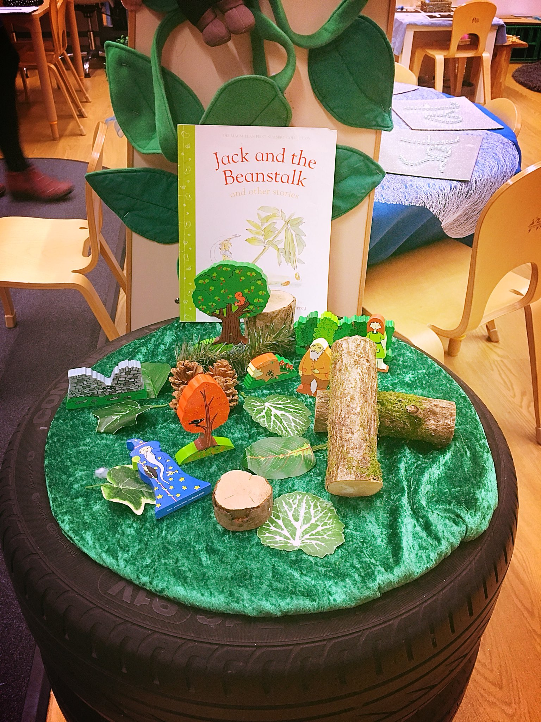
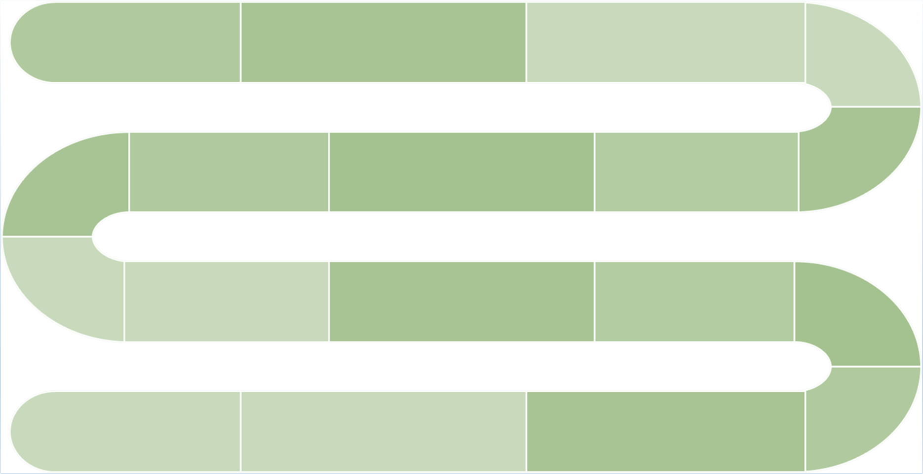
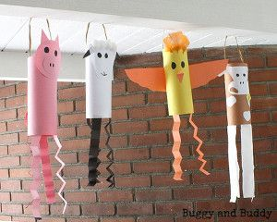
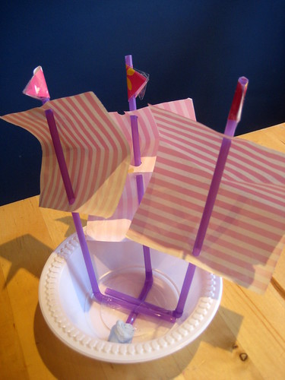
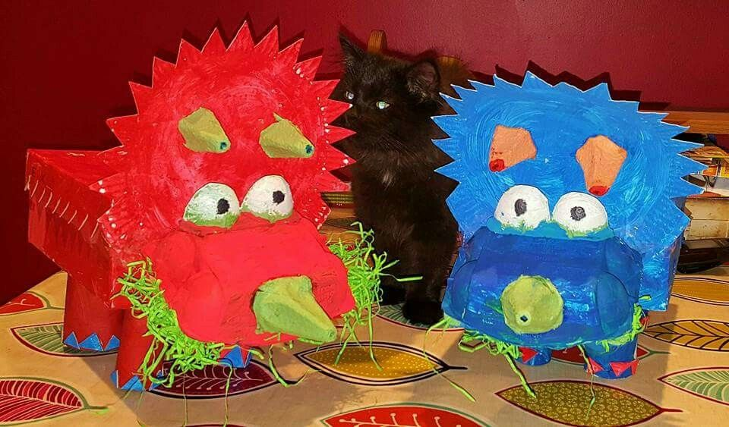
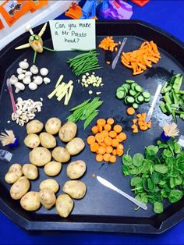
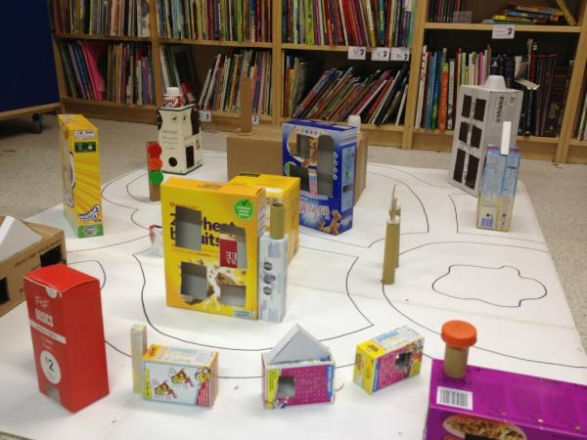
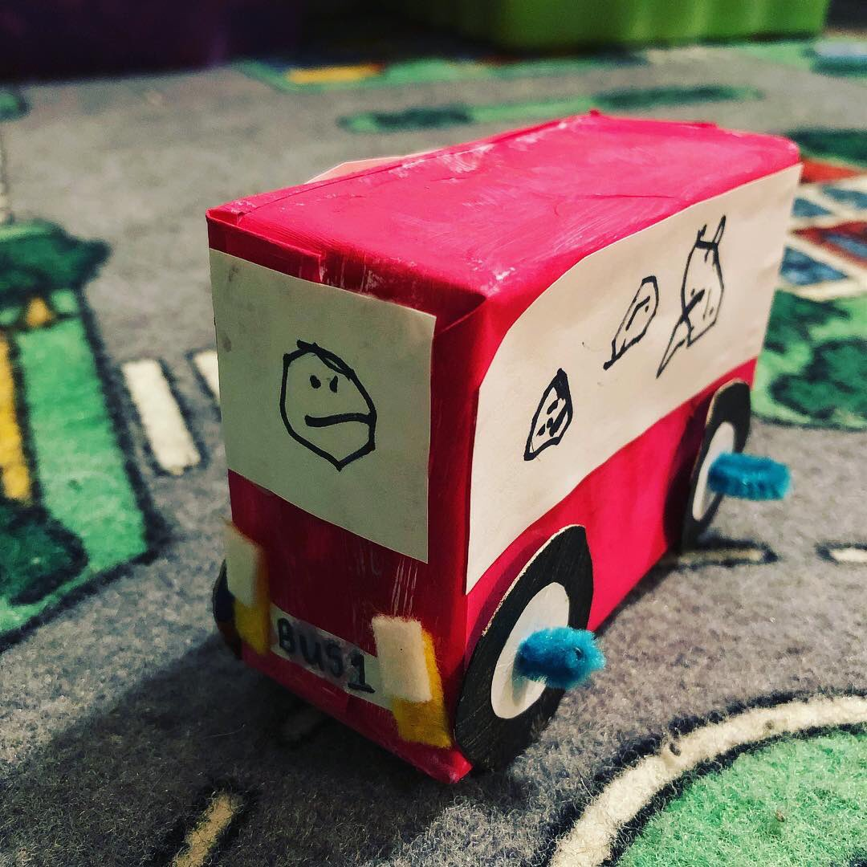
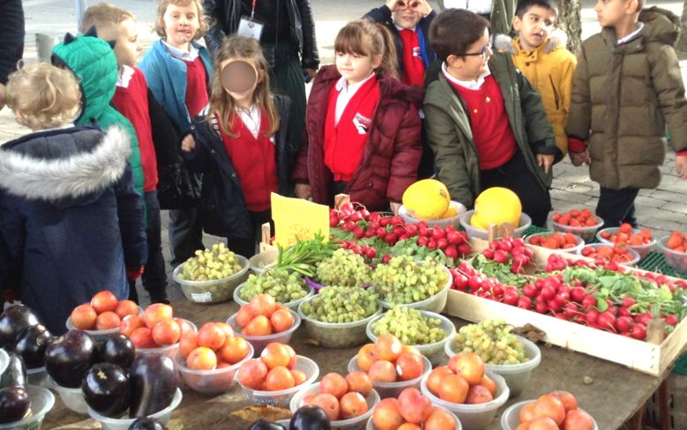
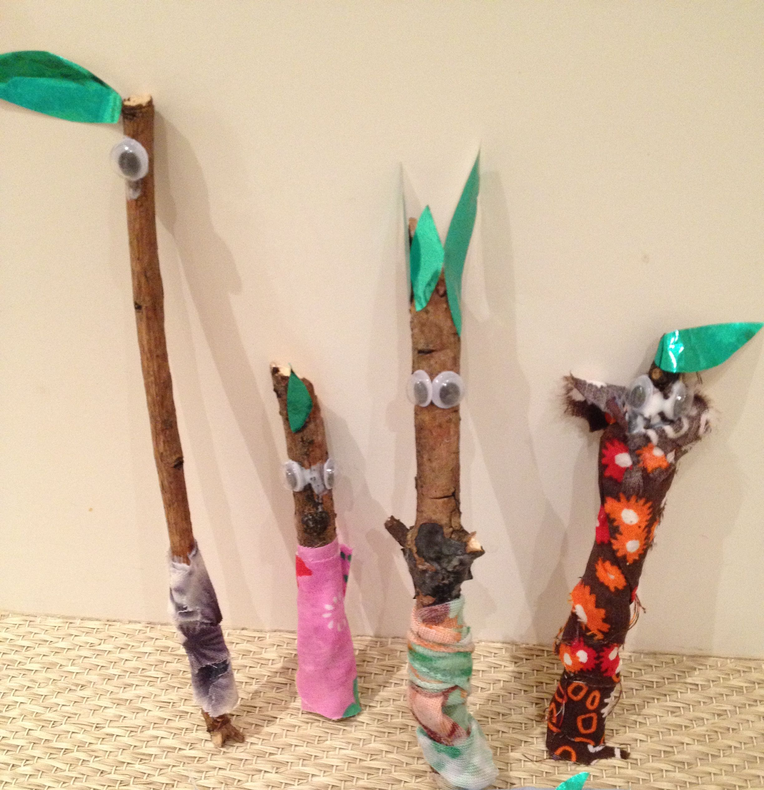
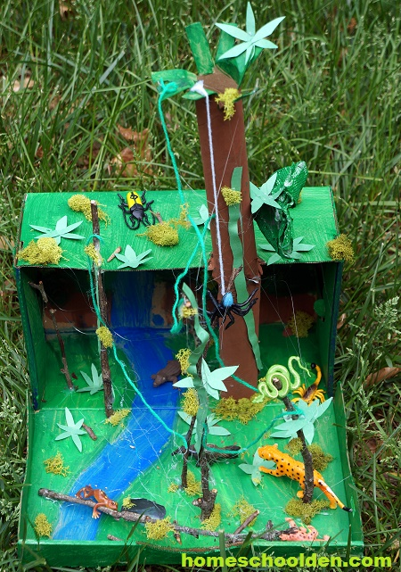
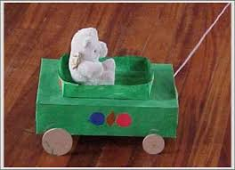
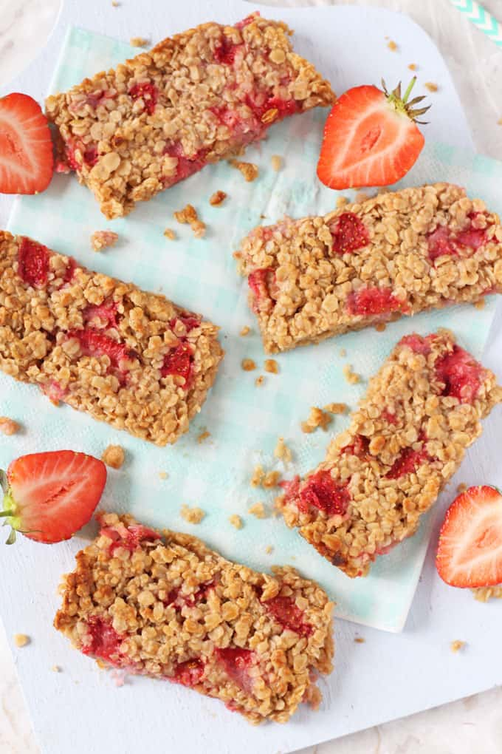

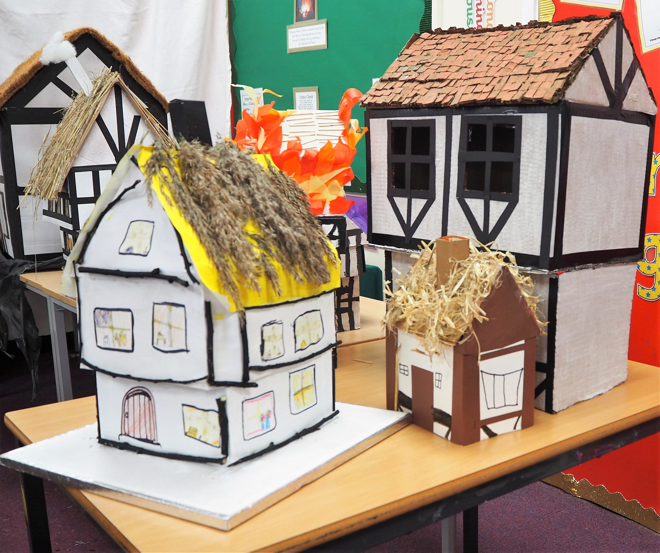
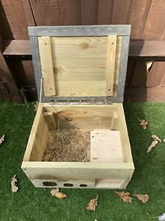
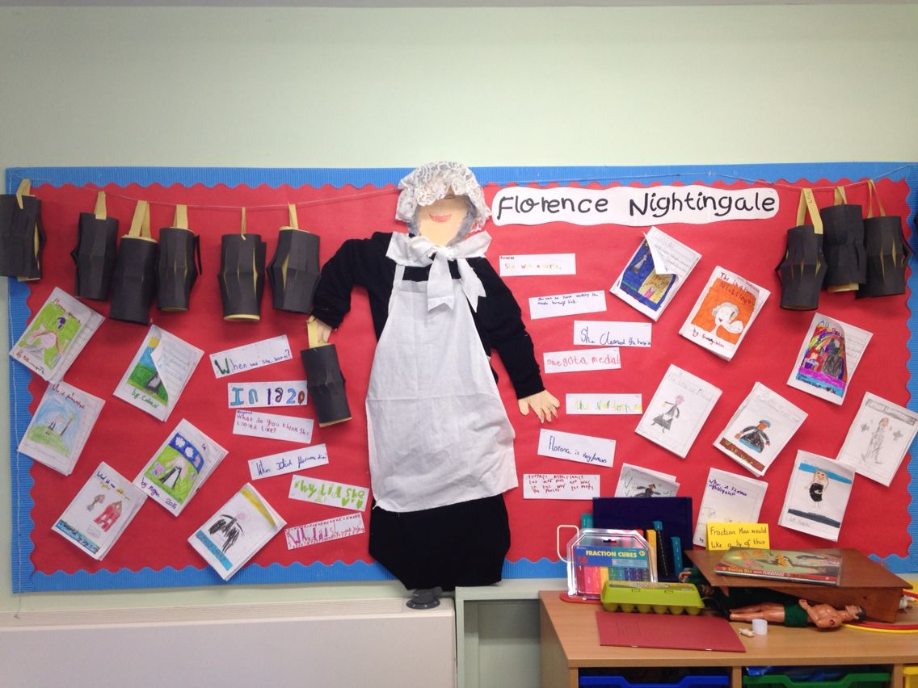
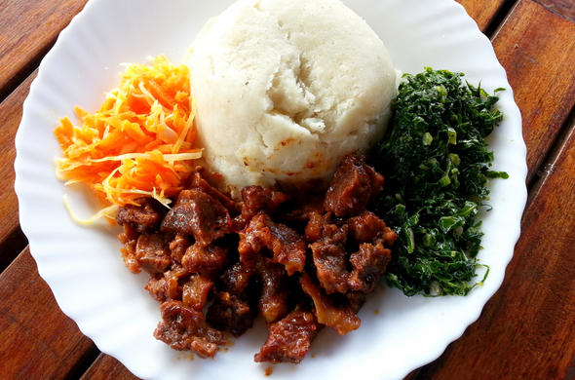

Dinosaurs, Farm animals
Creating a Chinese dragon, dinosaur sensory world/ 3D junk modelling; Explore different materials freely, in order to develop their ideas about how to use them and what to make.
Ourselves, Traditional tales
Use different tools to thread, sew, paint, cut, fasten.
Use a correct pencil grip and gaining control with mark making implements.
Using and holding scissors correctly
Pirates
Develop my own ideas and then decide which materials to use to express myself when creating a pirate ship.
Transport and Journeys
Make 3D models of different vehicles, based on own ideas.
EYFS
Summer
Manage own basic hygiene and understand the importance of healthy food choices.
Food, Glorious Food
Understand where different foods come from.
Growing
Use and handle tools, objects, construction and malleable materials safely and with increasing control, e.g. using the Woodwork Bench.
Journeys
Select from and use a range of tools and equipment to perform practical tasks.
Year​ One
Toys
Design purposeful, functional, appealing products for themselves and other users based on design criteria; select from and use a range of tools and equipment to perform practical tasks.
Rainforests
Investigate a range of existing products; evaluate ideas and products against own design criteria and consider views of others to improve their work.
Our Perfect Planet
Use the basic principles of a healthy and varied diet to prepare dishes.
Great Fire of London
Build structures, exploring how they can be made stronger, stiffer and more stable.
Year
Two
Kenya
Use the basic principles of a healthy and varied diet to prepare dishes; understand where food comes from.
Wonderful Walthamstow; Nocturnal Animals
Select from and use a wide range of materials and components, including construction materials, textiles and ingredients, according to their characteristics.
Nurturing Nurses
Textiles-choose suitable materials and measure, cut and join textiles to make a product, with some support.
Mission Grove Primary School Curriculum Road Map - DT

Slide 2
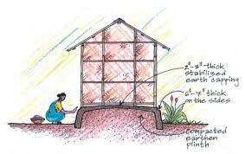
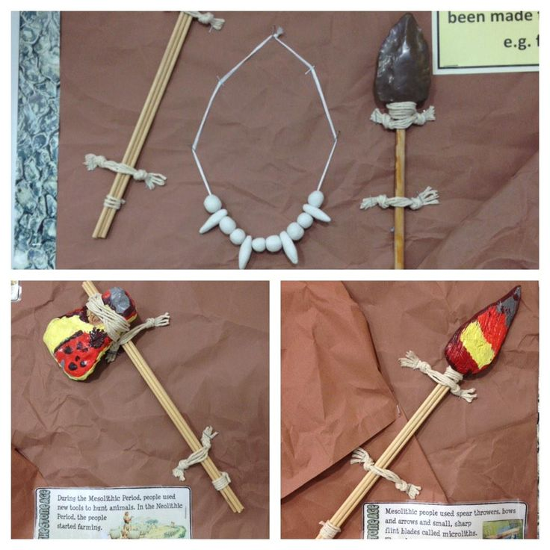

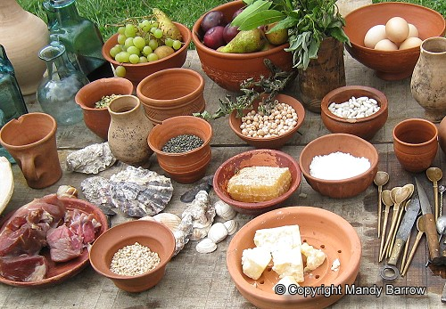
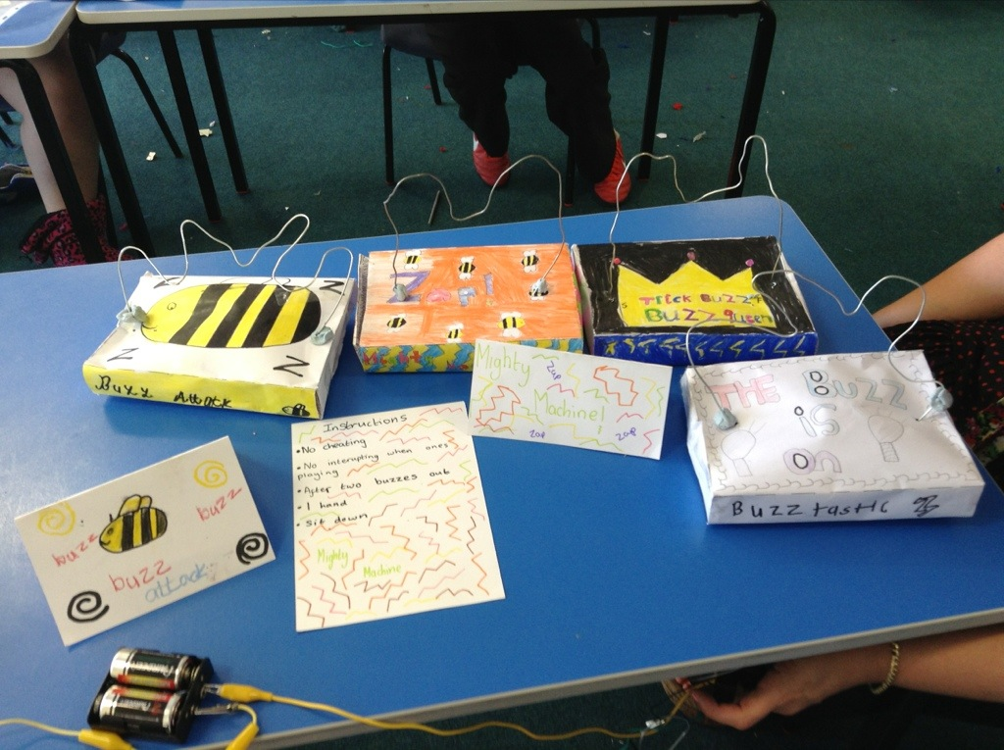
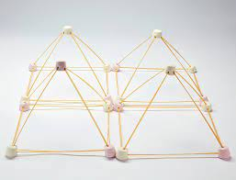
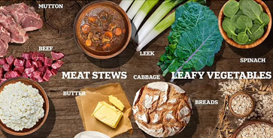
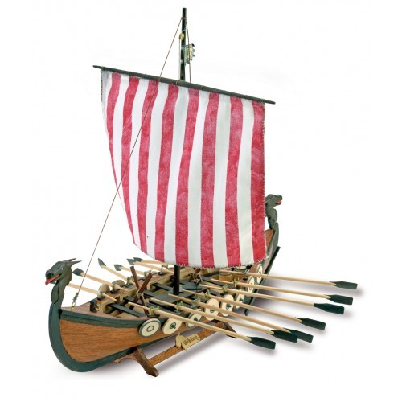
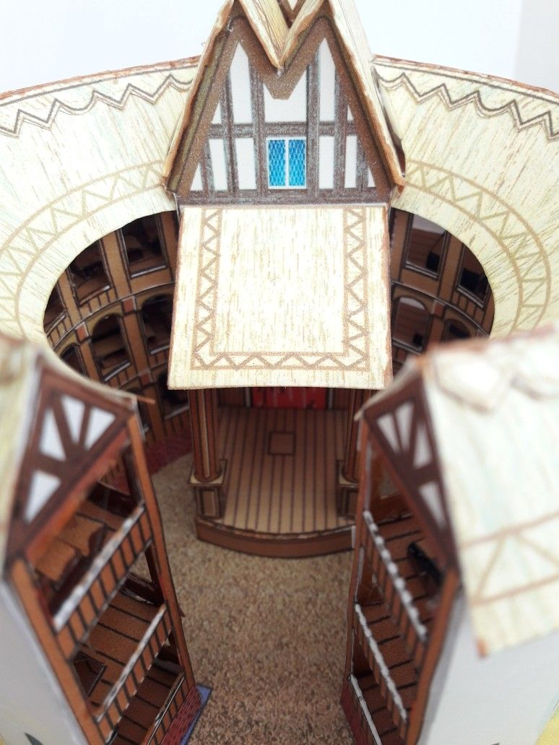
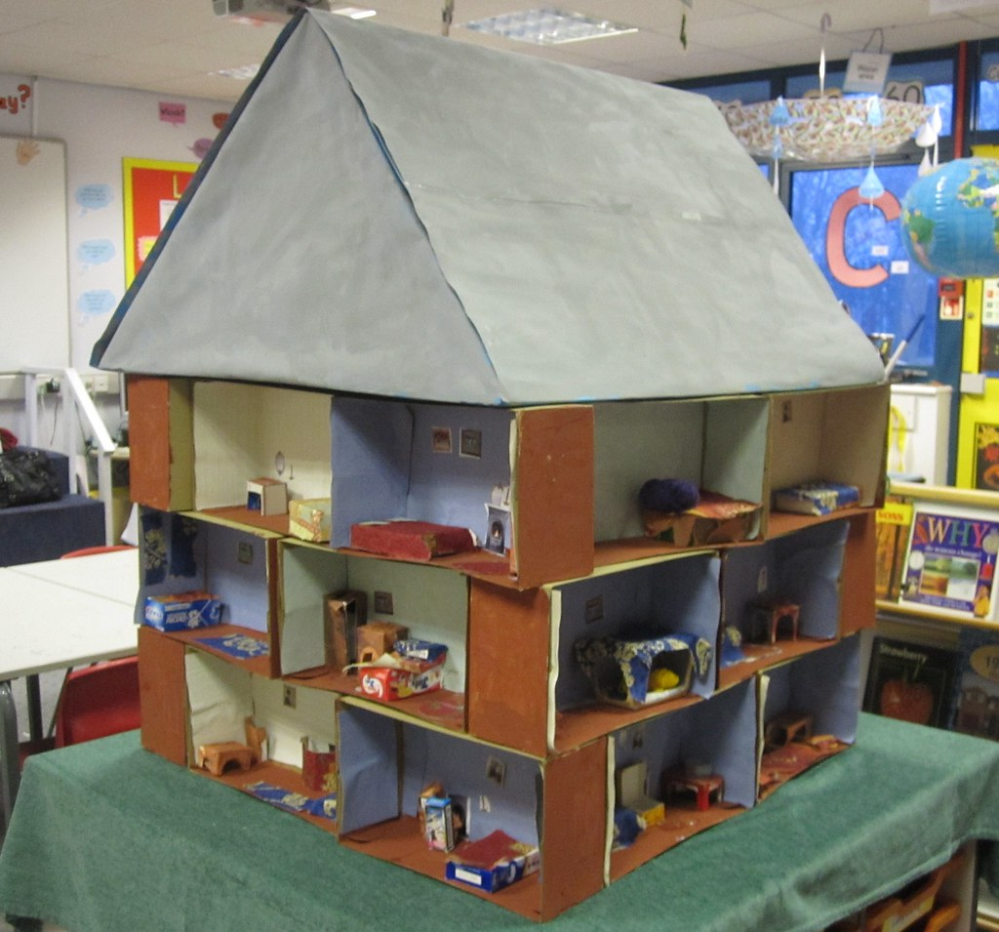
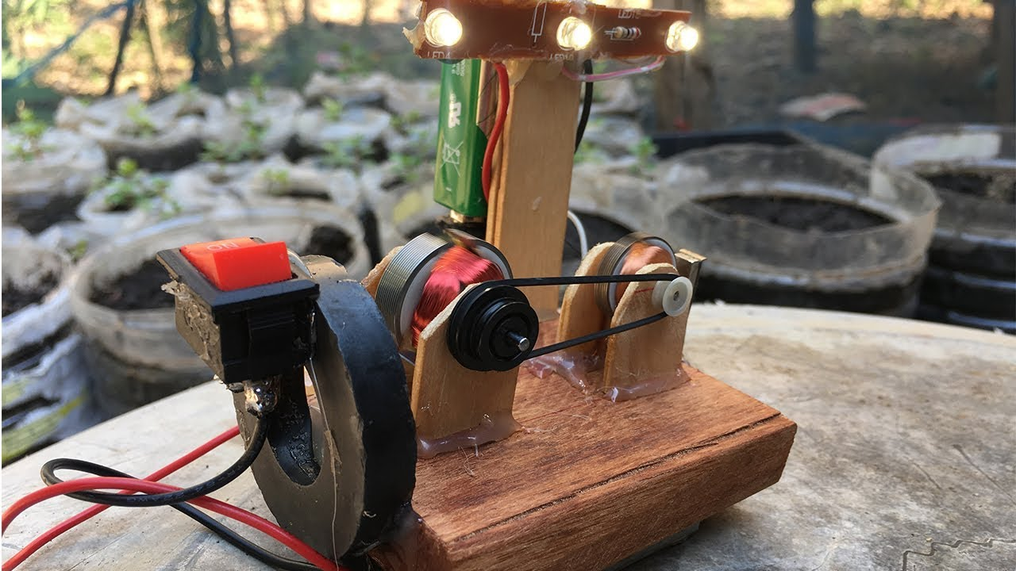
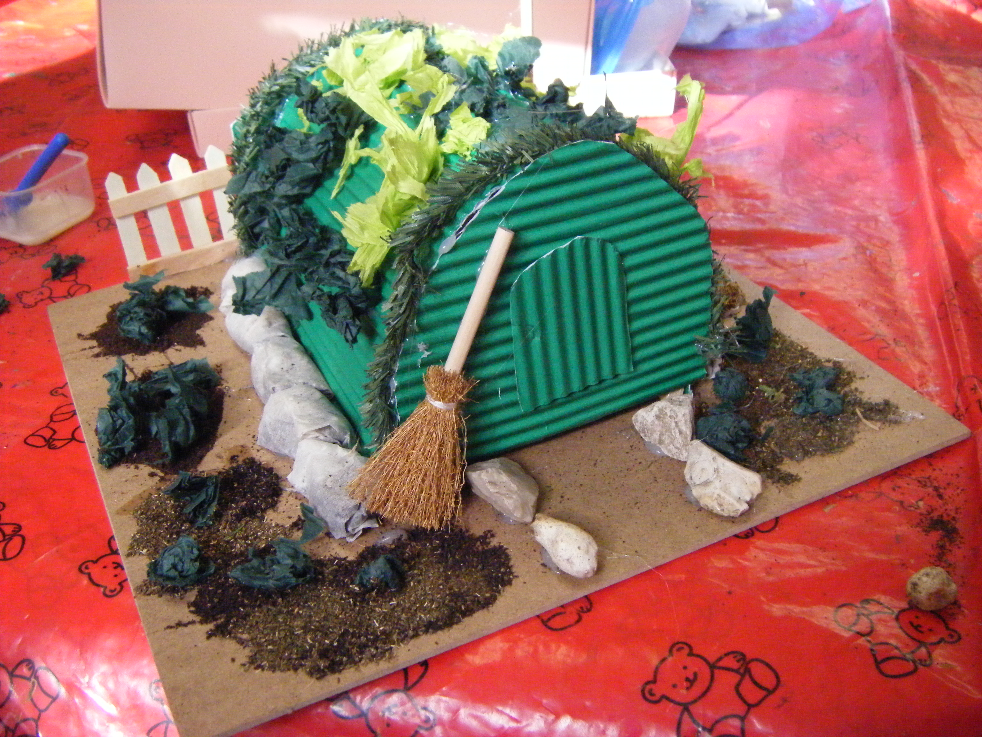
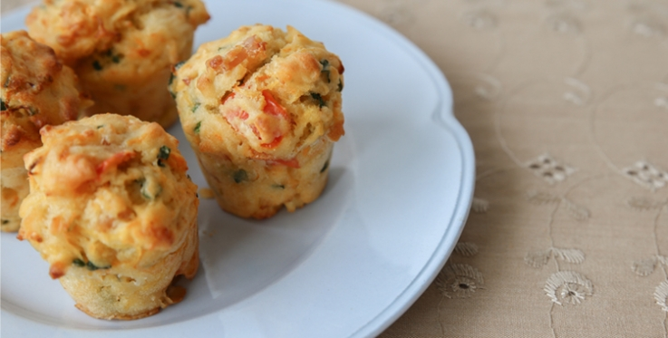
This Is Me
Generate, develop, model and communicate their ideas through discussion, annotated sketches and cross-sectional diagrams.
The Stone Age
Use research and develop design criteria to inform the design of innovative, functional, appealing products that are fit for purpose, aimed at particular individuals or groups
The Romans
Understand seasonality, and know where and how a variety of ingredients are grown, reared, caught and processed.
Year Three
Electricity
Understand and use electrical systems in their products.
Egyptians
Select from and use a wider range of tools and equipment to perform practical tasks accurately.
Year
Four
The Vikings
Understand and use mechanical systems in their products. Evaluate ideas and products against design criteria to improve their work.
Anglo Saxons
Understand and apply the principles of a healthy and varied diet.
The Victorians
Select from and use a wider range of tools and equipment to perform practical tasks [for example, cutting, shaping, joining and finishing], accurately.
Year
Five
Healthy Walthamstow
Prepare and cook a variety of predominantly savoury dishes using a range of cooking techniques.
Shakespeare
Select from and use a wider range of materials and components, including construction materials, textiles and ingredients, according to their functional and aesthetic qualities.
World War II
Apply understanding of how to strengthen, stiffen and reinforce more complex structures.
Earth and Space
Understand and use electrical systems in their products.
Year Six
Mission Grove Primary School Curriculum Road Map - DT

