Slide 1

Kensuke’s Kingdom

Slide 2
In Kensuke’s Kingdom we never find out what Michael’s parents did or felt when they realised he had gone overboard because the story follows Michael.
Imagine you are writing the story of what his parents did and how they reacted when they realised he was gone…

Slide 3
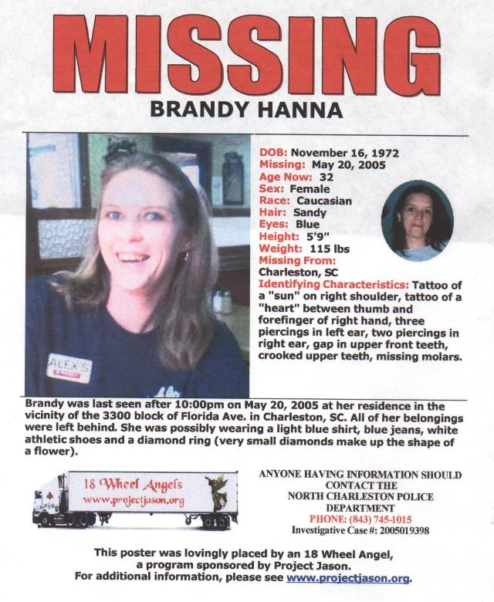

Slide 4
Michael’s parents have decided to issue a Wanted Poster as they search for him.
Q. What information would you expect to see?

Slide 5
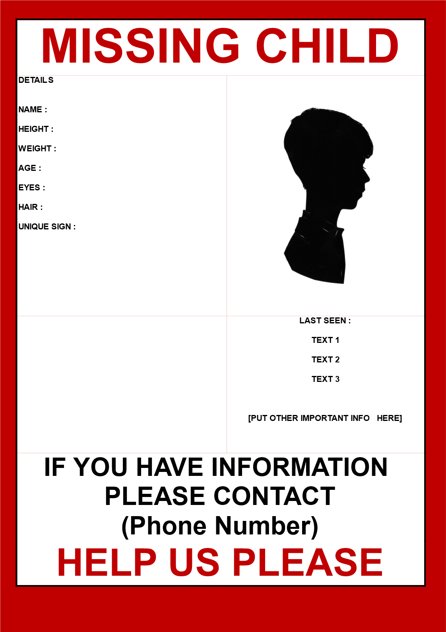

Slide 6
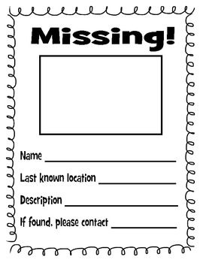

Slide 7
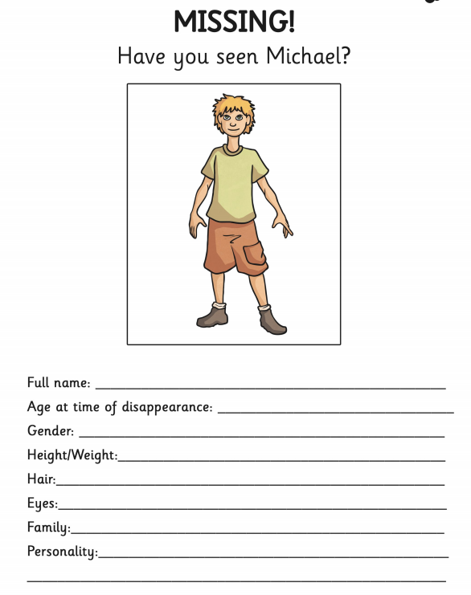

Slide 8
Independent Activity
Your task is to create a missing poster that could be used by Michael’s parents. Be sure to include as much detail as possible about Michael and the circumstances surrounding his disappearance.

Slide 9
Steps to Success- Remember to include…
Date of birth
Missing from
Gender
Race
Hair
Eyes
Height
Weight
Missing from
Identifying characteristics
Circumstances leading up to disappearance
Who to contact with information of Michael

