Slide 1
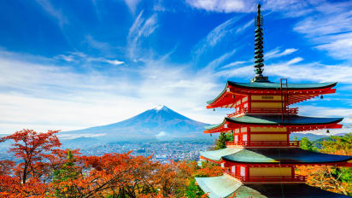
JAPAN
Spring 2 Term

Slide 2
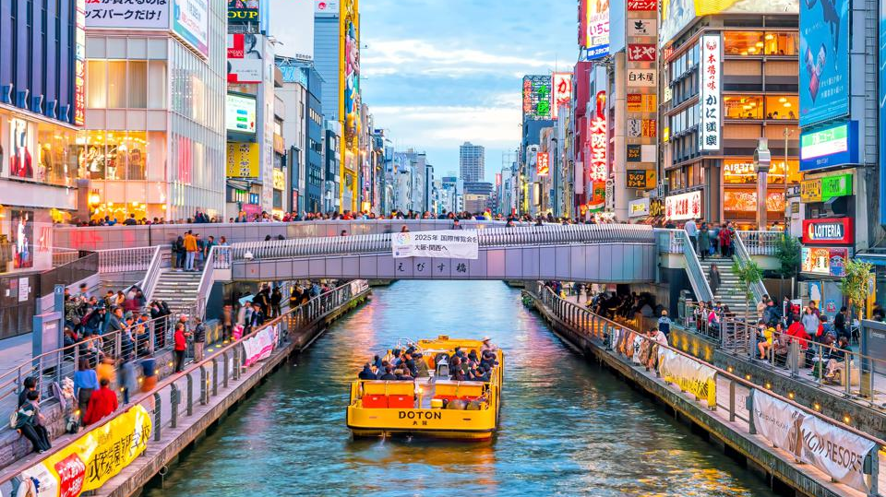
Lesson 1 - Why does Japan have ‘super cities’ like Tokyo along its coastline?
LO: To describes features of countries located on maps
SC: I can describe and label the geography of Japan
SC: I can explain what archipelago and population density mean.
SC: I can explain how physical geography can affect how and where people live.

Slide 3
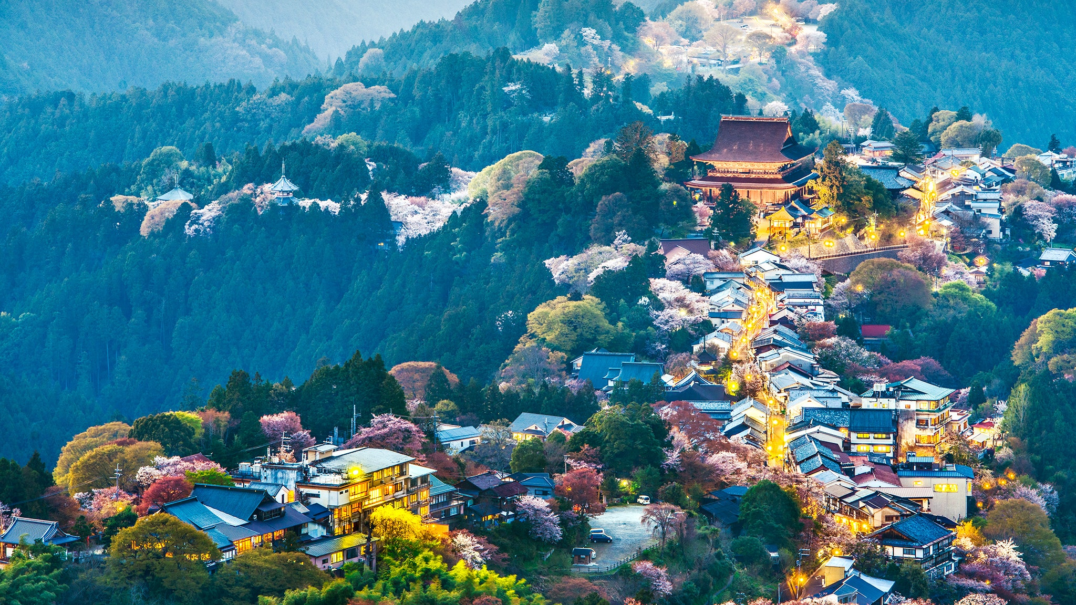
Introduction to Japan
Today we are going to be learning about the geography of Japan. Japan is a picturesque country with a rugged landscape surrounded by water, that supports a population with an ancient and revered culture.
https://www.youtube.com/watch?v=Ob7UhHBI7Oc
Watch up to 1min 26secs and then write the definition of ‘archipelego’ in your books.

Slide 4
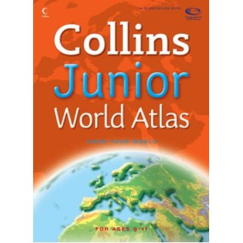
Using a map or atlas…
How would you narrow down where to look for Japan in the atlas? You could also use the internet or your school planners if you do not have an atlas.
What information could we use to help us?

Slide 5

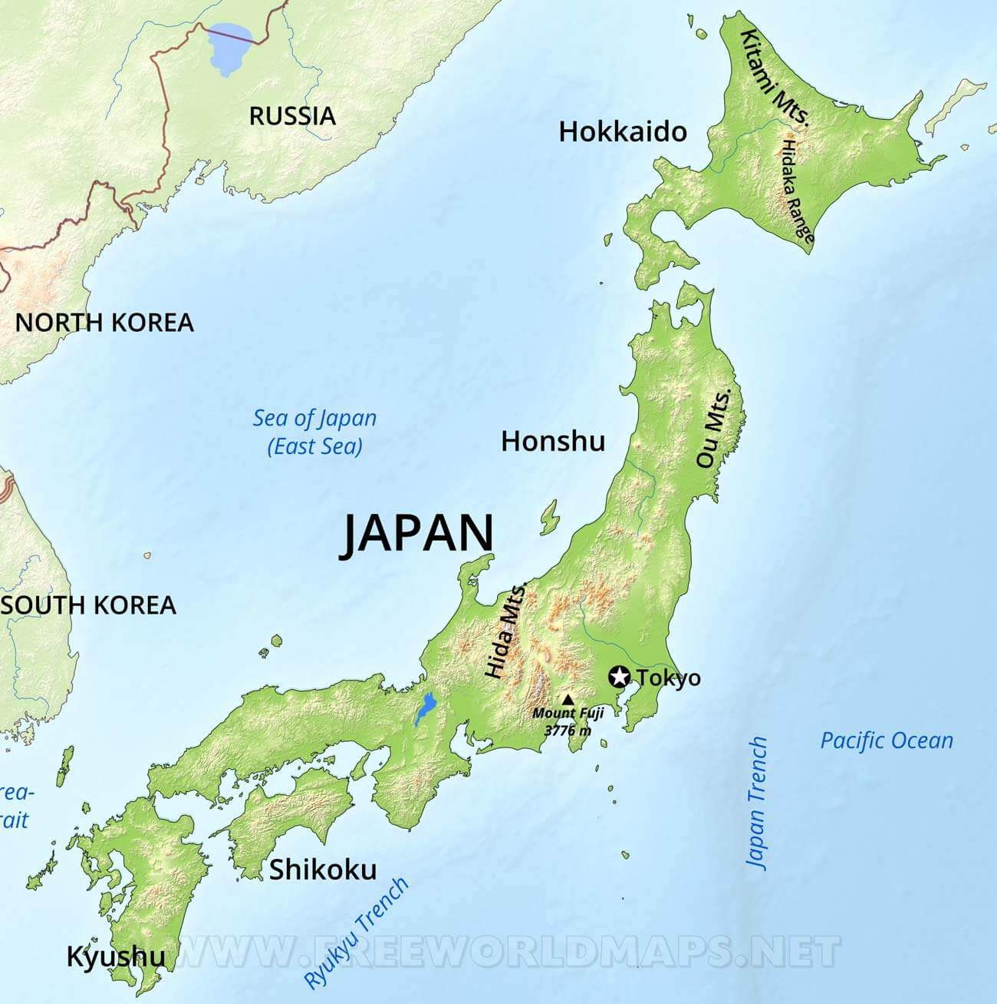
Key Facts about Japan…
Today let’s start by collecting some key facts in our books.
Population: 126,227, 877
Area: 377,915 km2
Capital:
Flag:
Highest point:
Main Languages spoken:
Extra:
GDP:
Notes:
If children have different atlases, ask them why they think the numbers may be slightly different or not exact?
(Populations change over time, so it depends on when the book was made/ numbers may be rounded for simplicity)
Write these facts in your books

Slide 6

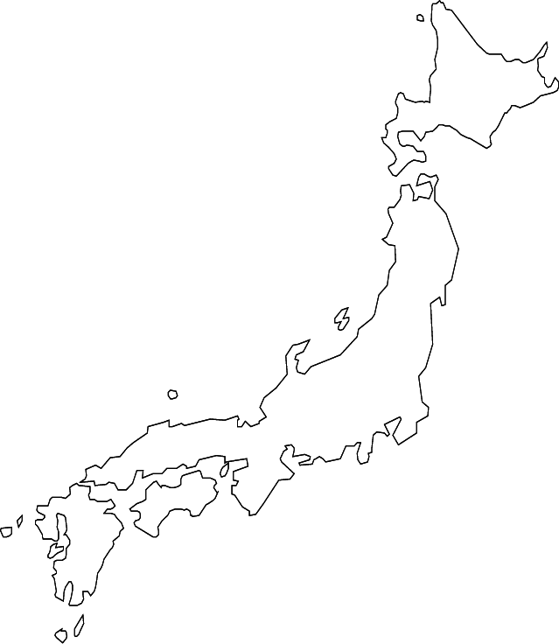
Japan is made of four main islands
(and thousands of other little ones remember!)
Watch the video from 1:26 – 1:55
https://www.youtube.com/watch?v=Ob7UhHBI7Oc
Task 1:
Can you label the four main islands correctly?
Can you label the important bodies of water correctly?
Either stick a picture of the map into your books, or copy/trace a simple outline in your books.
Challenge:
Can you also label the main cities and mountainous areas?

Slide 7
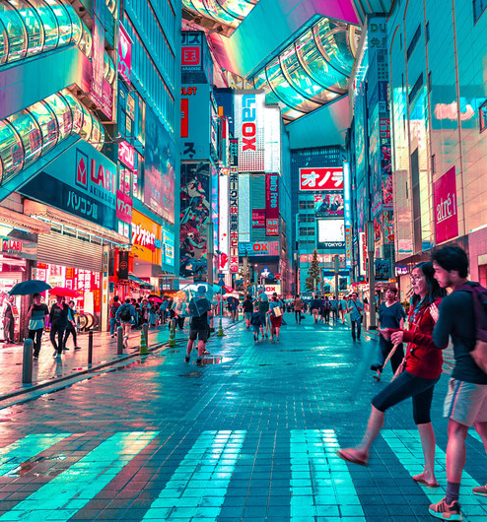
What is population density?
Watch the video from 1:55 – 2:47
https://www.youtube.com/watch?v=Ob7UhHBI7Oc
Write down the definition of ‘population density in your books.

Slide 8
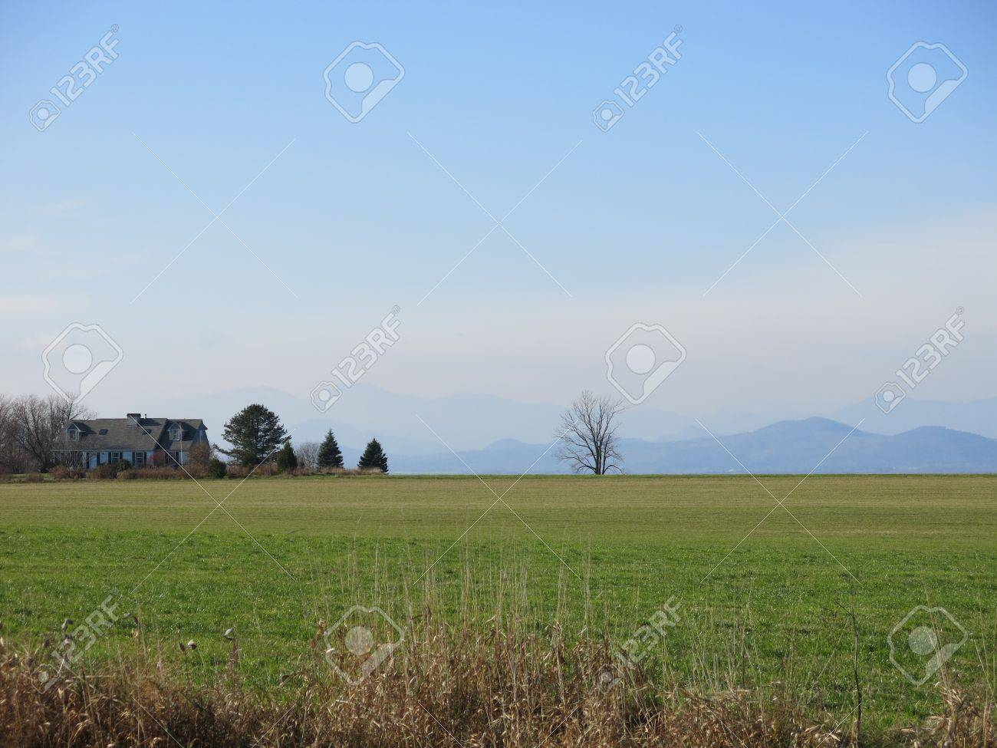
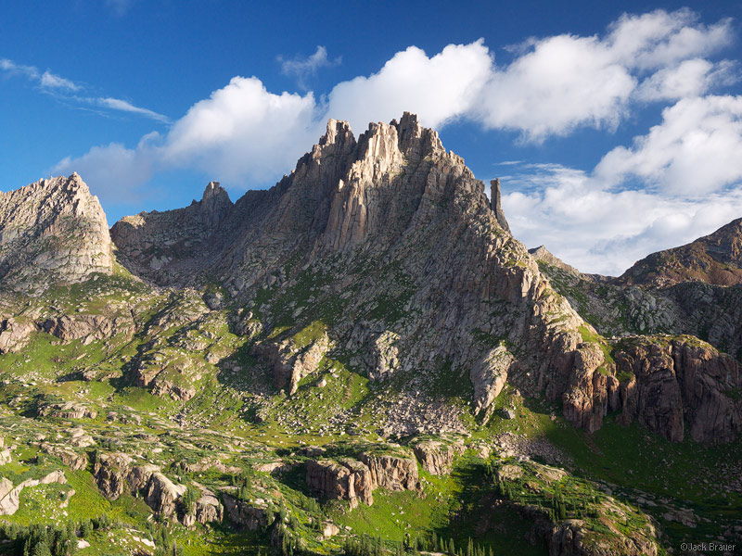
Discuss
You are planning to build a new town - where do you think would be easier?

Slide 9
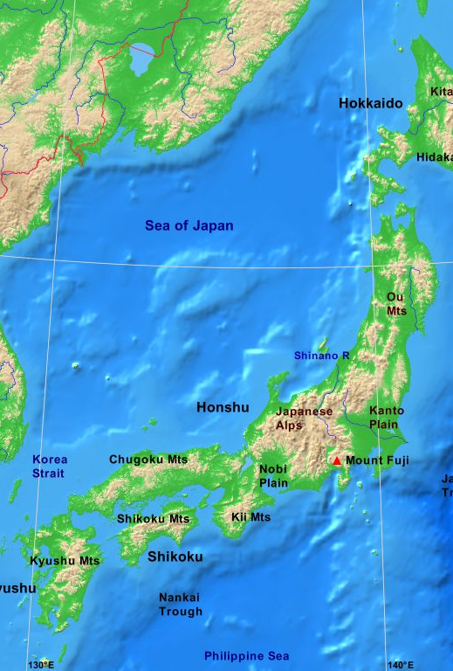
Topographical Map
Watch the video from 2:47 – 3:48
Https://www.youtube.com/watch?v=Ob7UhHBI7Oc
Topographical just means representing the physical features of a landscape.
All the grey/brown areas are the mountainous areas of Japan.

Slide 10
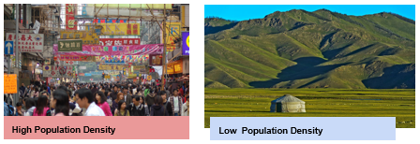
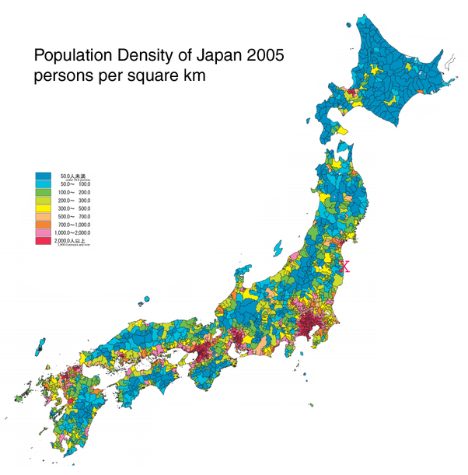
Population Density in Japan
The red places are very full of people, where there are over 1000 people per square kilometre. The blue places have a small amount of people living there.
Can you predict where the main cities are in Japan from using this map?
Can you predict where the mountainous areas might be? (Think about how mountains may affect the population of that area.)

Slide 11
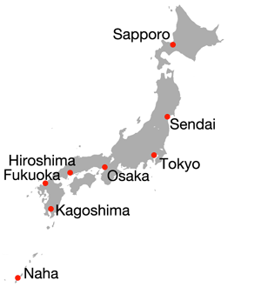
What do you notice?

Slide 12
Topographical Map – Higher Resolution
What other information may we be able to collect using a topographical map?
Mountains, lakes, rivers, cities, oceans, beaches, forests, roads, railtracks etc. Other maps may show temperature or rainfall, or population density, religious beliefs.
https://www.worldofmaps.net/typo3temp/images/topographie-japan.jpg
What does the colour key tell us?
http://maps.unomaha.edu/Peterson/geog1000/MapLinks/Japan.htm

Slide 13
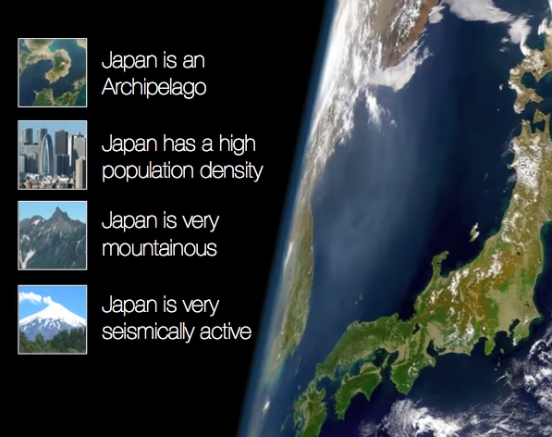
What have we learned today?
Watch the video from 3:48 – 5:36
https://www.youtube.com/watch?v=Ob7UhHBI7Oc

Slide 14
Write this question in your books:
Why has Japan developed many large cities like Tokyo along its coastline?
Using the four main features of Japanese geography, can you answer this question? Try and use specific evidence from your maps to support your answer.
Challenge: Why might people say that ‘Japan is a landscape where people and nature live in a very delicate balance’?
Population density islands large population (10th in the world)
Archipelago volcanoes earthquakes tsunamis (such as 2011)
Seismic activity ring of fire tectonic plates pacific plate
Mountainous Landscape Tokyo (30 million people)

Slide 15
Rate your answer:
Why has Japan developed many large cities like Tokyo along near its coastline?
Level 1: Japan has lots of large cities because it has lots of people and they want to live by the coast and not on the mountains.
Level 2: Japan has developed many large cities along its coastline because it is mainly near the coast where the land is flatter, making it better for people to live there. About 70% of the country is covered in mountains, which are not very good for farming or building homes, so people are squashed together in large cities like Japan’s capital: Tokyo (population 30 million).
Level 3/4: There are several factors that have meant Japan has developed large cities along its coastline. Firstly, Japan is an archipelago, which means it is made up of many islands ranging in size. The result of this is that there is a limit to the amount of space Japan has for people to expand into. Secondly, Japan has a large population with approximately 127 million people living there, making it the 10th largest population in the world. On the other hand, Japan’s land area not in the top ten for size, if fact it is the 61st largest country by land area. On top of this, 70% of Japan is covered by mountains, which are not ideal for farming or building homes. This means Japan’s large population is squeezed into the small amount living space left. Much of this space is by the coastlines, where bigger and bigger cities have formed as the population has grown over time. One example is Tokyo- the largest city in the world- with 30 million inhabitants.
Notes:
Highlighted strong elements for marking

Slide 16
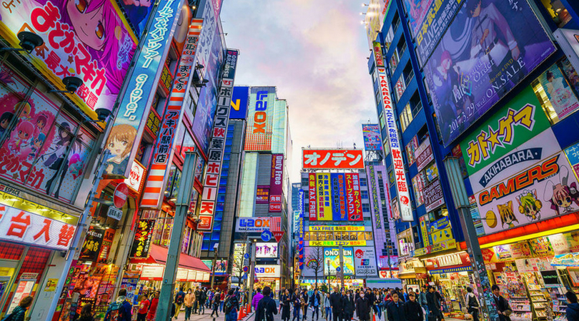
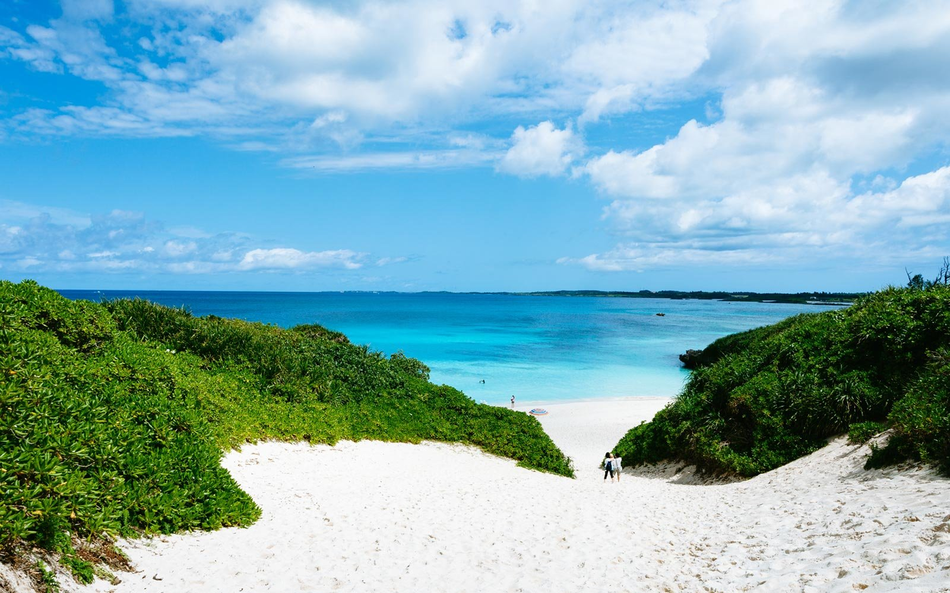
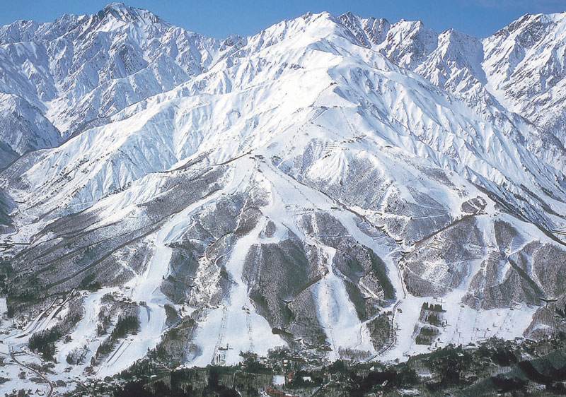
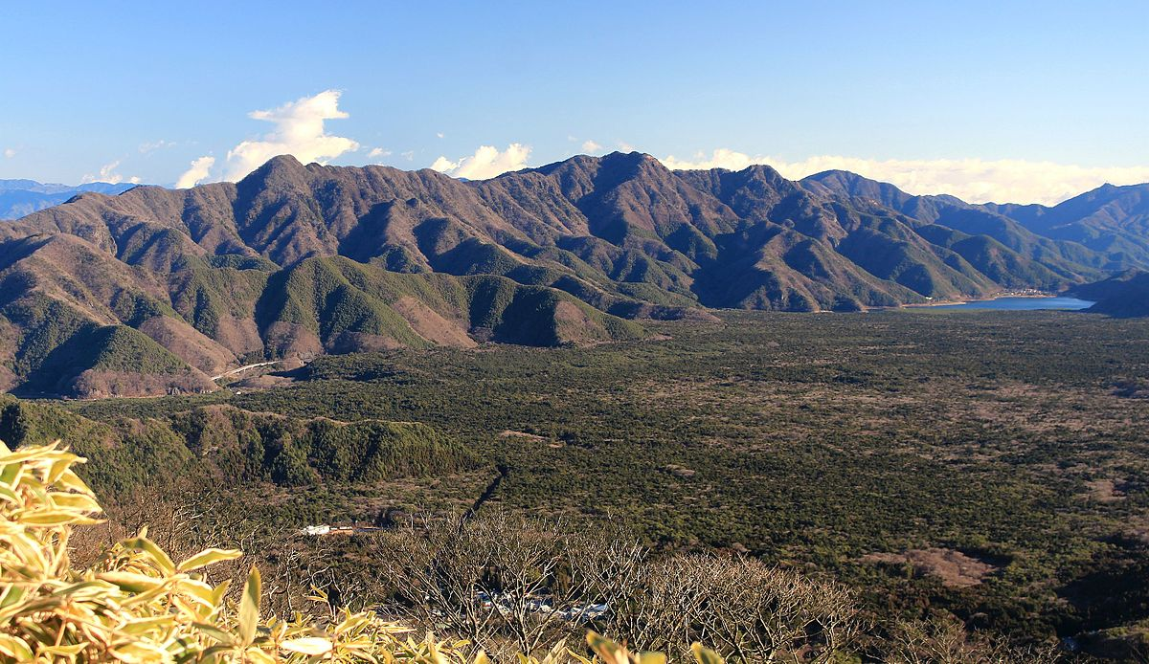
1
2
PLENARY
Which one of these photos is not of a place in Japan?
3
4
Notes:
Tokyo
Miyakojima, Japan
Aokigahara (sea of trees)
Hakuba Valley

Slide 17
1
2
Trick question! They all are in Japan! On your maps predict where they might be
3
4
Notes:
Tokyo
Miyakojima, Japan
Aokigahara (sea of trees)
Hakuba Valley

