Slide 1
Word Power!

Slide 2
Weekly Words
knots rudder
puncture becalmed hauling manky
rollicking snooty hindrance
develop

Slide 3
Monday

Slide 4
‘Never Heard the Word’ grid
TTYTP - Which words have you heard of before? Do you know what they mean?
Be honest - it doesn’t matter if you do or don’t know these words yet! You will by the end of the week!

Slide 5

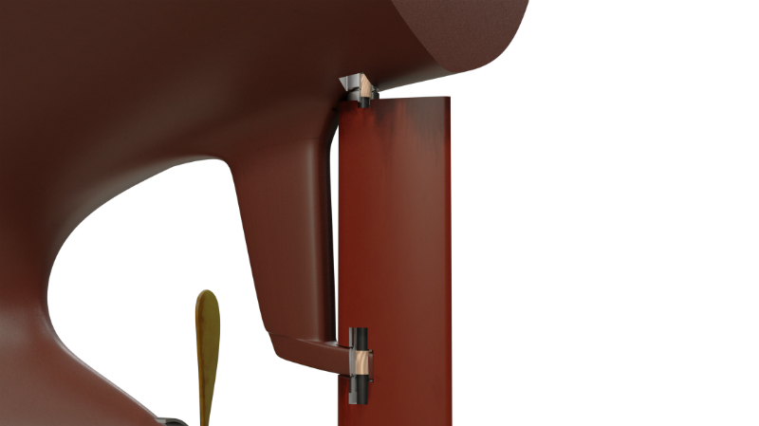
What are these?

Slide 6
What words can we relate to these pictures?
rudder
knots

Slide 7
But knots has another meaning...
‘We were planning on sailing about 200 miles a day, that’s about eight knots.’ (p. 26)
That can’t mean actual knots in a rope...so what does it mean?

Slide 8
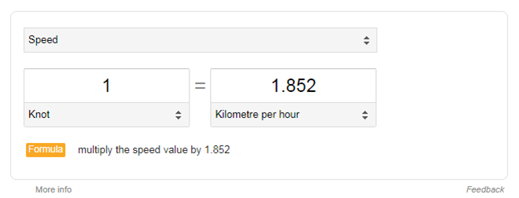
It’s actually a unit to measure speed!
https://bit.ly/2Ptg0Kg - google search of ‘knot unit of speed definition’

Slide 9
‘DOES’ the text have any Context Clues?
Definition - the meaning of the word is in the sentence, or nearby.
Opposite - look for words such as: however, unlike or opposed to and think about antonyms.
Example - an example is in the text to support the word’s meaning.
Synonym - other words, with similar meanings, are used in the sentence.

Slide 10
Tuesday

Slide 11
Weekly Words
knots rudder
puncture becalmed hauling manky
rollicking snooty hindrance
develop

Slide 12
becalmed
Let’s get a feel for the word!
What does it look like to you?
  What does it sound like to you?
    What does it feel like to you? How does it make you feel?
Can you act out the word?

Slide 13
hindrance
Let’s get a feel for the word!
What does it look like to you?
  What does it sound like to you?
    What does it feel like to you? How does it make you feel?
Try and say the word in 4 different ways!

Slide 14
rollicking
Let’s get a feel for the word!
What does it look like to you?
  What does it sound like to you?
    What does it feel like to you? How does it make you feel?
Try and say the word in 4 different ways!

Slide 15
hauling
Let’s get a feel for the word!
What does it look like to you?
  What does it sound like to you?
    What does it feel like to you? How does it make you feel?
Can you act out the word?

Slide 16
Wednesday

Slide 17
Weekly Words
knots rudder
puncture becalmed hauling manky
rollicking snooty hindrance
develop

Slide 18
Word Attack - Handwriting practise - consistent size
hindrance rollicking develop possibly
obstacle admonition develops visibly
complication reprimand developing sensibly
encumbrance earbashing developed audibly
Can you think of any other words that follow the patterns?
Can you see any other patterns in these or the other words?

Slide 19
Let’s check some dictionary definitions!
https://schools.collinsdictionary.com/
Do they match our ideas?

Slide 20
Thursday

Slide 21
Weekly Words
knots rudder
puncture becalmed hauling manky
rollicking snooty hindrance
develop

Slide 22
Word Ladder
Choose a word from our list this week. Can you create a ladder using synonyms?
_______________
_______________
_____________
aloof
lofty
snooty

