Slide 1
Word Power!

Slide 2
Weekly Words
dinghy reservoir
gibbered reckless liability rigid
lunacy regularity disdain
possible

Slide 3
Monday

Slide 4
‘Never Heard the Word’ grid
TTYTP - Which words have you heard of before? Do you know what they mean?
Be honest - it doesn’t matter if you do or don’t know these words yet! You will by the end of the week!

Slide 5
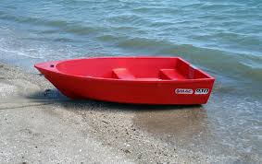
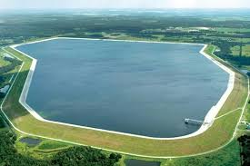
What are these?

Slide 6
What words can we relate to these pictures?
reservoir
dinghy

Slide 7
‘DOES’ the text have any Context Clues?
Definition - the meaning of the word is in the sentence, or nearby.
Opposite - look for words such as: however, unlike or opposed to and think about antonyms.
Example - an example is in the text to support the word’s meaning.
Synonym - other words, with similar meanings, are used in the sentence.

Slide 8
Tuesday

Slide 9
Weekly Words
dinghy reservoir
gibbered reckless liability rigid
lunacy regularity disdain
possible

Slide 10
gibbered
Let’s get a feel for the word!
What does it look like to you?
  What does it sound like to you?
    What does it feel like to you? How does it make you feel?
Can you act out the word?

Slide 11
disdain
Let’s get a feel for the word!
What does it look like to you?
  What does it sound like to you?
    What does it feel like to you? How does it make you feel?
Try and say the word in 4 different ways!

Slide 12
liability
Let’s get a feel for the word!
What does it look like to you?
  What does it sound like to you?
    What does it feel like to you? How does it make you feel?
Try and say the word in 4 different ways!

Slide 13
lunacy
Let’s get a feel for the word!
What does it look like to you?
  What does it sound like to you?
    What does it feel like to you? How does it make you feel?
Can you act out the word?

Slide 14
Wednesday

Slide 15
Weekly Words
dinghy reservoir
gibbered reckless liability rigid
lunacy regularity disdain
possible

Slide 16
Word Attack - Handwriting practise - joining the s
disdain lunacy possible possibly
scorn lunatic terrible terribly
contempt lunar horrible horribly
derision lunarscape incredible incredibly
Can you think of any other words that follow the patterns?
Can you see any other patterns in these or the other words?

Slide 17
Let’s check some dictionary definitions!
https://schools.collinsdictionary.com/
Do they match our ideas?

Slide 18
Thursday

Slide 19
Weekly Words
dinghy reservoir
gibbered reckless liability rigid
lunacy regularity disdain
possible

Slide 20
Word Ladder
Choose a word from our list this week. Can you create a ladder using synonyms?
_______________
_______________
_____________
careless
thoughtless
reckless

Slide 21
Homophones
This word is derived from the Greek homo meaning ‘same’, while phone means ‘voice; utterance’ - put those together, you get homophone - words that sound the same!
Which words are homophones? What does each word mean? Can you think of any others?
farther
whose
father
who’s
morning
mourning

